Slide 1
Connecting the Digital Footprint (webinar series)
Increasing Digital Access for Low-and-Moderate (LMI) Youth:
Laying the Foundation
Thursday, May 28, 2020
11AM (EST) to 12PM (EST)

Slide 2
Webinar Agenda:
Welcome
Introductions
Terry Lee: Why Are We Here? Aim of the webinar series
Christine Fox: Broadband Imperative
Michael Flood: Educational Broadband
Carol Miller: Key Challenges Spurring Broadband Investment(s)
Dr. Robert McLaughlin: Systemic Approach to Digital Equity
Q & A
Next steps

Slide 3
Connecting the Digital Footprint (webinar series)
Webinar #2: Equipping Low-and-Moderate Income (LMI) Youth for the New Normal - Ensuring Computer Access
Thursday, June 4, 2020 - 11AM to 12PM (EST)
Today’s learning environment now requires home computers. However, many low-and-moderate income (LMI) youths find themselves at a digital device disadvantage.
Webinar #3: Strengthening Tech Support Capacity in Low-and-Moderate Income (LMI) Communities: Promoting a Learning Ecosystem
Thursday, June 11, 2020 – 1PM to 2PM (EST)
With the surge in digital access needs for low-and-moderate income (LMI) learners, implementing affordable, high-impact approaches to building LMI communities’ tech support capabilities is essential.
Webinar #4: Financial and Economic Inclusion Resources Promoted Through Digital Supports – Low-and-Moderate Income (LMI) Learners Safety Net
Monday, June 15, 2020 – 12PM to 1PM (EST)
As equitable home access to broadband and devices improves, so does the opportunity to effectively assist LMI learners leverage resources for educational and economic advancement.
Webinar #5: Positive Pathways Out of Poverty. TBD.
Details Forthcoming

Slide 4
Increasing Digital Access for Low-and-Moderate (LMI) Youth:
Laying the Foundation
Moderator: Terry Lee, Community Affairs Specialist, Federal Deposit Insurance Corporation – Atlanta Region
Panelists:
Christine Fox, Deputy Executive Director, State Education Technology Directors Association
Michael Flood, Vice President, Kajeet
Carol Miller, Director, Broadband Technology Department of Business and Economic Affairs
Dr. Robert McLaughlin, Executive Director, National Collaborative for Digital Equity

Slide 5
The views expressed in this presentation are the presenters and do not necessarily represent the views of the Federal Deposit Insurance Corporation

Slide 6
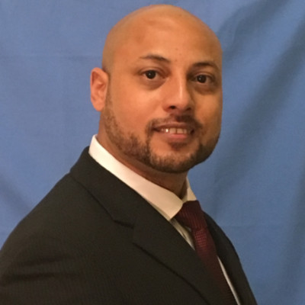
Terry Lee: Community Reinvestment Act and Broadband

Slide 7
Additional Resources
FDIC:
FDIC External
FDIC’s Coronavirus Website
Frequently Asked Questions for Financial Institutions https://www.fdic.gov/coronavirus/faq-fi.pdf
Joint Statement around FIL-19-2020 https://www.fdic.gov/news/news/financial/2020/fil20019.html
FIL-19-2020 https://www.fdic.gov/news/news/financial/2020/fil20019.pdf
OCC:
Expanding Internet Access https://www.occ.gov/publications-and-resources/publications/community-affairs/community-developments-investments/nov-2018/ca-cdi-newsletter-nov-2018.html
FRB:
Closing the Digital Divide https://www.dallasfed.org/~/media/documents/cd/pubs/digitaldivide.pdf

Slide 8
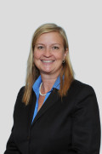





Christine Fox: Broadband Imperative

Slide 9
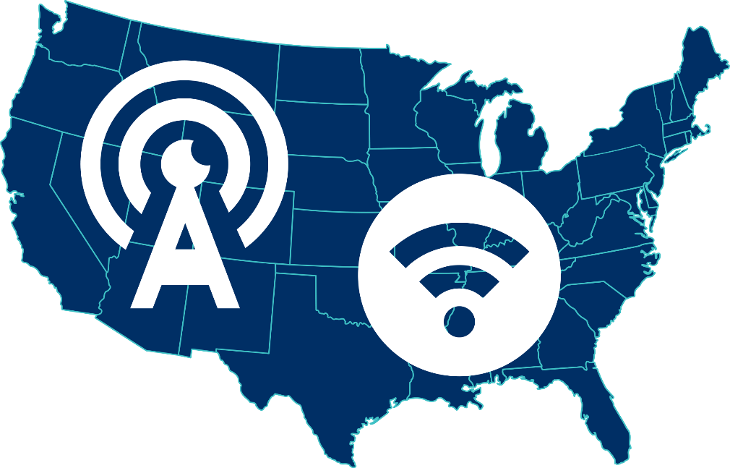

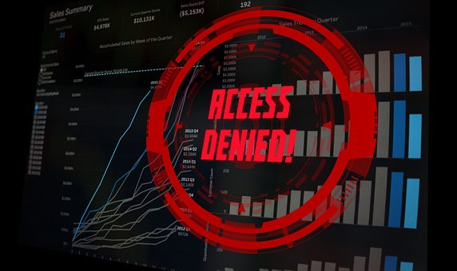
Christine Fox: The Homework Gap

Slide 10
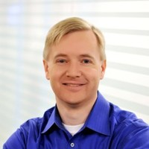
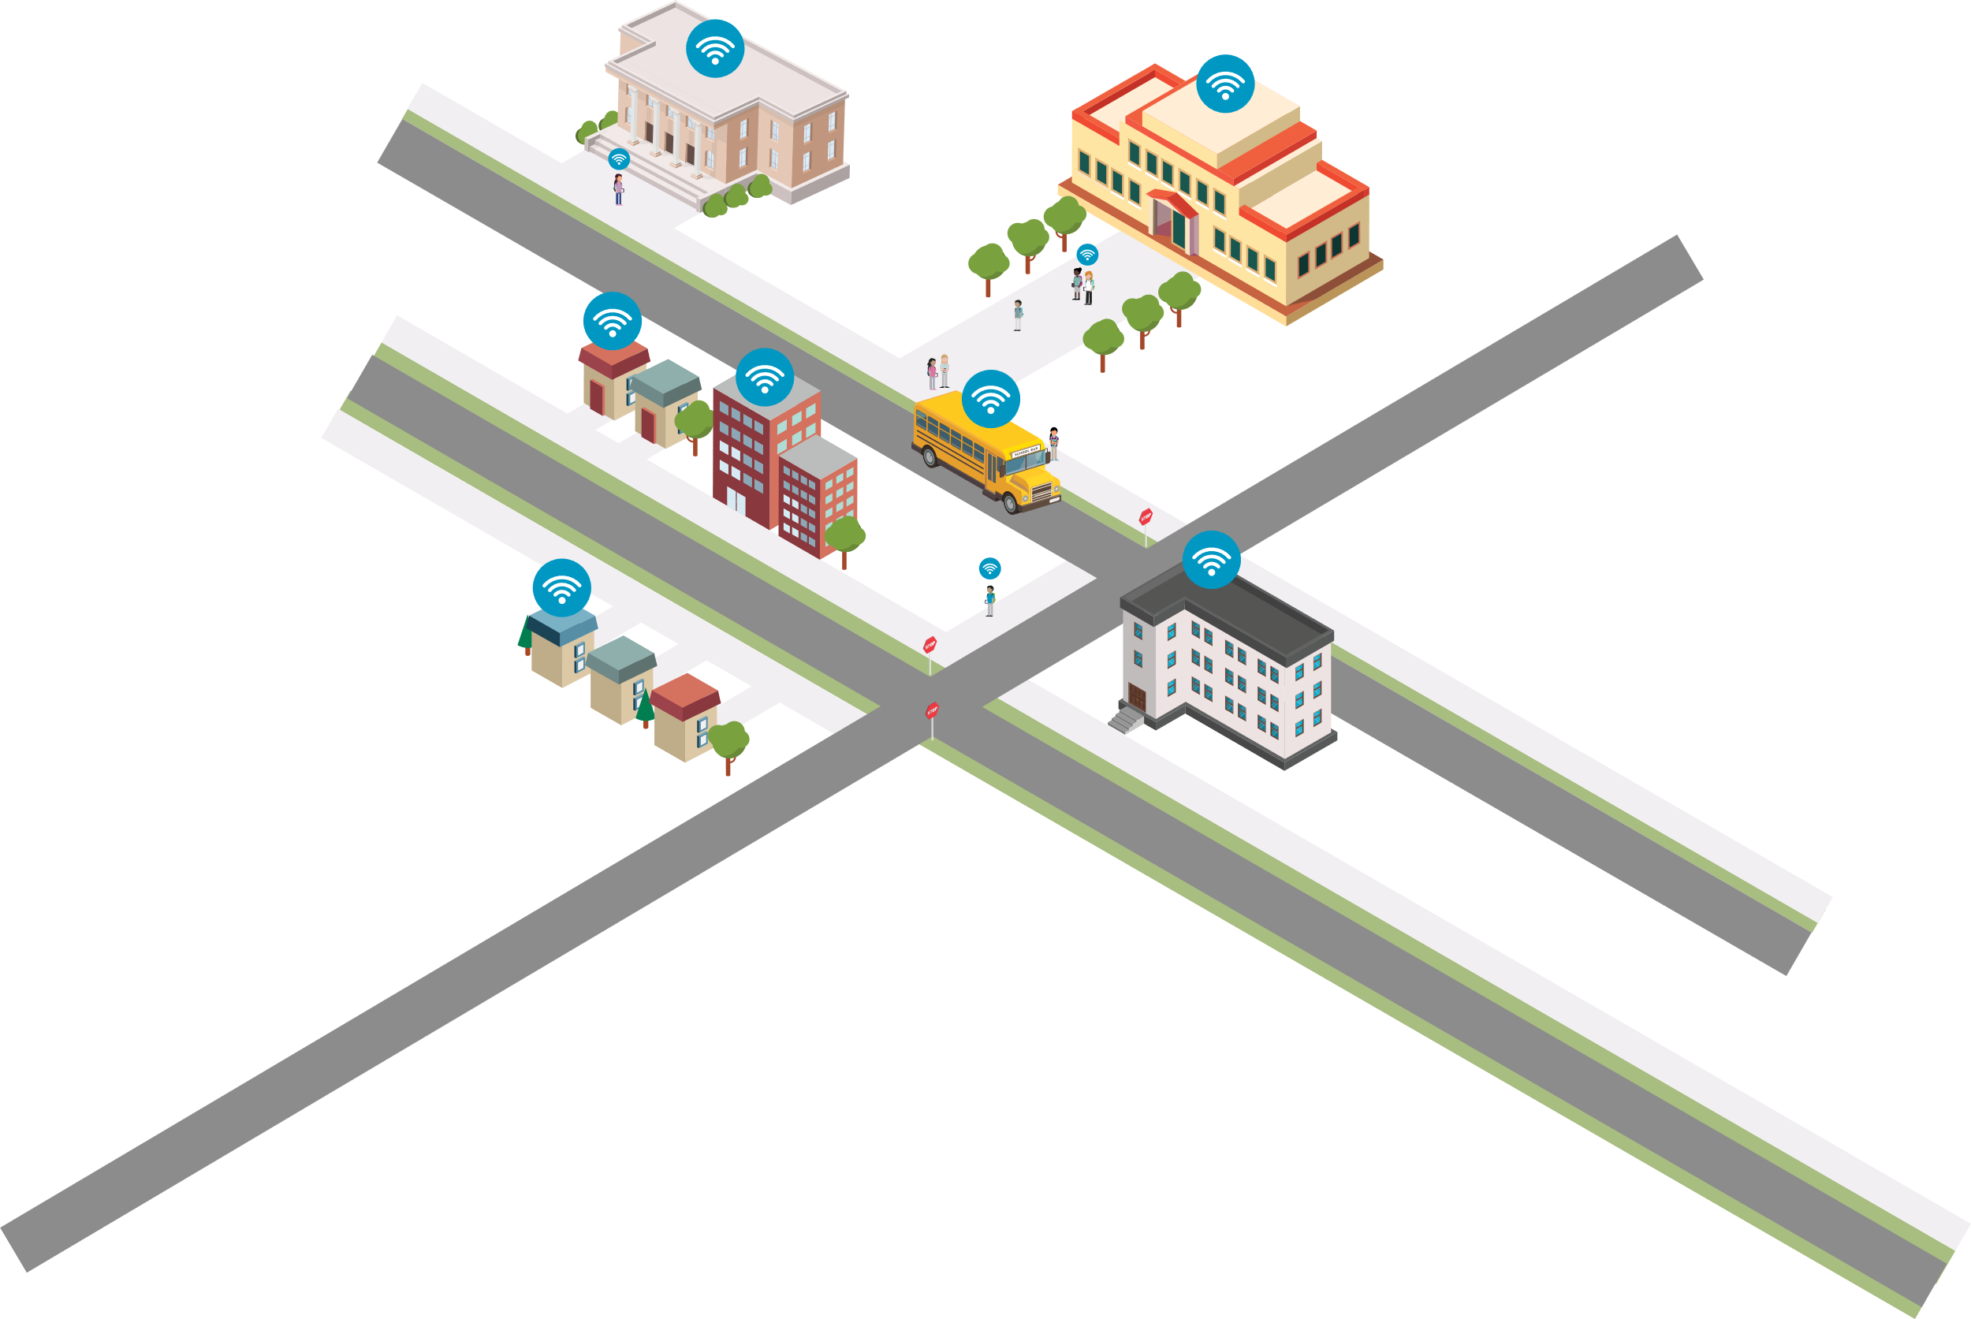






Michael Flood: Education Broadband
A RAPID TRANSITION TO DISTANCE LEARNING
55 million students impacted by school closures
14 percent of households with school-age children do not have Internet access. (2018, US Dept. of Commerce)
One in five students trouble completing homework because of Internet access. (2018, Pew Research)
SmartBus Wi-Fi®
SmartSpot®
Device + Hotspot
4G LTE Embedded Devices

Slide 11


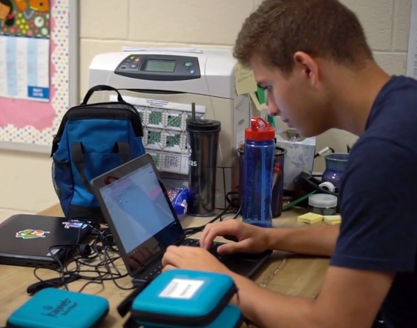

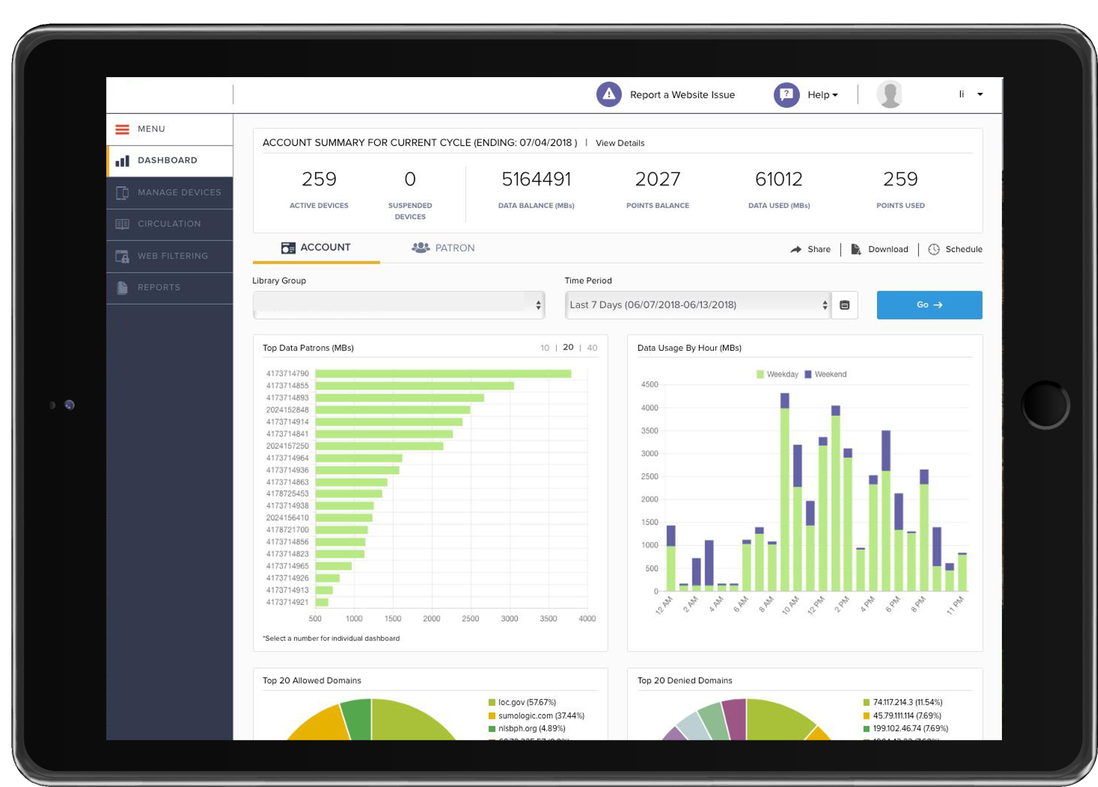


Michael Flood: Education Broadband
EDUCATIONAL FILTERS
TIME-OF-DAY CONTROLS
Multiple 4G LTE carriers ensure every student has portable and mobile access for expanded coverage nationwide.
REPORTING & ANALYTICS

Slide 12
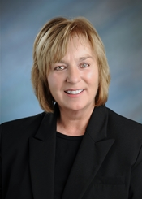
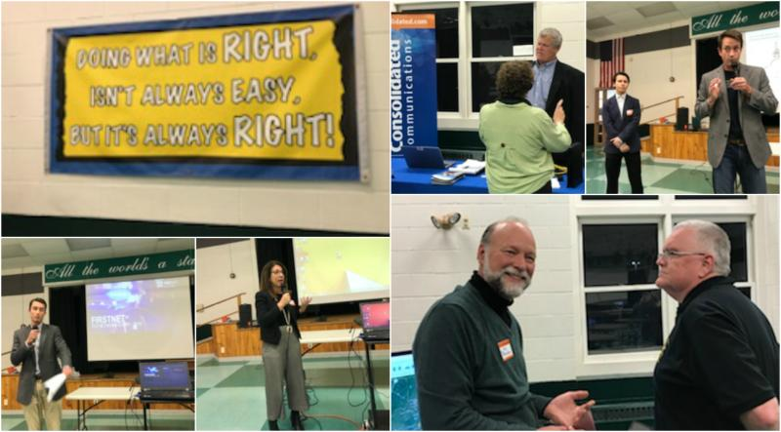
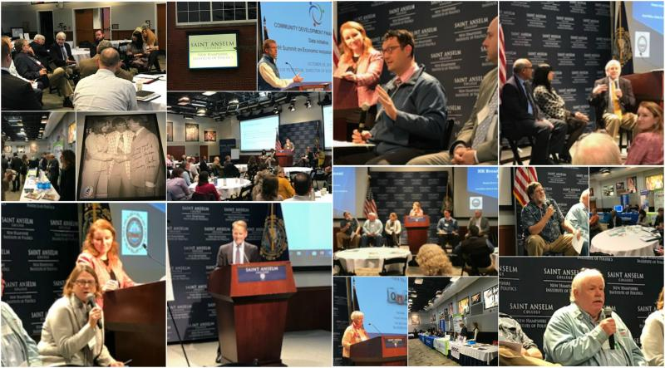


Carol Miller: Key Challenges for Broadband Investments

Slide 13
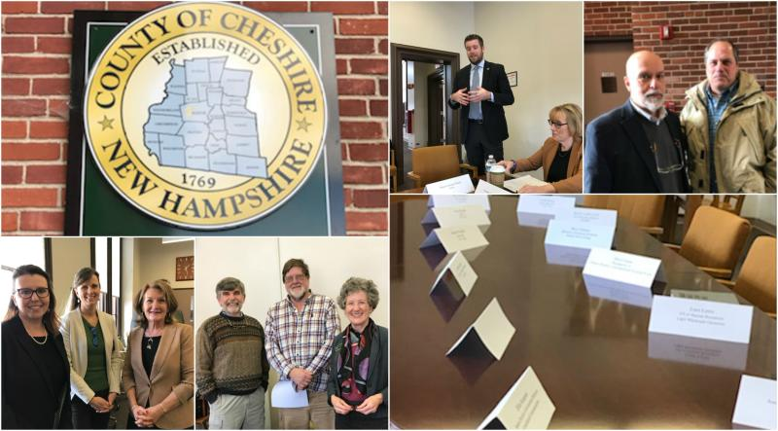
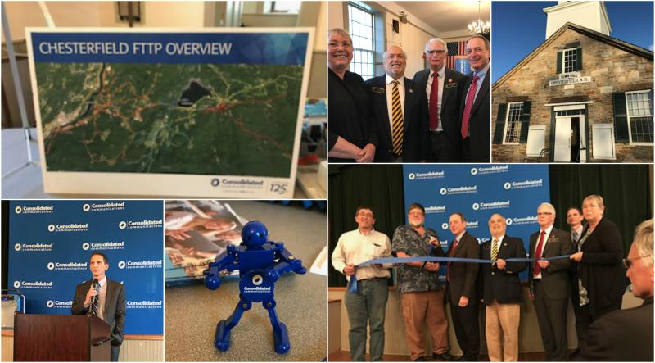

Carol Miller: Key Challenges continued…

Slide 14
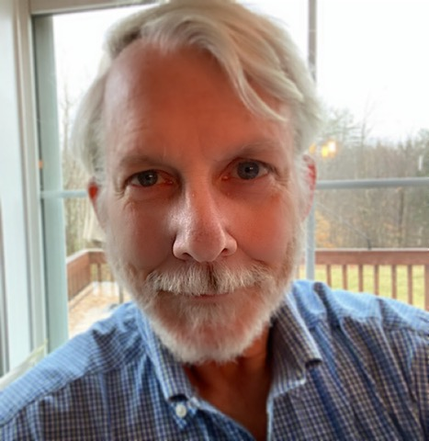






Dr. Robert McLaughlin: Systemic Approach to Inclusion

Slide 15
Next Steps

Slide 16
Next Webinar #2
Equipping Low-and-Moderate Income (LMI) Youth for the New Normal:
Ensuring Computer Access
Thursday, June 4, 2020
11AM to 12PM (EST)

Slide 17
Carol Miller, Director
Broadband Technology Department of Business and Economic Affairs
carol.a.miller@livefree.nh.gov
(603) 271-0252
Christine Fox, Deputy Executive Director
State Education Technology Directors Association
cfox@setda.org
Michael Flood, Vice President
Kajeet
mflood@kajeet.com
Dr. Robert McLaughlin, Executive Director
National Collaborative for Digital Equity
rmclaughlin@digitalequity.us
(802) 249-1159
Terry Lee, Community Affairs Specialist
Federal Deposit Insurance Corporation – Atlanta Region
telee@fdic.gov
(678) 916-2270

