Slide 1
Connecting the Digital Footprint (webinar series) Equipping Low-and-Moderate Income (LMI) Youth for the New Normal: Ensuring Computer Access
Thursday, June 4, 2020
11AM (EST) to 12PM (EST)

Slide 2

Connecting the Digital Footprint upcoming webinar Webinar #3: Strengthening Tech Support Capacity in Low-and-Moderate Income (LMI) Communities: Promoting a Learning Ecosystem Thursday, June 11, 2020 – 1PM to 2PM (EST) With the surge in digital access needs for low-and-moderate income (LMI) learners, implementing affordable, high-impact approaches to building LMI communities’ tech support capabilities is essential. Webinar #4: Financial and Economic Inclusion Resources Promoted Through Digital Supports – Low-and-Moderate Income (LMI) Learners Safety Net Monday, June 15, 2020 – 12PM to 1PM (EST) As equitable home access to broadband and devices improves, so does the opportunity to effectively assist LMI learners leverage resources for educational and economic advancement. Webinar #5: Positive Pathways Out of Poverty. TBD. Details Forthcoming

Slide 3
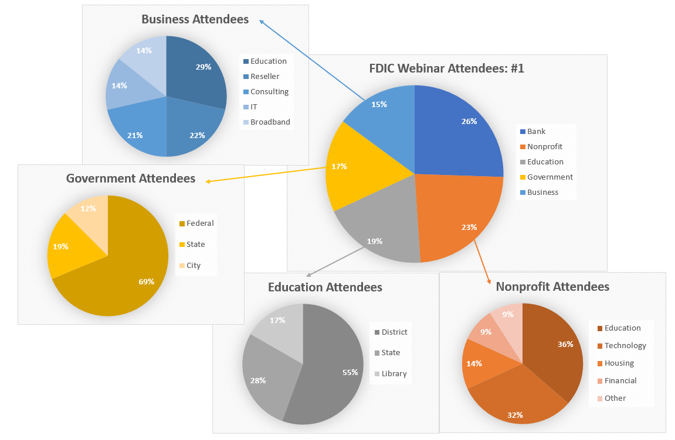
Webinar #1 Audience

Slide 4
Webinar Agenda:
Terry Lee: Welcome
Introductions
Community Reinvestment Act (CRA)
Ulrike Smith: Refurbishing and Donating Devices
Sarah Segrest: Resources for Greater Impact
Lisa Trisciani: Creating Capacity
Bob McLaughlin: VISTA Pilot
Q & A
Webinar #3
Adjourn

Slide 5
Increasing Digital Access for Low-and-Moderate (LMI) Youth: Laying the Foundation Moderator: Terry Lee, Community Affairs Specialist, Federal Deposit Insurance Corporation – Atlanta Region Panelists: Ulrike Smith, CRA Compliance Officer, Franklin Savings Bank Sarah Segrest, Director of Business Development, The Douglas Stewart Company Lisa Trisciani, Vice President, Connection Public Sector Solutions Bob McLaughlin, Executive Director, National Collaborative for Digital Equity

Slide 6
The views expressed in this presentation are the presenters and do not necessarily represent the views of the Federal Deposit Insurance Corporation

Slide 7
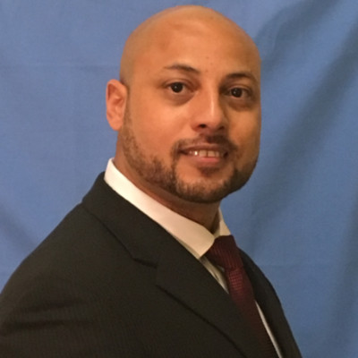
Terry Lee: Community Reinvestment Act

Slide 8
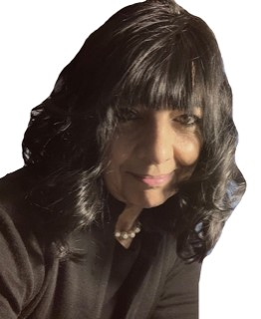

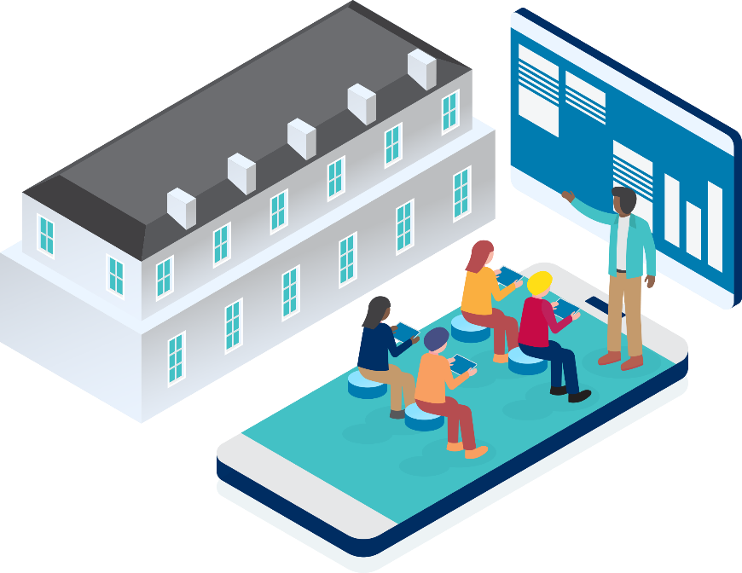


Ulrike Smith: Refurbishing and Donating Devices

Slide 9


Ulrike Smith: Where Are We Going?

Slide 10
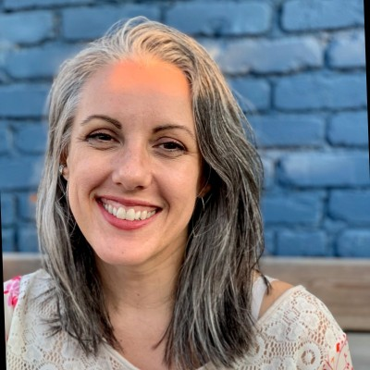
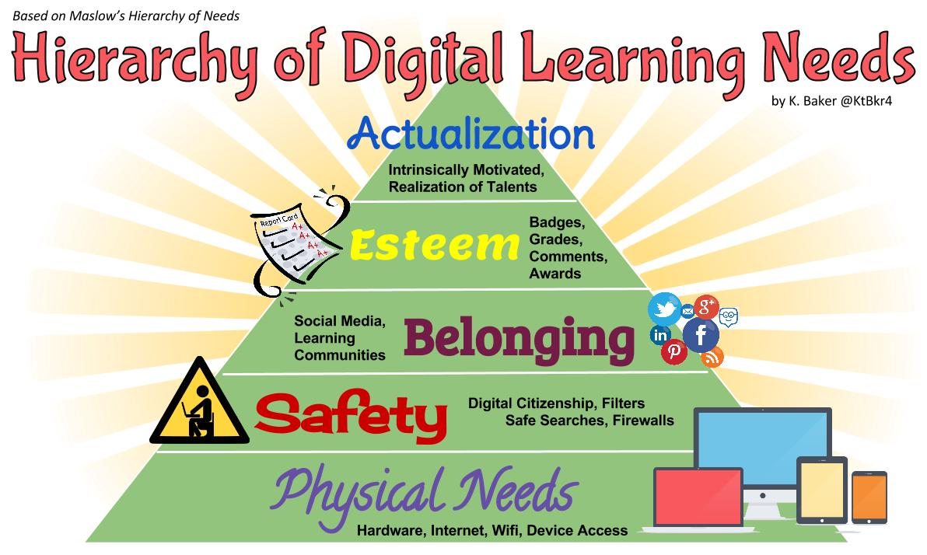
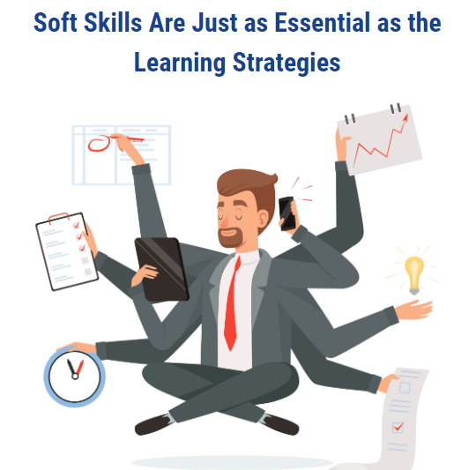

Sarah Segrest: Resources for Greater Impact

Slide 11

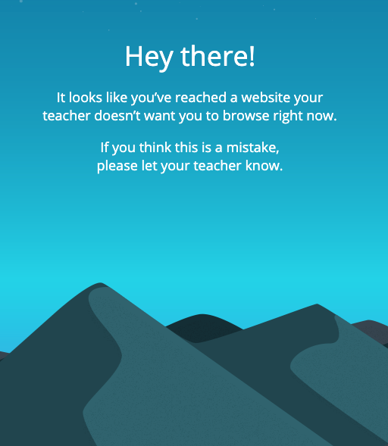
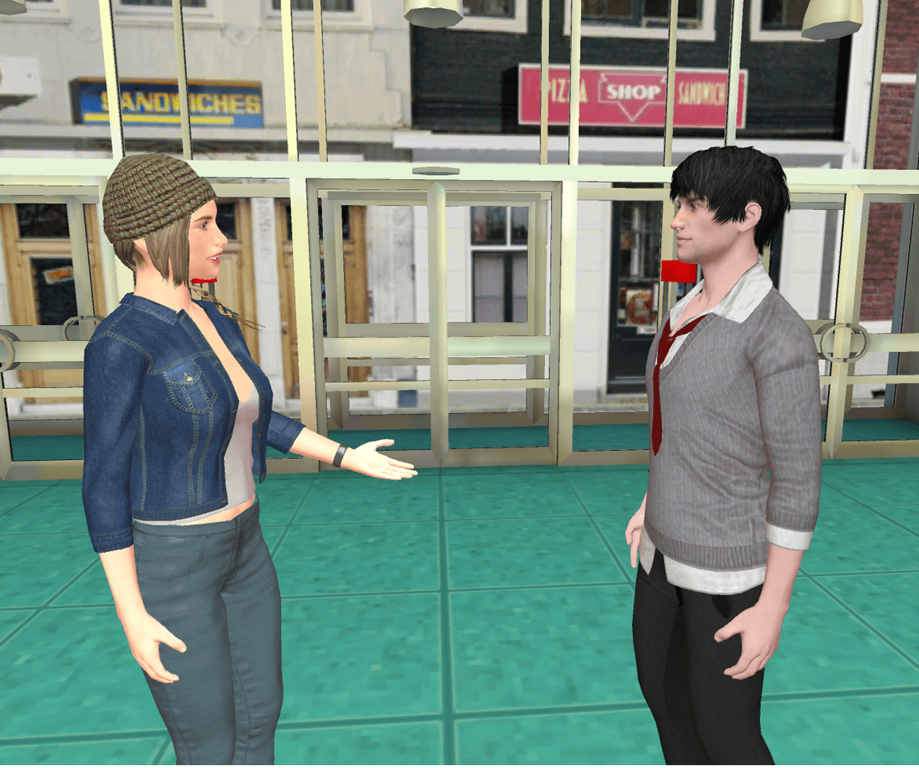
Sarah Segrest: EdTech Tools for Equity

Slide 12
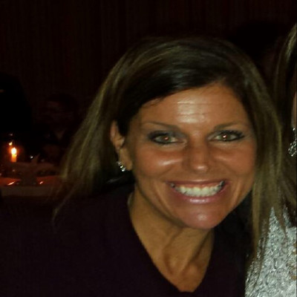

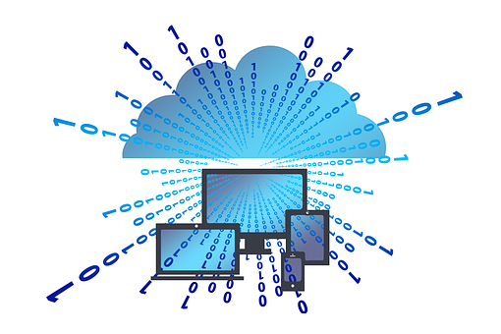

Lisa Trisciani: Creating Capacity

Slide 13


Lisa Trisciani: Nashua Project

Slide 14
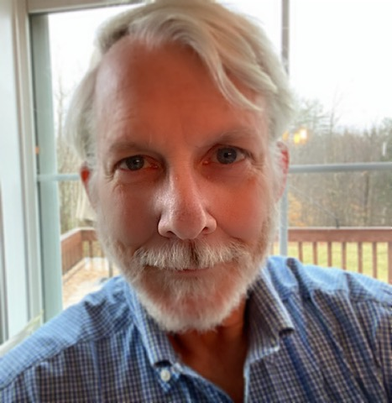




Dr. Robert McLaughlin: VISTA Pilot Program

Slide 15
Q & A

Slide 16
Next Webinar #3 Strengthening Tech Support Capacity in Low-and-Moderate Income (LMI) Communities: Promoting a Learning Ecosystem
Thursday, June 11, 2020
1PM to 2PM (EST)

Slide 17
Ulrike Smith, CRA Compliance Officer
Franklin Savings Bank
Ulrike.smith@fsbnh.bank
(603) 934-4445
Sarah Segrest, Director of Business Development
The Douglas Stewart Company
ssegrest@dstewart.com
(608) 698-0370
Lisa Trisciani, Vice President,
Connection Public Sector Solutions
lisa.trisciani@connection.com
(603) 494-9811
Dr. Robert McLaughlin, Executive Director National Collaborative for Digital Equity
rmclaughlin@digitalequity.us
(802) 249-1159
Terry Lee, Community Affairs Specialist Federal Deposit Insurance Corporation – Atlanta Region
telee@fdic.gov
(678) 916-2270

