Slide 1
Connecting the Digital Footprint (webinar series)
Strengthening Tech Support Capacity in Low-and-Moderate Income (LMI) Communities: Promoting a Learning Ecosystem
Thursday, June 11, 2020
1PM (EDT) to 2PM (EDT)

Slide 2

Connecting the Digital Footprint upcoming webinars
Webinar #4: Financial and Economic Inclusion Resources Promoted Through Digital Supports: Low-and-Moderate Income Learners Safety Net
Monday, June 15, 2020 – 12PM to 1PM (EDT)
As equitable home access to broadband and devices improves, so does the opportunity to effectively assist LMI learners leverage resources for educational and economic advancement.
Webinar #5: Coordinated Approaches to Systemic Inclusion: Building Pathways Out of Poverty
Thursday, June 25, 2020 – 11AM to 12PM (EDT)
Many LMI individuals and communities continue to experience siloed efforts with regard to financial, economic, educational and digital inclusion. Taking a more coordinated, systemic approach can strengthen pathways for LMI youths and families out of intergenerational poverty.

Slide 3
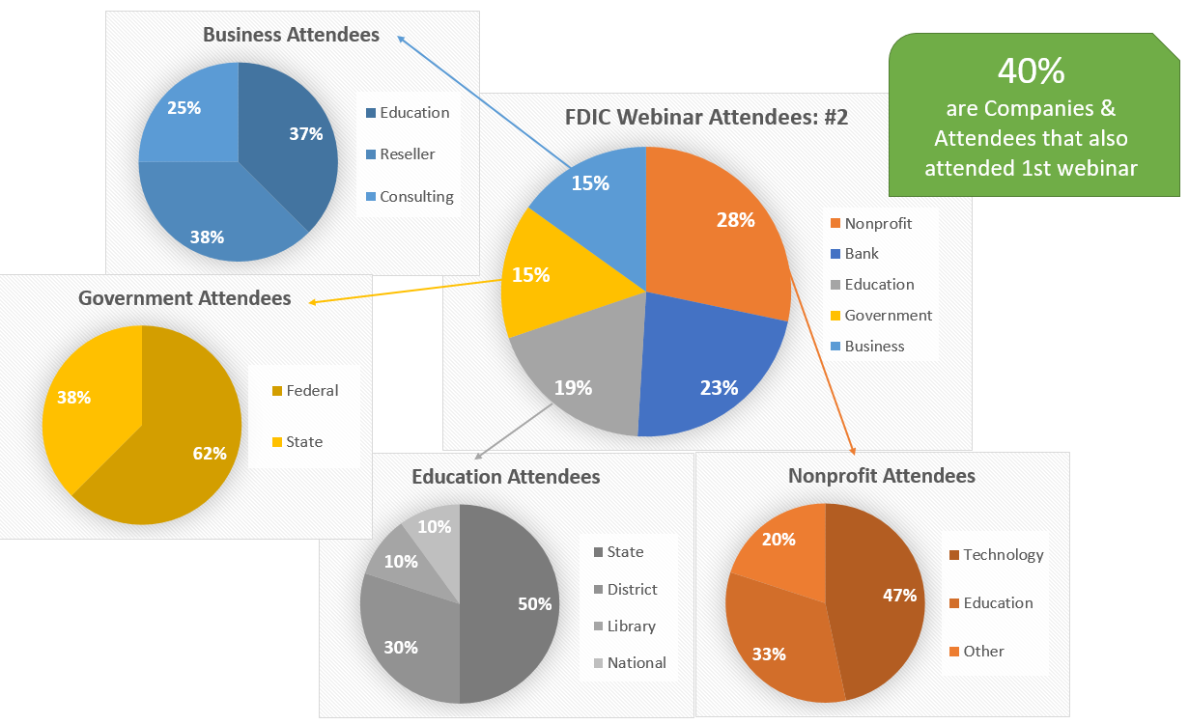
Webinar #2 Audience

Slide 4
Webinar Agenda:
Terry Lee: Welcome
Introductions
Community Reinvestment Act
Christine Fox: Key Issues and Resources
Geoff Belleau: Supporting Capacity
Jenelle Leonard: Capacity Building
Bob McLaughlin: Systemic Inclusion
Q & A
Webinar #4 Announcement
Adjourn

Slide 5
Strengthening Tech Support Capacity in Low-and-Moderate Income Communities: Promoting a Learning Ecosystem
Moderator: Terry Lee, Community Affairs Specialist, Federal Deposit Insurance Corporation – Atlanta Region
Panelists:
Christine Fox, Deputy Executive Director
State Education Technology Directors Association
Geoff Belleau, Education Programs Consultant California Department of Education
Jenelle Leonard, Program Officer (retired)
US Department of Education
Bob McLaughlin, Executive Director
National Collaborative for Digital Equity

Slide 6
The views expressed in this presentation are the presenters and do not necessarily represent the views of the Federal Deposit Insurance Corporation

Slide 7
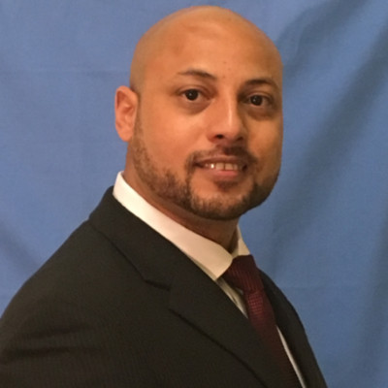
Terry Lee: Community Reinvestment Act

Slide 8






Christine Fox: Broadband Imperative

Slide 9
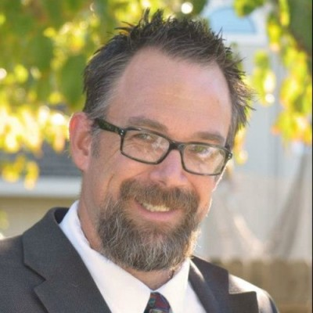
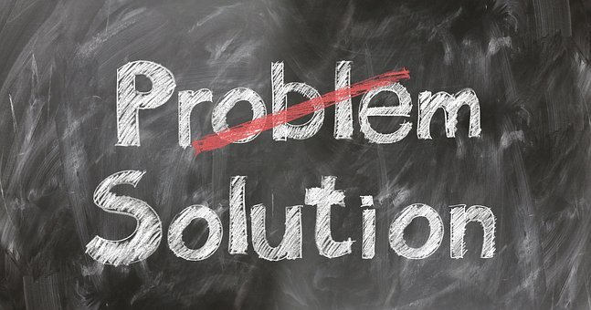



Geoff Belleau: Mouse Squad and Tech Exchange

Slide 10




Jenelle Leonard: Capacity Building

Slide 11
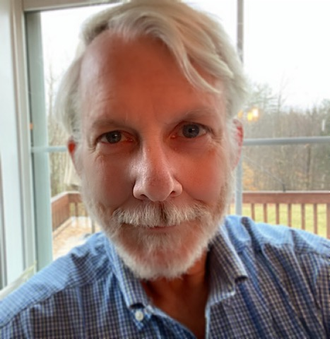




Dr. Robert McLaughlin: VISTA Pilot Program

Slide 12
Q & A

Slide 13
Next Webinar #4
Education and Economic Inclusion Resources Promoted Through Digital Supports:
Low-and-Moderate Income (LMI) Learners Safety Net
Monday, June 15, 2020
12PM to 1PM (EDT)

Slide 14
Christine Fox, Deputy Executive Director
State Education Technology Directors Association
cfox@setda.org
(202) 715-6636 ext. 702
Geoff Belleau, Education Programs Consultant
California Department of Education
gbelleau@cde.ca.gov
(916) 324-9943
Jenelle Leonard, Program Officer (retired)
US Department of Education
jleonard@digitalequity.us
Dr. Robert McLaughlin, Executive Director
National Collaborative for Digital Equity
rmclaughlin@digitalequity.us
(802) 249-1159
Terry Lee, Community Affairs Specialist
Federal Deposit Insurance Corporation – Atlanta Region
telee@fdic.gov
(678) 916-2270

