Slide 1
Connecting the Digital Footprint (webinar series) Financial and Economic Inclusion Resources Promoted Through Digital Supports: Low-and-Moderate Income Learners Safety Net
Monday, June 15, 2020
12PM (EDT) to 1PM (EDT)

Slide 2

Connecting the Digital Footprint upcoming webinar Webinar #5: Coordinated Approaches to Systemic Inclusion: Building Pathways Out of Poverty Thursday, June 25, 2020 – 11AM to 12PM (EDT) Many LMI individuals and communities continue to experience siloed efforts with regard to financial, economic, educational and digital inclusion. Taking a more coordinated, systemic approach can strengthen pathways for LMI youths and families out of intergenerational poverty.

Slide 3
Webinar Agenda:
Terry Lee: Welcome
Introductions
Aim of Webinar
Roger Rosen: Lexile Level Learners
Maryam Moeinazad: Blended Learning Environment
Susan Ballard: Digital Learners and Cyber Safety
Bob McLaughlin: Equitable Access
Q & A
Webinar #5 Announcement
Adjourn

Slide 4
Financial and Economic Inclusion Resources Promoted Through Digital Supports: Low-and-Moderate Income (LMI) Learners Safety Net Moderator: Terry Lee, Community Affairs Specialist, Federal Deposit Insurance Corporation – Atlanta Region Panelists: Roger Rosen, CEO Rosen Digital Maryam Moeinazad, Channel Manager GoGuardian Susan Ballard, Vice President, National Collaborative for Digital Equity (past president), American Association of School Librarians Bob McLaughlin, Executive Director National Collaborative for Digital Equity

Slide 5
The views expressed in this presentation are the presenters and do not necessarily represent the views of the Federal Deposit Insurance Corporation

Slide 6
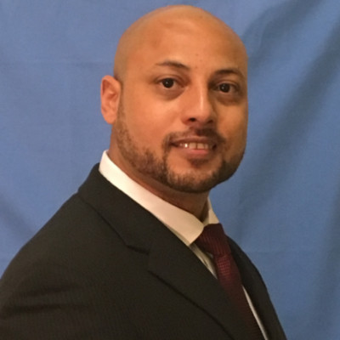
Terry Lee: Aim of Webinar

Slide 7
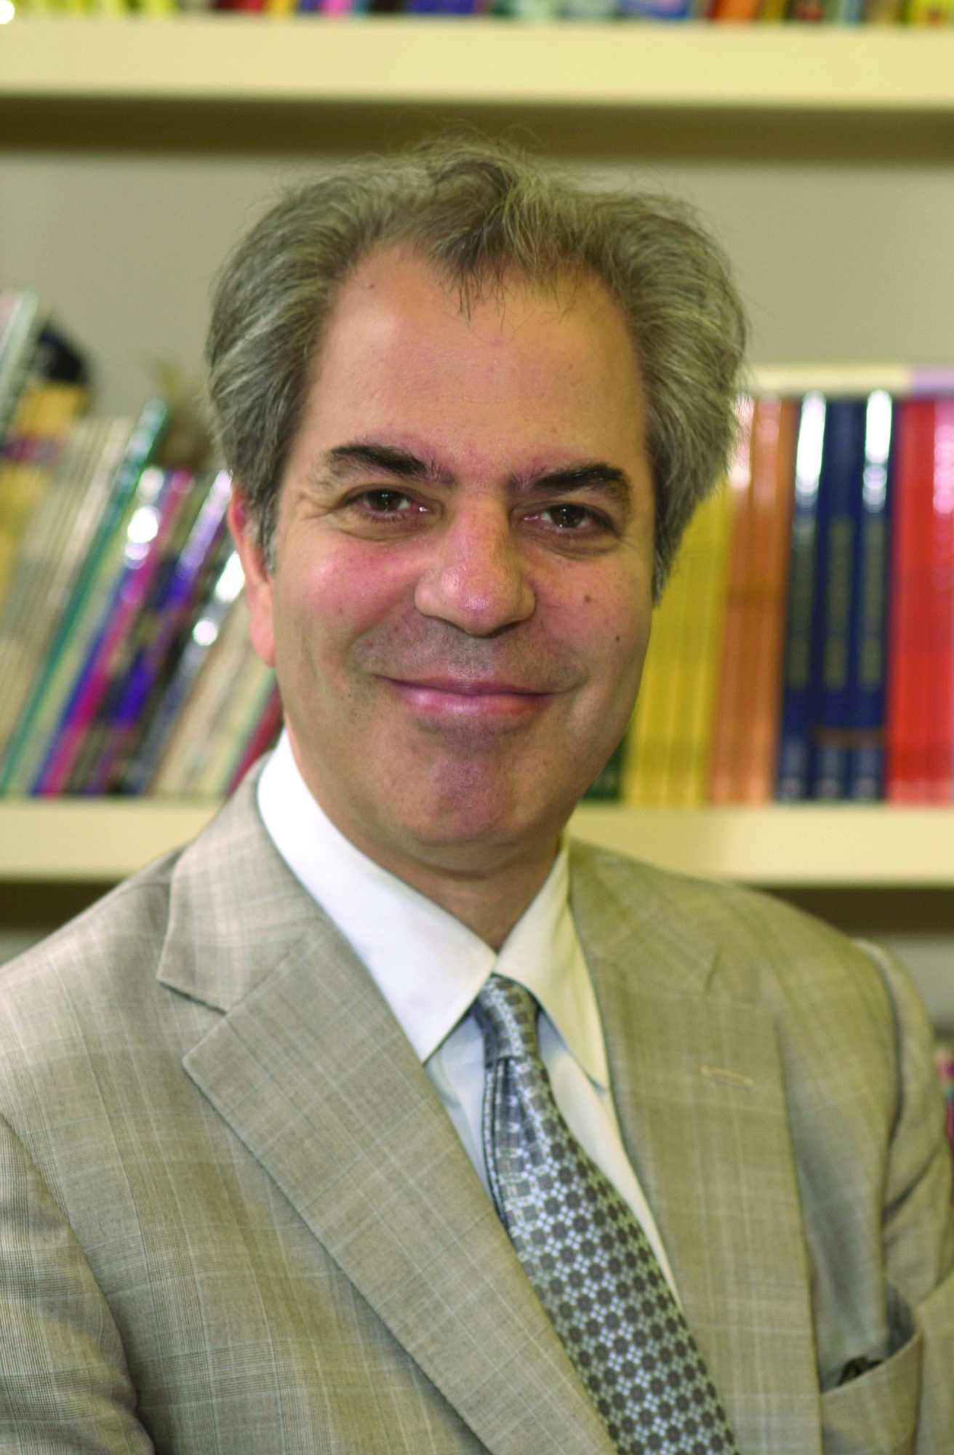
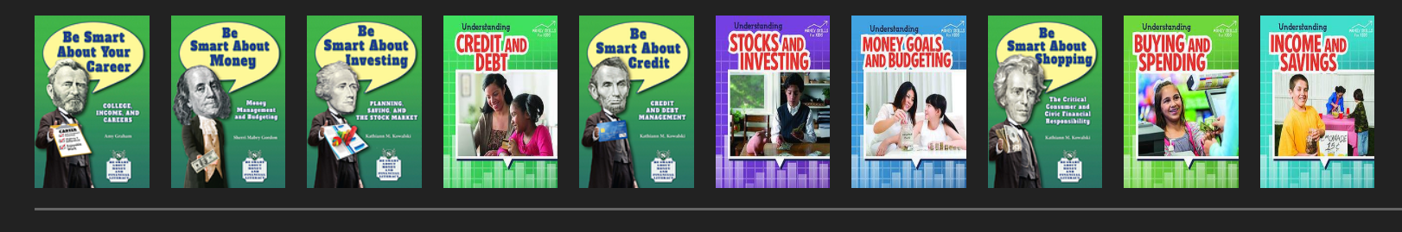
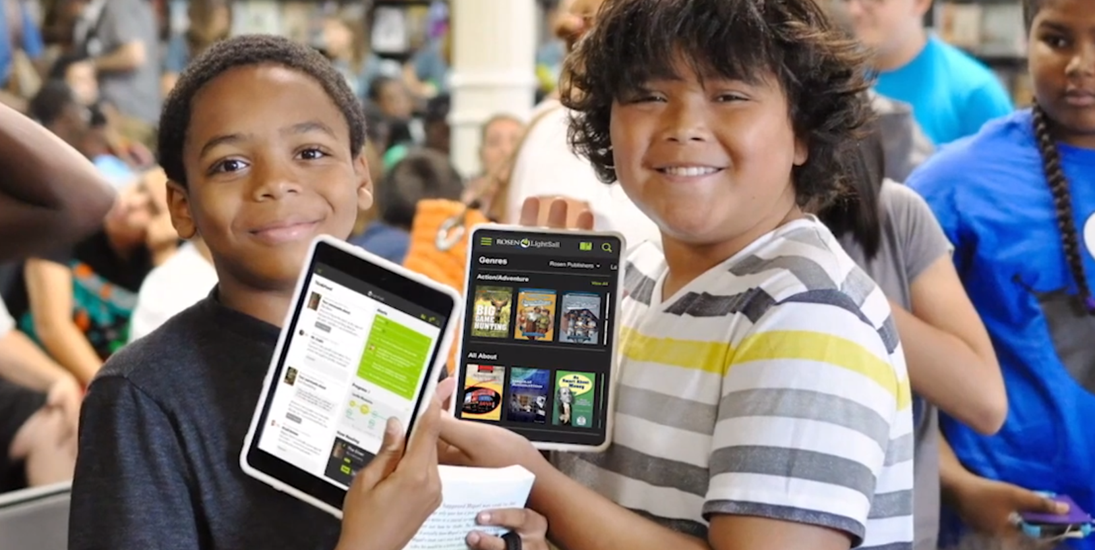


Roger Rosen: Lexile Level Learning

Slide 8
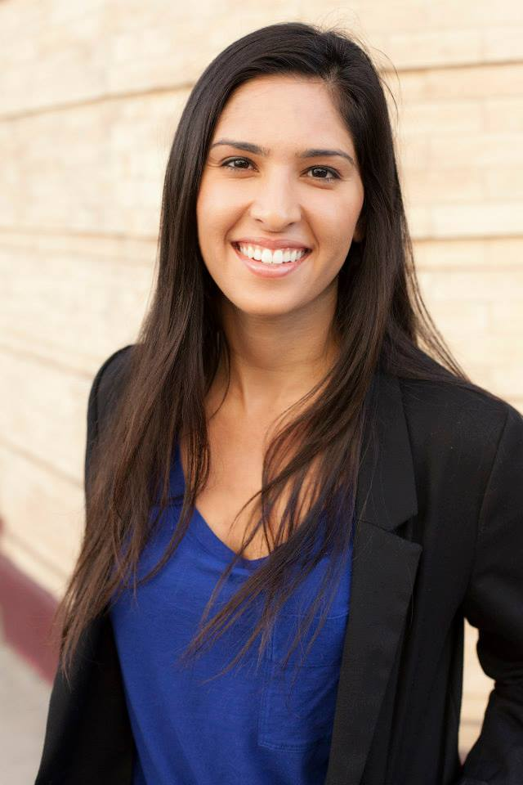



Maryam Moeinazad: Blended Learning Environment

Slide 9
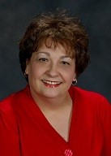
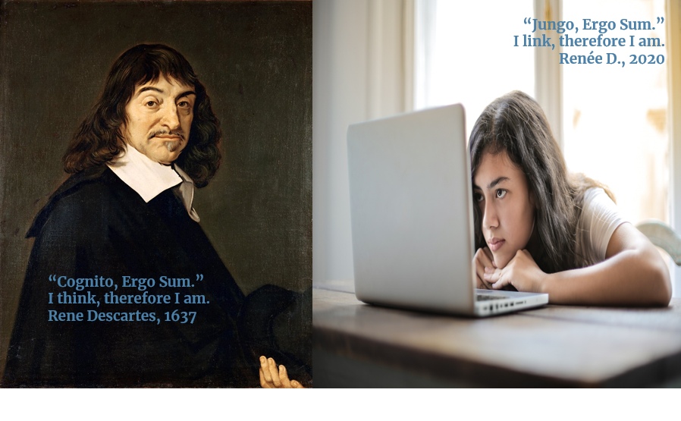

Susan Ballard: Digital Learners and Cyber Safety

Slide 10
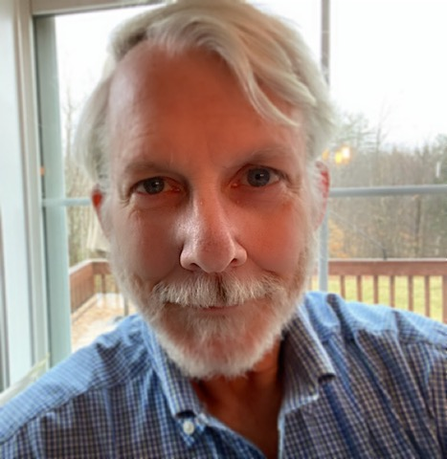




Dr. Robert McLaughlin: Supporting Equitable Access

Slide 11
Q & A

Slide 12
Next Webinar #5 Coordinated Approaches to Systemic Inclusion: Building Pathways Out of Poverty
Thursday, June 25, 2020
11PM to 12PM (EDT)

Slide 13
Roger Rosen, CEO
Rosen Digital
rogerrosen@gmail.com
(800) 237-9932
Maryam Moeinazad, Channel Manager
GoGuardian
Maryam@goguardian.com
(424) 296-4273
Susan Ballard, Past President
American Association of School Librarians
sdballard@digitalequity.us
(603) 247-8308
Dr. Robert McLaughlin, Executive Director National Collaborative for Digital Equity
rmclaughlin@digitalequity.us
(802) 249-1159
Terry Lee, Community Affairs Specialist Federal Deposit Insurance Corporation – Atlanta Region
telee@fdic.gov
(678) 916-2270

