Slide 1
Connecting States’ Financial, Economic and Digital Inclusion Initiatives
(webinar series)
Webinar # 2
Systemic Inclusion Allies and Resources
Monday, October 17, 2022
10:00AM (ET) to 11:00AM (ET)

Slide 2
WEBINAR SERIES
Webinar #3: Be Kind and Refurbish - Laptops Bundled with Financial & Economic Inclusion Resources
Wednesday, November 2, 2022 – 1PM to 2PM (ET)
Why and how to create sustainable statewide ecosystems for refurbishing and donating computers
Webinar #4: Finding Free & Low-Cost Broadband Bundled with Financial and Economic Inclusion Resources
Wednesday, November 16, 2022 – 4PM to 5PM (ET)
How to leverage drive-imaging to offer inclusion apps and pointers with discounted broadband & devices.
Webinar #5: Encouraging Youth Leadership Development - The Future of Digital and Financial Inclusion
Monday, November 28, 2022 – 1PM to 2PM (ET)
How youth can lead local digital equity needs-sensing and planning while building their own digital, media & financial literacy skills.
Webinar #6: Uncovering Rural Systemic Inclusion Strategies - Outside the Urban Lines
Thursday, December 15, 2022 – 1PM to 2PM (ET)
Challenges, opportunities and lessons learned thus far from systemic inclusion efforts in New Hampshire.

Slide 3
Webinar Agenda:
Welcome/Opening Remarks
Terry Lee, FDIC
Aim of the webinar series (spoiler alert: systemic inclusion)
Dr. Bob McLaughlin, NCDE
Panelists:
Angela Bennett, NTIA
Amy Passow, CDW
Colin Rhinesmith, DERC
David Rothstein, CFEF
Lauren Smith, USDOL
Jill Wheeler, CFPB
Dr. Fallon Wilson, MMTIC (unable to join us,
slides included)
Q & A
Next steps

Slide 4
Panelists Thoughts:
Promising and impactful inclusion resources
How their efforts stand ready to support those addressing other inclusion dimensions
How those addressing other inclusion dimensions can enhance their own inclusion outcomes
Systemic Inclusion = Financial, Economic Educational & Digital Inclusion

Slide 5
The views expressed in this presentation are the presenters and do not necessarily represent the views of the Federal Deposit Insurance Corporation

Slide 6
Aims of the webinar series
Dr. Robert McLaughlin, NCDE
Opportunity & challenge to bring together underrepresented and leaders in otherwise disparate inclusion siloes to design for systemic impact on intergenerational poverty
Systemic Inclusion = “FEED” – financial, economic, educational & digital
FDIC webinar series to help local, state and national inclusion leaders connect across inclusion dimensions, with planning led by underserved and committed to impact on poverty
National summit, March 15-16, 2023, in Atlanta for State systemic inclusion teams to share most promising strategies for integration in each other’s State plans
www.InclusionJunction.org enable inclusion leaders to share about their efforts and find colleagues to collaborate with

Slide 7
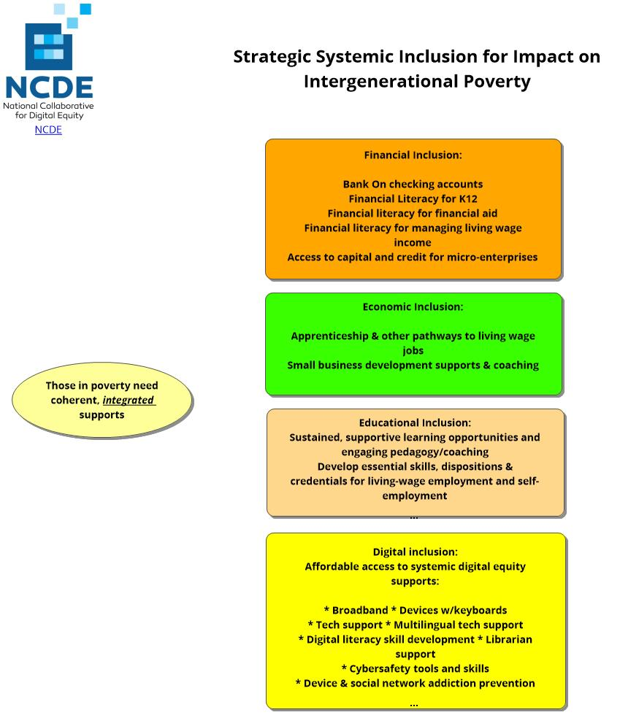

Slide 8
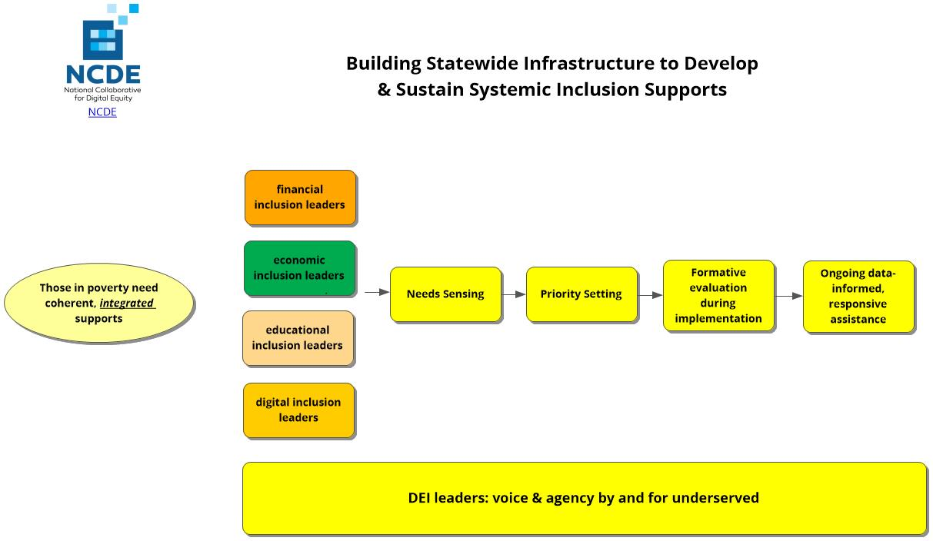

Slide 9
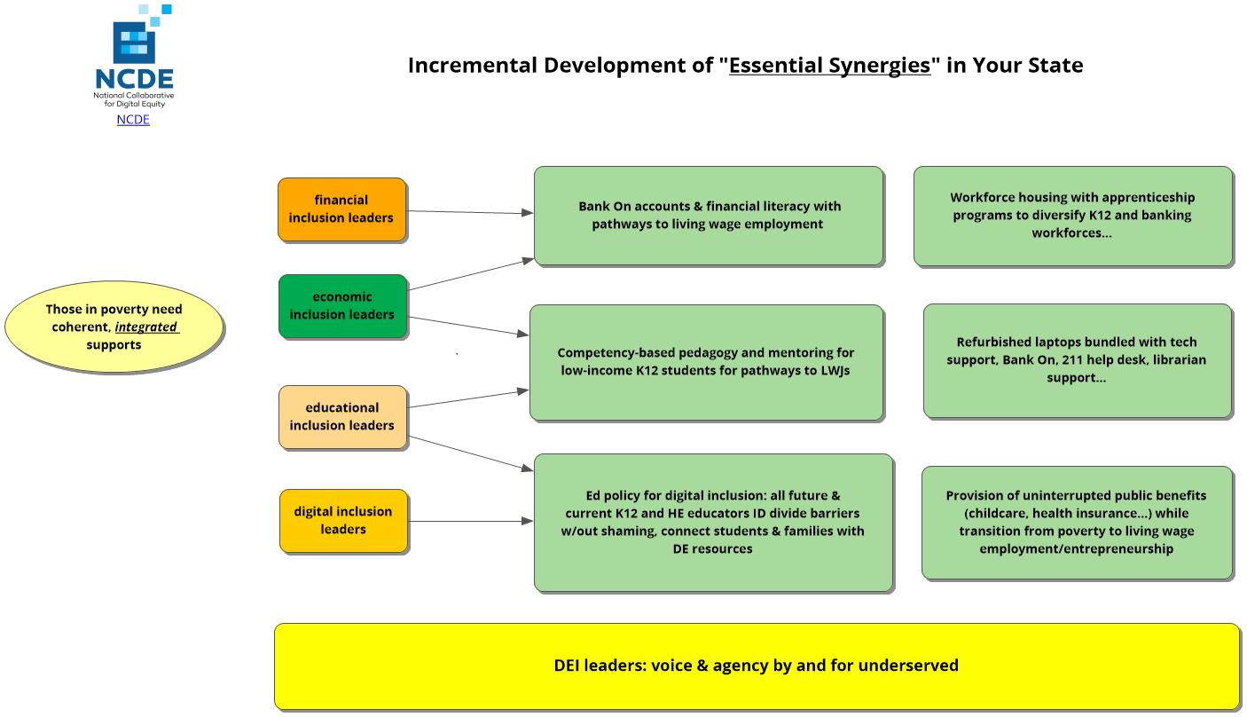

Slide 10
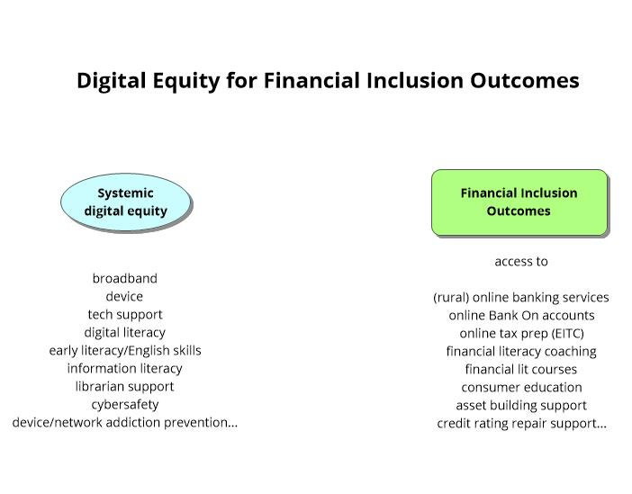
Digital Equity Supports for Financial Inclusion

Slide 11
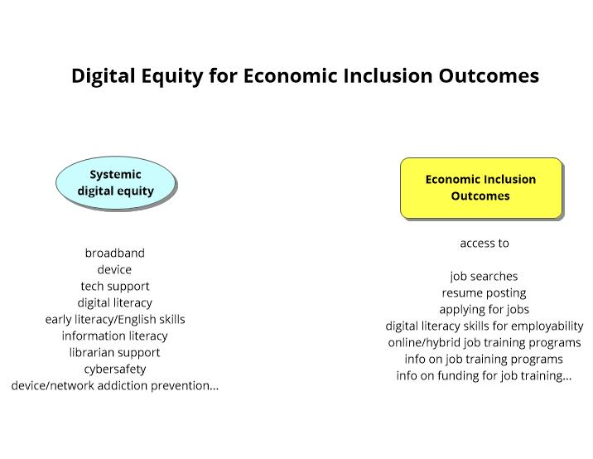
Digital Equity Supports for Economic Inclusion

Slide 12
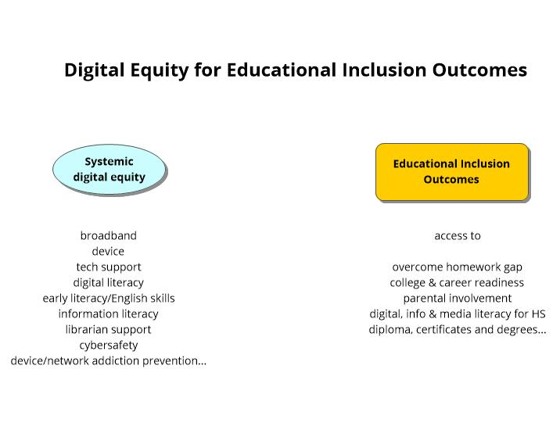
Digital Equity Supports for Educational Inclusion

Slide 13
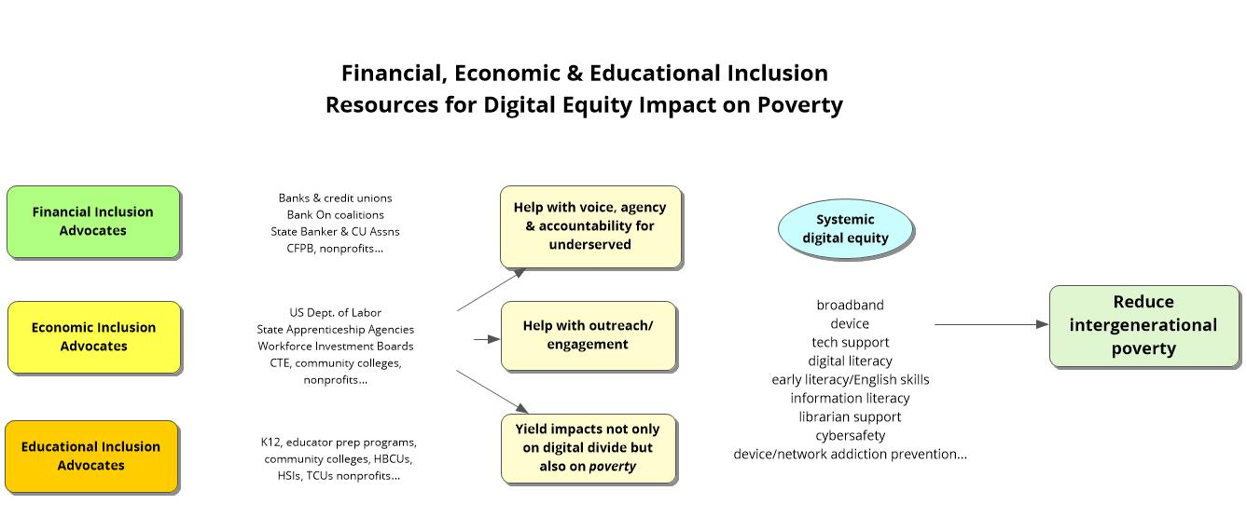
FI, EI & EdI Resources for DE Impact on Poverty

Slide 14
Angela Thi Bennett, Director of Digital Equity, NTIA

Slide 15
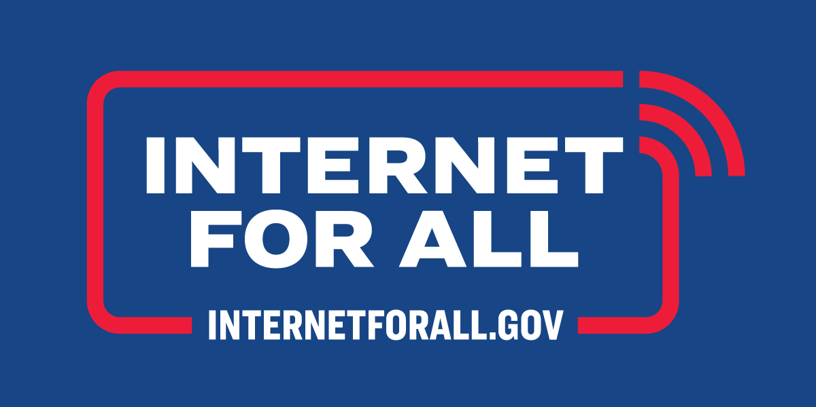
Digital equity act Programs
Funded by the Bipartisan Infrastructure Law
Administered by the Department of Commerce's National Telecommunications and Information Administration
May 2022

Slide 16

NTIA will administer ~$48B through four programs that drive high-speed Internet access, affordability, and adoption
NTIA will administer ~$48B of funding from the Bipartisan Infrastructure Law
FCC to administer $14.2B
For Affordable Connectivity Program, which replaced the EBB program
DIGITAL
EQUITY
MIDDLE
MILE
BEAD
TRIBAL
$42.45B
$2.75B
$2.00B
$1.00B
USDA to administer $2.0B
Broadband Equity, Access & Deployment Program
A program to get all Americans online by funding partnerships between states or territories, communities, and stakeholders to build infrastructure where we need it to and increase adoption of high-speed Internet.
Digital Equity Act
Three programs that provide funding to promote digital inclusion and advance equity for all. They aim to ensure that all communities can access and use affordable, reliable high-speed Internet to meet their needs and improve their lives.
Tribal Connectivity Technical Amendments
A program to help tribal communities expand high-speed Internet access and adoption on tribal lands.
Enabling Middle Mile Broadband Infrastructure
A program to expand middle mile infrastructure, to reduce the cost of connecting unserved and underserved areas.
Via the Rural Utilities Service
Private Activity Bonds $0.6B
Authorizes State and local governments to use private activity bonds for rural broadband

Slide 17
Digital Equity Act created three programs to promote digital equity and inclusion
PROGRAMS HIGHLIGHTS
Funding pool
$2.75B
  The Digital Equity Act created three programs:
  Example eligible uses of funds across three programs include:
State Planning $60M formula funding program to develop digital equity plans | State Capacity $1.44B formula funding program to implement plans & promote digital inclusion | Competitive $1.25B to implement digital equity and inclusion activities
Three programs that provide funding to promote digital inclusion and advance equity for all. They aim to ensure that all communities can access and use affordable, reliable high-speed Internet to meet their needs and improve their lives.
Developing digital equity plans; states must develop a plan to be eligible for state capacity grants | Making awards to other entities to help make digital equity plans | Improving accessibility and inclusivity of public resources
Implementing digital equity plans and related activities | Providing digital literacy and digital skills education | Facilitating the adoption of high-speed Internet
ESTIMATED TIMELINE
Timeline approximate unless exact date specified
Competitive Program launches within 1 month of first Capacity awards
NOFO live 5/13
2022
Due 7/12
2023
2024
2025
2026+
Planning app
1-year state planning
State cap. app
5-year state capacity implementation
Comp. app
4-year competitive implement.

Slide 18
Planning funds will be used to develop State Digital Equity Plans, which must contain several components
Vision
  Stated vision for digital equity
Outreach and Engagement
  Description of plan to collaborate with key stakeholders to achieve its digital equity goals
  List of organizations that collaborated on and contributed to digital equity plans
  Coordination and outreach strategy
Objectives
  Measurable objectives
  Assessment of how those objectives will impact the State's plans and outcomes
Integration
  Asset inventory of current strategies
  Description of incorporation of local plans
  Description of coordination of use of capacity grant funds with BEAD funds
Barriers to Digital Equity
  Identify barriers to digital equity
  Include a digital needs assessment
Implementation
  Implementation strategy
  Timeline

Slide 19
The Digital Equity Act focuses on addressing the needs of "covered populations" as defined by the statute
Covered Populations
Identity groups and communities disproportionally impacted by digital inequity
 | Low-income households
 | Aging populations
 | Incarcerated individuals
 | Veterans
 | People with disabilities
 | People with language barriers
 | Racial and ethnic minorities
 | Rural inhabitants

Slide 20
Eligible entities are required to engage with key stakeholders as a part of developing digital equity plans
 | Key stakeholder groups may include:
 | Community anchor institutions |  | Organizations that represent covered populations
 | County and municipal governments |  | Civil rights organizations
 | Local educational agencies |  | Entities that carry out workforce development programs
 | Indian Tribes, Alaska Native entities, or Native Hawaiian organizations, where applicable |  | State agencies that administer or supervise adult education or literacy activities
 | Nonprofit organizations |  | Public housing authorities

Slide 21
Every stakeholder plays a role in the Digital Equity programs
Illustrative, non-exhaustive
Community anchor institution
  Partner with States, other territories, and Tribal / Native entities to develop State Digital Equity Plans
  Advocate for community interests and needs
Community orgs
  Serve as a thought partner as States, other territories, and Tribal / Native entities design their outreach strategies
  Advocate for community interests and needs
Telecom provider
  Provide States, other territories, and Tribal / Native entities with background data on their baseline and digital equity needs
Tribal government
  Submit a letter of intent to participate in the Planning Grant Program
  Coordinate with relevant State(s) to develop state-wide Plans
Local government
  Collaborate with States, other territories, and Tribal / Native to develop State Digital Equity Plans
Individual
  Participate in the planning process of your local jurisdiction

Slide 22
Additional resources about the Digital Equity Programs
 | Visit the InternetForAll.gov for additional information on federal funding programs
 | Engage with your State or territory regarding their plans to improve high-speed Internet access and achieve digital equity
 | Submit questions to digitalequity@ntia.gov
 | Attend future NTIA webinars, including program-specific application guidance webinars for applicants
1
2
3
4

Slide 24
Amy Passow, CDW

Slide 25
CDW Funding Solutions
Amy Passow
Monday, October 17, 2022

Slide 26
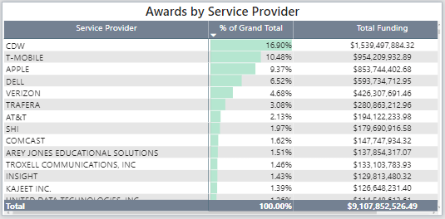
Emergency Connectivity Fund Leader
Devices & Mobile Connections

Slide 27
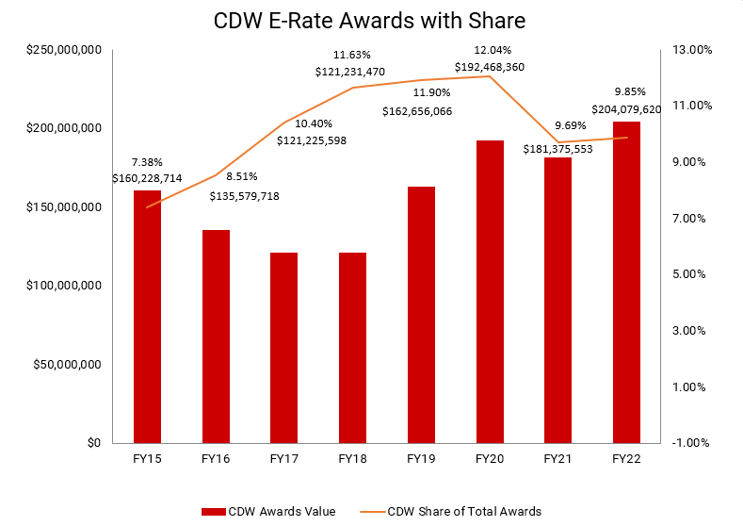
E-Rate program leader
Category 2

Slide 28

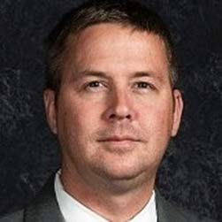
Funding Solutions Focus
Amy Passow
Sr Mgr, EDU Funding Solutions
        Role
        Education Funding Strategy
        Internal and Partner Process & Alignment
        Team and Public Presentations
        Conversations with Customers
        Contact Email: AmyPass@CDW.com
Curtiss Strietelmeier, PhD Public Sector Funding Strategist
        Role
        Funding and Legislation Research
        Document and Resource Development
        Team and Public Presentations
        Conversations with Customers
        Contact Email: Curtiss@CDWG.com
2
CDW.com | 800.800.4239
CDW | Confidential

Slide 29

CDW E-Rate TEams
Program knowledge, compliance, experience, investment
To update the icons, navigate to the CDW Black Icons Library at the end of this deck. Select an appropriate icon and copy it. Navigate back to this slide, click on the icon you would like to change. Right click and select Change Picture – From Clipboard.
You may need to scale / center the icon slightly
E-Rate Sales
E-Rate Program
E-Rate Invoicing
E-Rate Solutions
E-Rate Manager
Sr Mrg, EDU Funding Solutions
Program Manager: E-Rate
Program Analyst
Sr Invoicing Specialist
Sr Invoicing Specialist
K12 focused solution architect team
29

Slide 30

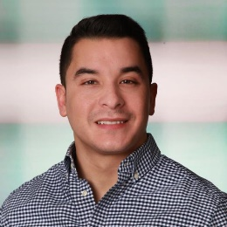
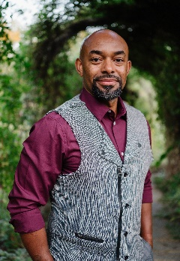
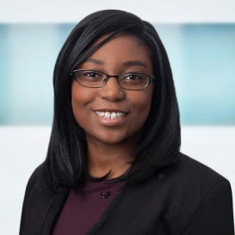


CDW National HBCU Team
Mike Durand, Hi-ED East Director
Tramaine Martin, HBCU Sales Manager
Ebony Thomas, HBCU AM
Mitch Huffington, HBCU Exec. AM
Yakira Love, HBCU AM

Slide 31
Closing the Technology Gap & Facilitating Change
Lack of Skill Set & Technology Workforce
Transforming The Staff & Student Experience
Creating Interdepartmental Synergies

Slide 32



LocalizeIT with CDW Amplified™ Services
Consult with Cisco Certified
Solution Architects
Solution Engineers
Solution Deployment
BoM Creation
Installation
Configuration
Migration
CDW Managed Services
Improve Performance
Reduce Risk
IT Service Team available 24/7/365
CDW collaborates with Local and National Service Providers to execute the full Scope of Work
Structured Cabling
AP Installation
Security Camera Installation
Secure Asset Disposal

Slide 33
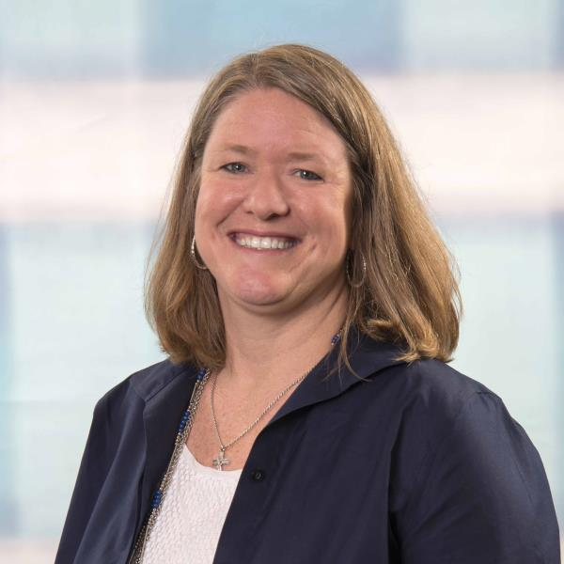
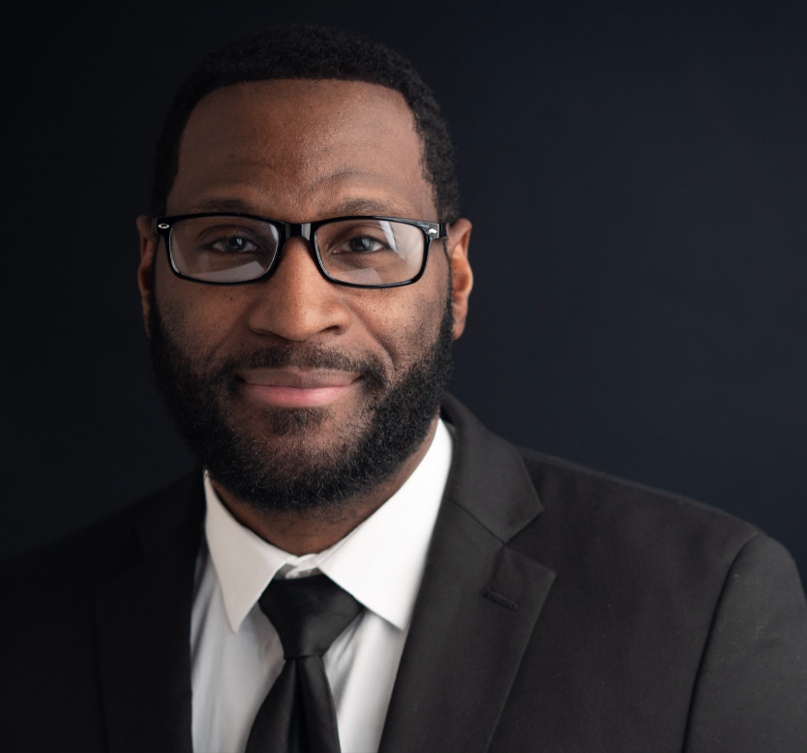
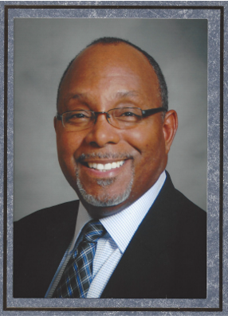
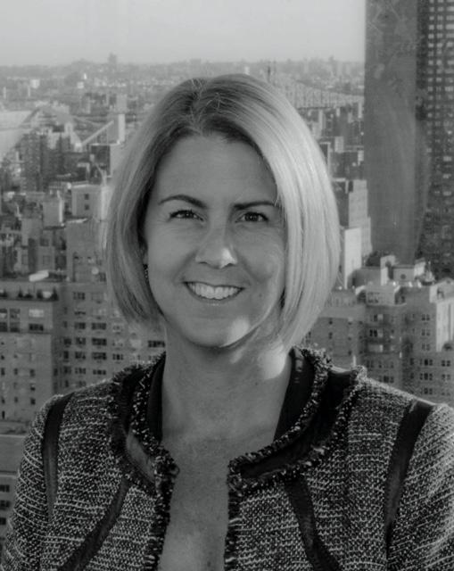


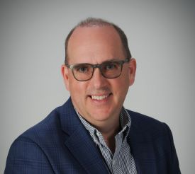
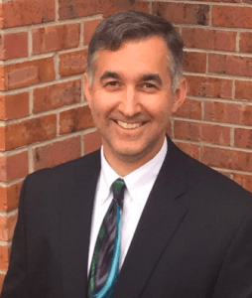
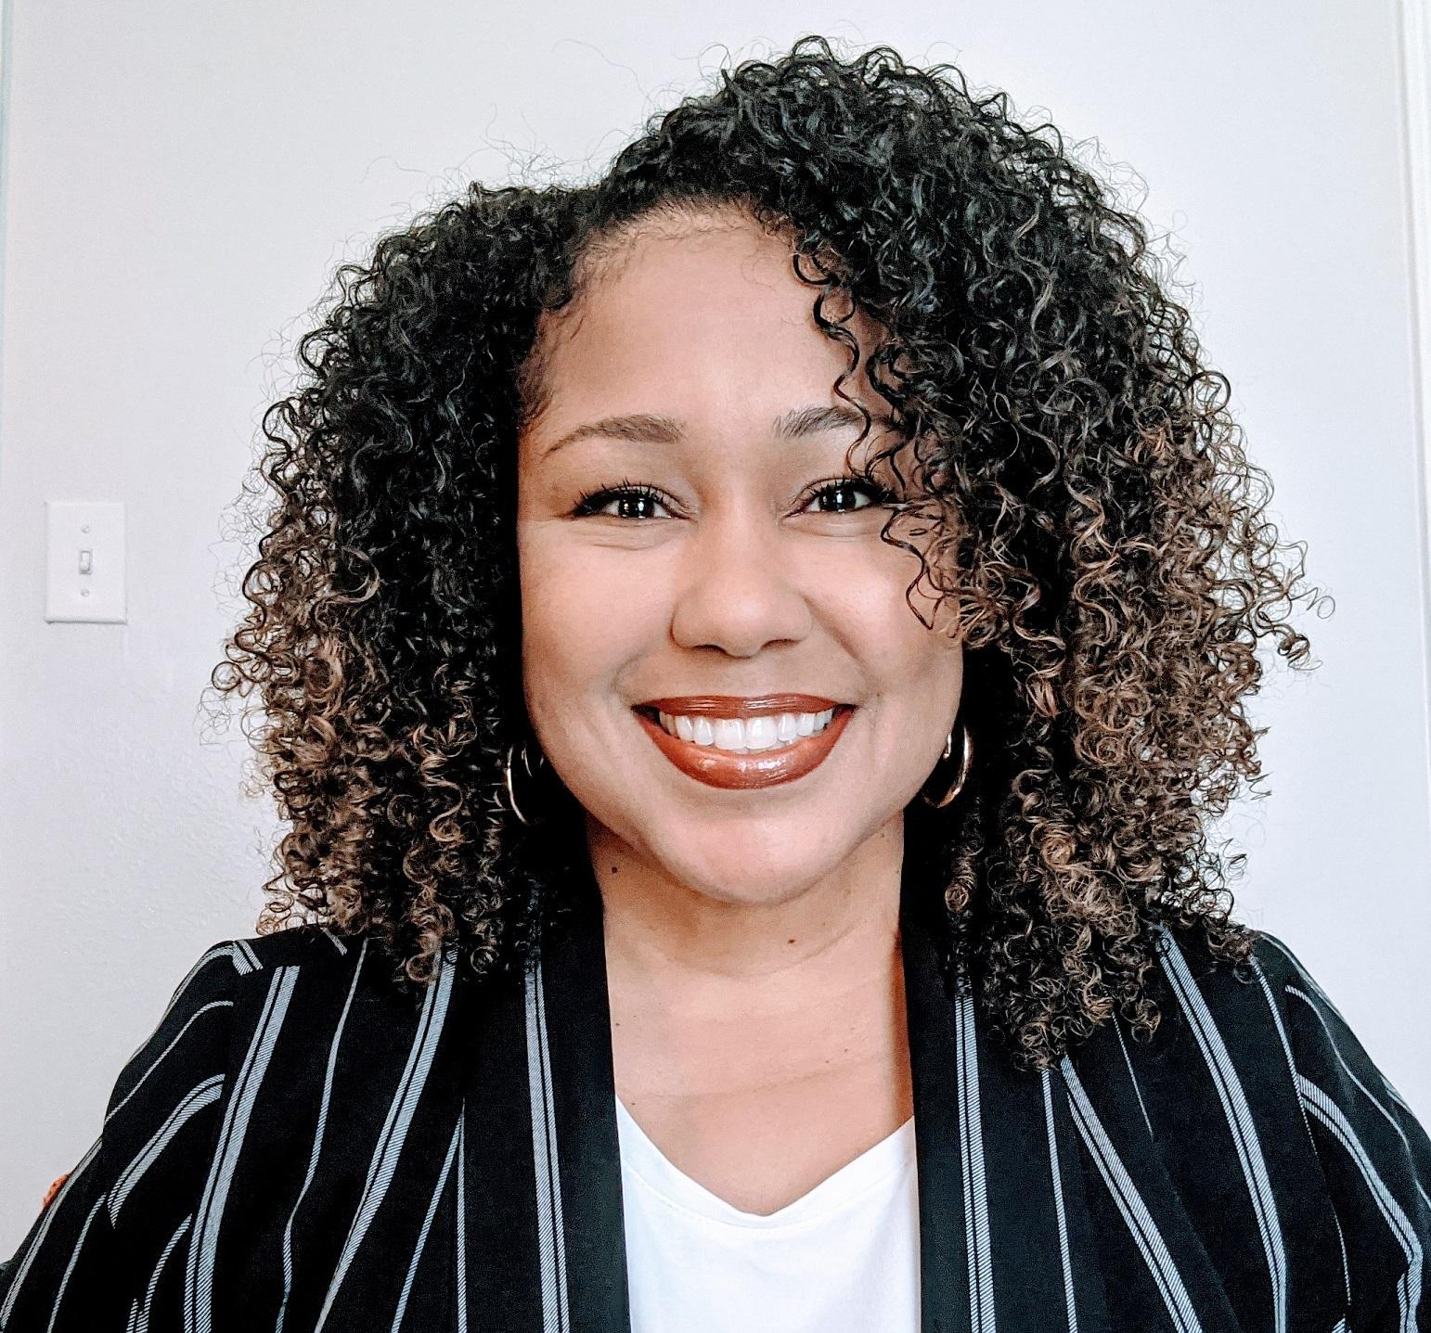
Education Strategy Impact Team
Partnering with innovative schools to make technology work to so students can do great things
Wendy Jones
M.Ed, CETL
Corey L. Gordon
M.Ed
Jacob M Wilson, III
Ph.D
Diana Gross
M.S. Ed
Jennette Vanderpool
Ed.D
Thomas Ashley II
M.Ed, CETL
Bryan Krause
M.Ed
Akilah Willery
Ed.D, CETL

Slide 34


WE GET EDUCATION
EDUCATION STRATEGY TEAM.
At CDW Education, we know schools cannot achieve their educational goals with classrooms absent of technology. We also know learning outcomes are enhanced when technology is aligned and integrated with pedagogical goals. Over the last decade, the way students learn and collaborate has drastically changed. With educated and passionate school leaders, technology can better prepare students to quickly adapt new skills for the complex and evolving needs of the future. In response to the increasing complexities that schools face scaling digital learning, we’ve built a K-12 customer-focused Education Strategy Impact team. Comprised of a diverse group of educators who understand the unique needs of our customers and partner with administrators, IT teams and instructional leaders, we work to ensure everyone understands the benefits, challenges and impact technology can have in the classroom.
MANAGER:
NEW YORK CITY:
WENDY JONES, M.Ed, CETL
Wendy is a lifelong educator with extensive district leadership experience. As a former education strategist,
she supports the team as they provide educational and thought leadership, empower digital transformation, and build relationships that impact teaching and learning for
our CDW Education customers.
DIANA GROSS, M.S.Ed
Diana is a former Director of Learning and Innovation with over 20 years of domestic and global experience visioning, designing, implementing and managing large scale innovative education projects. Diana applies a background of educational neuroscience research & project M&E to ensure sustainability & scalability of future forward initiatives.
EAST:
JACOB M. WILSON, III, Ph.D
COREY L. GORDON, M.Ed
Jake is a former PreK-12 Administrator, Chief Discipline
Officer, 21st CCLC program designer, grant author, MTSS Systems coach, and leadership mentor. He strategically helps districts assess and move toward their goals.
Corey is a former PreK-12 Administration & NASA STEM Senior Specialist.He guides districts through the strategic initiatives that impact integrated technology, tiered interventions, STEM, and systems coaching. Corey connects technology to federal funding, special education, CTE, and beyond school hour programs to enhance instruction.
CENTRAL:
THOMAS ASHLEY II, M.Ed, CETL
AKILAH WILLERY, Ed.D, CETL
Akilah is a former Exec. Director of Professional & Digital Learning. She partners with administrators, curriculum leaders, and technology teams to ensure all stakeholders understand technology’s impact in the classroom. She is passionate about sharing cybersecurity awareness for non-technical audiences.
Thomas is a former K-12 Chief Technology Officer, mentor, and past chair of the Indiana Cyber Security Task Force. He supports districts with leadership, project management, effectiveness reviews, and educational reform that lead to improved culture, innovation, and student achievement.
CSM, CSSGB
WEST:
Jennette Vanderpool, Ed.D
BRYAN KRAUSE, M.Ed
Jennette is a former Sp. Ed. administrator, 504 Coordinator & university professor with 20 years experience. She is passionate about helping school districts adapt to the unique technological needs of their students and staff. With a background in curriculum design, implementation, LCAP and union negotiations, she helps school districts break through barriers in the technology adoption process.
Bryan is a former Area Assistant Superintendent and Career and Technical Education Director with 30 years of leadership and professional development experience. He works closely with school districts on implementing best practices across a variety of platforms. He is passionate about the use of technology to improve learning with coding, robotics, and the inclusion of special populations.

Slide 35
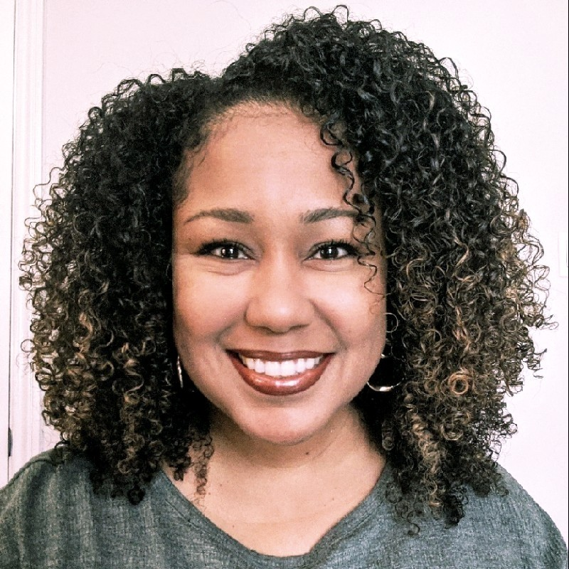
DIGITAL TRANSFORMATION
CDW Education recognizes that educational leaders are navigating unique challenges and opportunities that will shape educational outcomes for years to come. With our Education Strategy team’s unique experience and expertise, we are excited to partner with our customers, addressing our shared goal of improving student achievement through a district’s educational technology initiatives.
As innovation leads to further integration of digital systems with physical environments, new possibilities and pitfalls must be considered. It’s no longer what you know about technology, it’s about the experience you can create with it. By analyzing research and data across CDW Education’s global network of partners and customers, we’re able to guide customers through the most critical aspects of digital transformation. Through on-site planning sessions and workshops, we partner with school leaders to develop a vision for change that will create lasting impact. We help identify which solutions will best enhance curricula, enable student ownership and make it easier for students to develop essential skills.
K-12 EDUCATION STRATEGISTS.
BRYAN
KRAUSE
THOMAS
ASHLEY
COREY L.
GORDON
DIANA GROSS
JACOB WILSON III
JENNETTE
VANDERPOOL
AKILAH WILLERY

Slide 36
Colin Rhinesmith, Digital Equity Research Center

Slide 37


Digital Equity Ecosystems Measurement (DEEM) Framework
Colin Rhinesmith, Ph.D.
FDIC/NCDE Webinar
October 17, 2022

Slide 38
About Me
Colin Rhinesmith, Ph.D. (he/him)
Founder and Director,
Digital Equity Research Center, Metropolitan New York Library Council
Senior Fellow, Benton Institute for Broadband & Society
https://dercenter.org/

Slide 39

Digital Equity Ecosystems
Interactions between individuals, communities, populations, and their larger environments that all play a role in shaping the work to promote more equitable access to technology and social, economic, and racial justice.
- https://dercenter.org/digital-equity-ecosystems/
https://www.benton.org/blog/impacts-covid-19-digital-equity-ecosystems

Slide 40
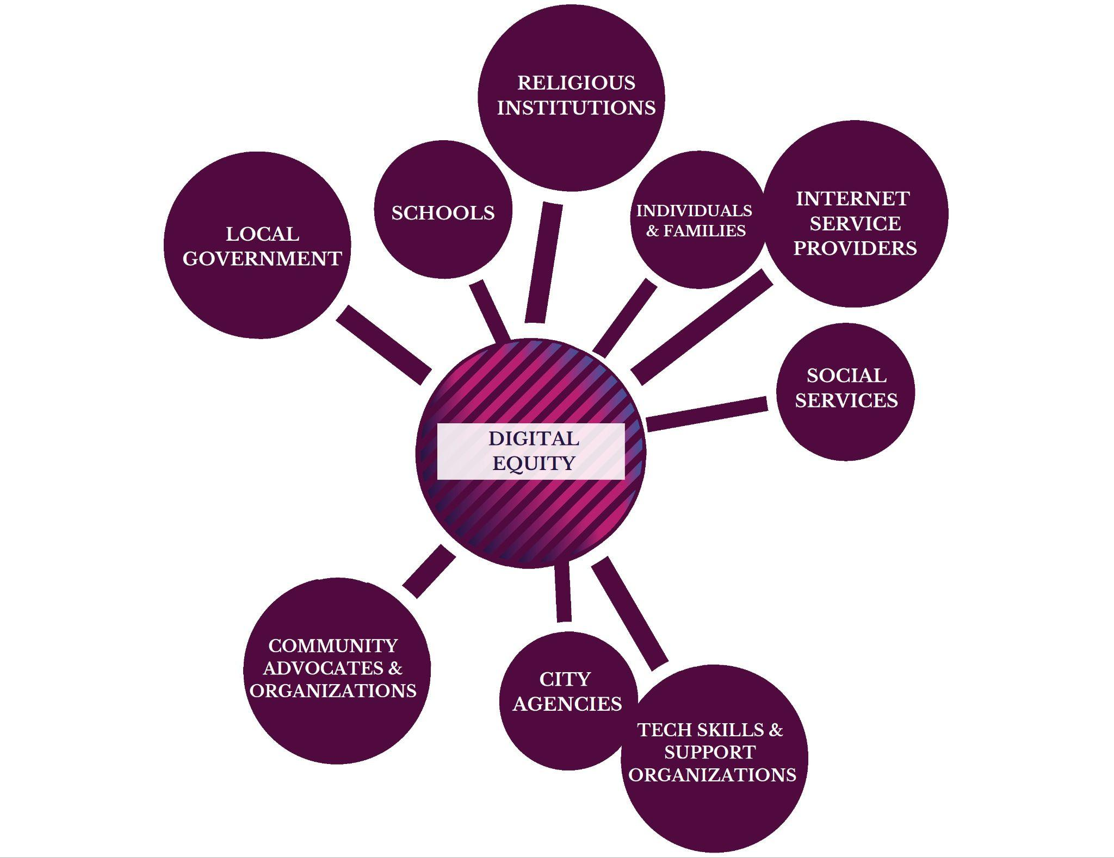
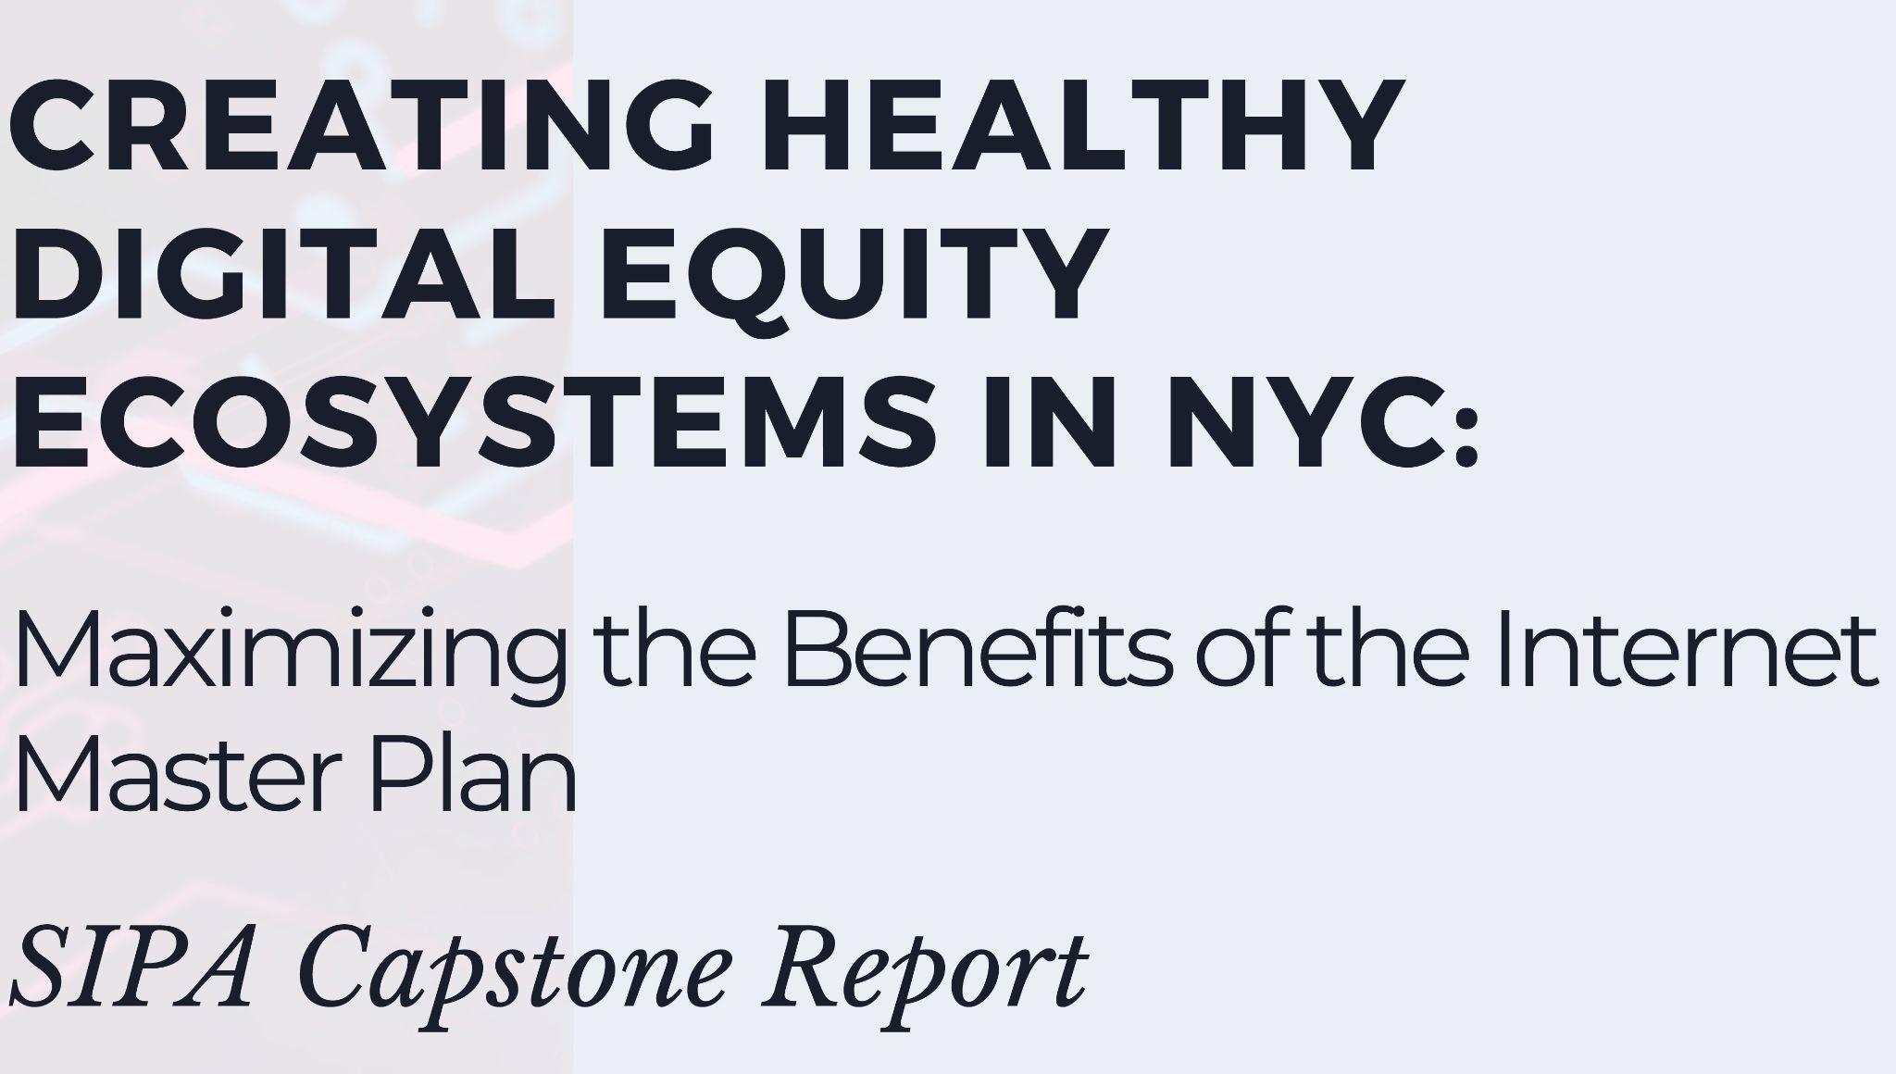
Digital Equity Ecosystems
https://www.sipa.columbia.edu/academics/capstone-projects/guide-fighting-digital-redlining

Slide 41
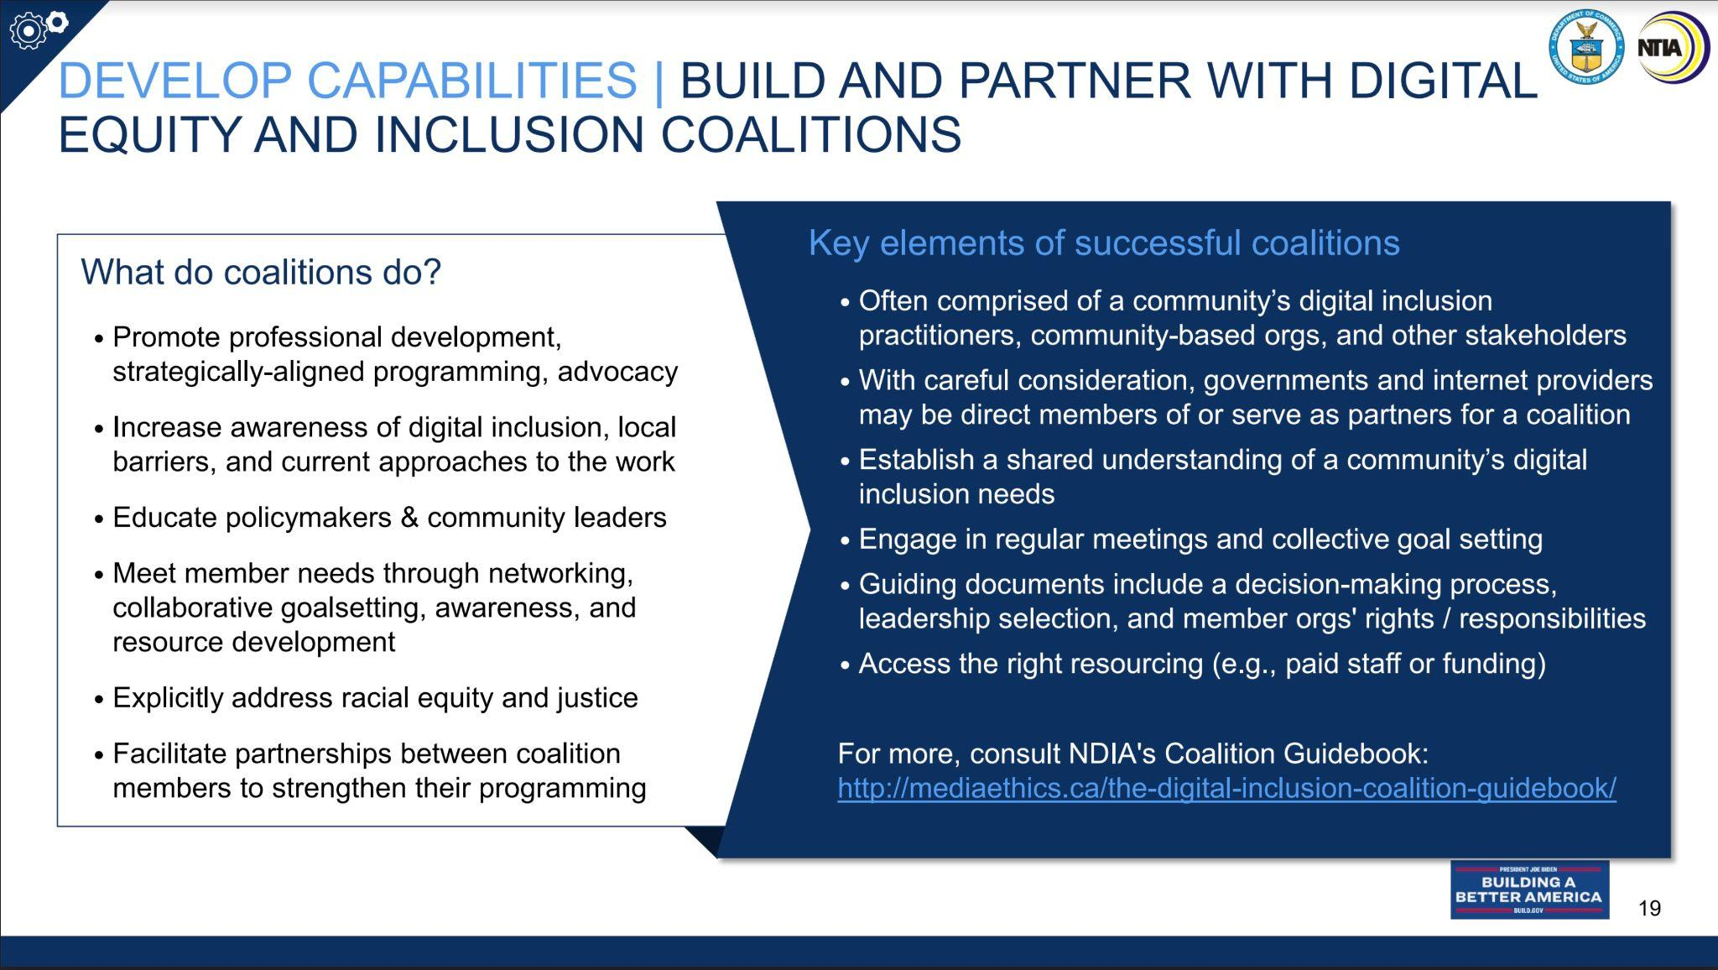
Next Steps
Coalitions in NYC and beyond are key to promoting healthy digital equity ecosystems.
https://thebronx.org/digital-equity/

Slide 42
Digital Equity Ecosystems Measurement
(DEEM) Framework
Coalition Impact
indicators related to positive changes to the lives of individuals and the broader community that a coalition is hoping to bring about through its efforts. (e.g., increased broadband access, increased digital literacy)
Coalition Strength
indicators related to the capacities and efforts of coalition members related to the valued impacts of the coalition (e.g. the nature and reach of programs run by member organizations)
indicators related to the organization, structure, and relationships of a coalition as a whole (e.g., how much trust exists across members, how aligned they are to coalition goals, how equitable governance of the coalition is)
Coalition Health

Slide 43

Thank you! Questions?
Colin Rhinesmith, Ph.D.
📧 email: crhinesmith@metro.org
🌐 web: https://crhinesmith.com
🐦 Twitter: @crhinesmith
This work is licensed by Colin Rhinesmith under a Creative Commons Attribution ShareAlike 4.0 International License.
https://www.flickr.com/photos/benichidori/2751248321/in/photolist

Slide 44
David Rothstein, Cities for Financial Empowerment Fund
Locations Projects

Slide 45

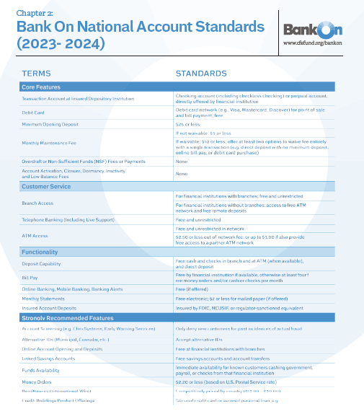
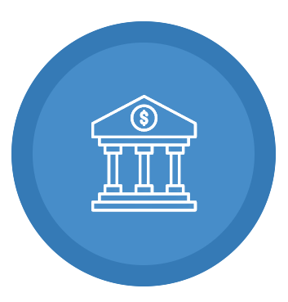



Updated
Bank On
National Account Standards
Affordable
Safe
Functional
Monthly fees of $5 or less with a low minimum opening deposit
No overdraft, non-sufficient funds, or dormancy fees
Pay bills, make deposits and withdrawals, and transfer money

Slide 46

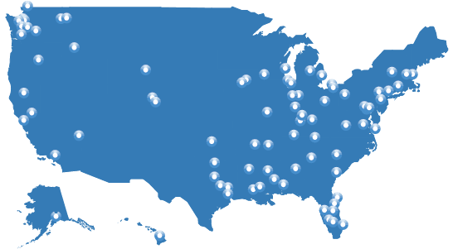

The National Movement
260+
46,000+
47%
56%
Bank On
certified
accounts
Branches with certified accounts across all 50 states and Washington D.C.
of all US bank branches offer a Bank On certified account
of the national deposit market share is comprised of FIs with Bank On certified accounts
= Bank On Coalitions
Notes:
37 Banks in Ohio Offer these accounts

Slide 47
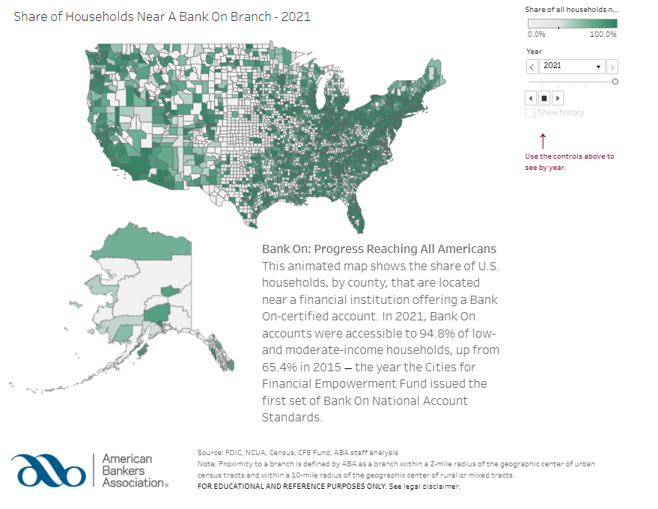
American Bankers Association Promotes
Bank On
Certified Accounts

Slide 48
Lauren Smith, US Department of Labor
(via Share Screen)

Slide 49
Jill Wheeler, Consumer Financial Protection Bureau

Slide 50
Your Money, Your Goals
A financial empowerment toolkit
Notes:
Sources and additional information
https://www.consumerfinance.gov/your-money-your-goals/
Your Money, Your Goals: A financial empowerment toolkit
https://files.consumerfinance.gov/f/documents/cfpb_your-money-your-goals_financial-empowerment_toolkit.pdf

Slide 51
Disclaimer
This presentation is being made by a Consumer Financial Protection Bureau (Bureau) representative on behalf of the Bureau. It does not constitute legal interpretation, guidance or advice of the Bureau. Any opinions or views stated by the presenter are the presenter’s own and may not represent the Bureau’s views.
This document includes links or references to third-party resources. The inclusion of links or references to third-party sites does not necessarily reflect the Bureau’s endorsement of the third-party, the views expressed on the third-party site, or products or services offered on the third-party site. The Bureau has not vetted these third-parties, their content, or any products or services they may offer. There may be other possible entities or resources that are not listed that may also serve your needs.

Slide 52
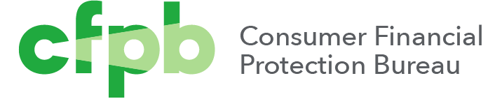

Introduction to the CFPB
The Consumer Financial Protection Bureau is a 21st century agency that implements and enforces Federal consumer financial law and ensures that markets for consumer financial products are fair, transparent, and competitive.
Notes:
Instructions for Facilitator:
Introduce key facts about the CFPB using information from the website.
Explain that a key goal of the training is to connect frontline staff to CFPB resources, including Consumer Response.
The Bureau
We aim to make consumer financial markets work for consumers, responsible providers, and the economy as a whole. We protect consumers from unfair, deceptive, or abusive practices and take action against companies that break the law. We arm people with the information, steps, and tools that they need to make smart financial decisions.
In a market that works, the prices, risks, and terms of the deal are clear upfront so that consumers can understand their options and comparison shop. Companies all play by the same consumer protection rules and compete fairly on providing quality and service. To achieve this vision, the CFPB works to:
Empower
We create tools, answer common questions, and provide tips that help consumers navigate their financial choices and shop for the deal that works best for them.
Enforce
We take action against predatory companies and practices that violate the law and have already returned billions of dollars to harmed consumers.
Educate
We encourage financial education and capability from childhood through retirement, publish research, and educate financial companies about their responsibilities.
Explain that a key goal of the training is to connect frontline staff to CFPB resources, including Consumer Response.

Slide 53
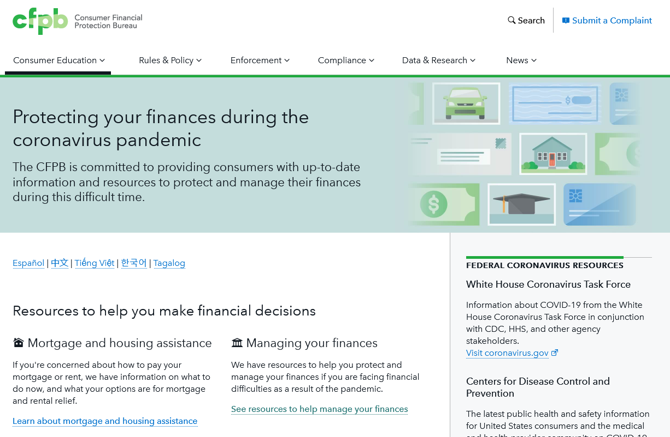
Commitment to supporting consumers
The CFPB is committed to providing consumers with up-to-date information and resources to protect and manage their finances as the situation evolves during this difficult time.
Available at: https://www.consumerfinance.gov/coronavirus/
Notes:
Key concept
There are resources that can help you as you do this work in your community.
Sources and additional information
https://www.consumerfinance.gov/coronavirus/
Instructions for facilitation
Methodology: Closing / Presentation
Suggested script​
The CFPB is committed to supporting consumers.
It’s important that consumers protect and manage their finances during the COVID-19 pandemic. The CFPB is committed to providing consumers with current information and resources to help them do that as the pandemic situation evolves.
Federal, state and local governments, and communities are working to respond to the growing public health threat of coronavirus, or COVID-19.
The CFPB and other financial regulators have encouraged financial institutions to work with their customers to meet their community needs. You can find CFPB’s guidance addressing the coronavirus for financial institutions—including banks, credit unions, credit reporting companies, and other institutions—on our website.

Slide 54
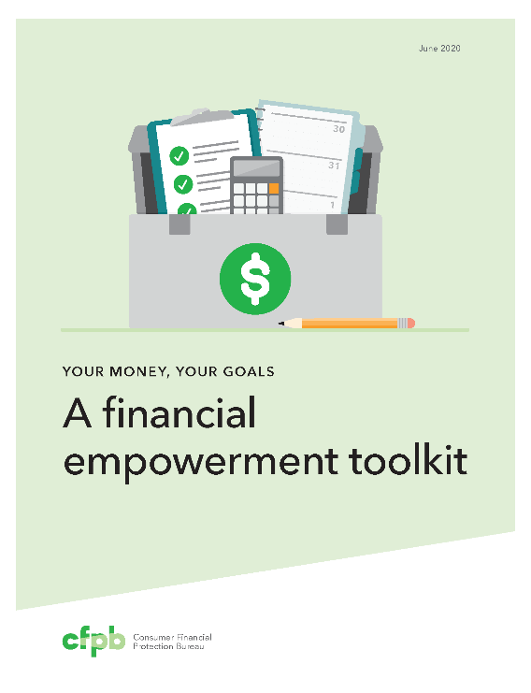

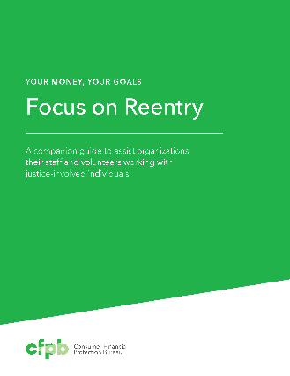





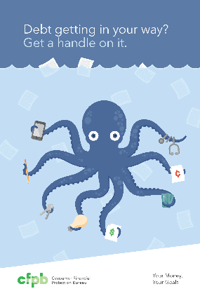
Your Money, Your Goals: Resources
One Toolkit
Comprehensive information for practitioners.
Four Companion Guides
Help practitioners contextualize the money conversation to the unique needs of specific populations.
Four Booklets
Actionable, compact booklets on bills, credit, debt and saving.
For in-person use.
All Available at: https://www.consumerfinance.gov/your-money-your-goals/
Selected materials available in Spanish.
Notes:
Key concept
The suite of Your Money, Your Goals resources is here to help your role as a practitioner.
Sources and additional information
Your Money, Your Goals website
https://www.consumerfinance.gov//your-money-your-goals/
Suggested script
Your Money, Your Goals is a set of financial empowerment materials for organizations that help people meet their financial goals by increasing their knowledge, skills, and resources.
Whether you’re helping people get a job, find a place to live, or deal with a legal problem, money always comes up. You can use these tools to start the conversation
Materials were designed through a collaborative process with partners on the ground. This included rigorous field testing by practitioners.
The materials were designed for use by frontline practitioners such as social workers, legal aid attorneys, housing counselors and many other volunteers who work with underserved communities. This is information that helps you have money conversations with the people you serve.
Materials are designed for people who are *not* financial experts but are trusted sources of information in their community.
Your Money, Your Goals includes a variety of resources:
Toolkit: The toolkit provides comprehensive information for practitioners. It is not a curriculum. Instead, you can use what tools work for the person you are working with in that moment.
Companion guides: Companion guides help you address the unique needs of people with disabilities, people with criminal records, Native communities, and the military community.
Booklets: There are four colorful booklets than can help you address being behind on bills, debt, credit, and savings. Behind on bills? and Want credit to work for you? are also available in Spanish.

Slide 55
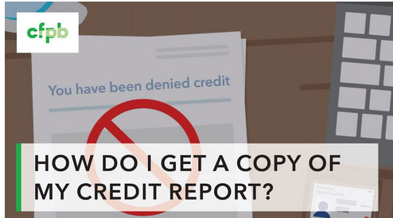
Videos to Spark Action
Play a video to introduce a topic and follow up with a tool or handout tied directly to that topic.
  Credit
  Debt
  Financial products and services
  Paying bills and saving
https://www.consumerfinance.gov/consumer-tools/educator-tools/your-money-your-goals/videos/
Notes:
Key concept
Short videos can help you introduce a topic.
Sources and additional information
Videos to spark action
https://www.consumerfinance.gov/consumer-tools/educator-tools/your-money-your-goals/videos/
Suggested script
These short videos help to explain concepts from the Your Money, Your Goals toolkit.
You can play a video to introduce a topic and follow up with a tool or handout tied directly to that topic.
Credit
Debt
Financial products and services
Paying bills and saving

Slide 56
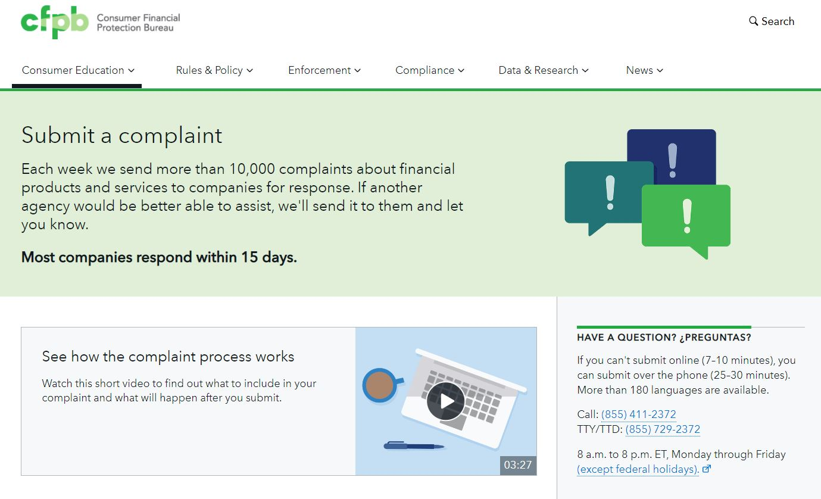
Submitting a complaint to the Bureau
https://www.consumerfinance.gov/complaint/
Submitting online usually takes less than 10 minutes
If consumers can’t submit online, they can submit a complaint over the phone. This usually takes 25-30 minutes
(855) 411-2372
TTY/TTD: (855) 729-2372
180 languages are available
8 a.m. to 8 p.m. ET, Monday through Friday
Notes:
Key concept
Having an issue with a financial product or service? If so, people can Submit a complaint to the CFPB and the CFPB will work to get them a response from the company.
Sources and additional information
https://www.consumerfinance.gov/complaint/
Note: Please refer to the webpage for latest contact info, rather than the Toolkit, since the webpage content is always up to date.
Suggested script
Consumers can submit complaints about:
Credit cards
Mortgages
Bank accounts and services
Student loans
Vehicle loans or leases
Payday loans
Other consumer loans (including installment loans, pawn loans, and title loans)
Debt collection
Money transfers or virtual currency
Credit reporting
Prepaid cards
Other financial services (including check cashing, money orders, cashier’s checks, credit repair, debt settlement, refund anticipation loans, foreign currency exchange, and traveler’s checks)
Every complaint the Bureau receives gives them insights into problems that people are experiencing in the marketplace and helps them to identify and prioritize problems for potential action.
How to submit a complaint has the information you or the people you serve need to make a complaint online or phone, or by mail.
As a trusted service provider you help the people you serve by sharing this handout.
NOTE: For the presenters' awareness, the website requires consumers to create an account to submit a complaint.
At present, third parties assisting consumers will need to submit complaints over the phone as the new web format does not presently have an option for third parties to submit complaints.
Consumers submitting complaints by mail can send to:
Consumer Financial Protection Bureau
PO Box 27170
Washington, DC 20038

Slide 57

Ask CFPB
CFPB offers clear, impartial answers to hundreds of financial questions on Ask CFPB.
Find the information you need to make more informed choices about your money.
Search for your question or browse questions and answers by topics.
Available at: https://www.consumerfinance.gov/ask-cfpb/
Notes:
Key concept
Ask CFPB helps practitioners and the people you serve find clear, impartial answers to financial questions.
Sources and additional information
Ask CFPB
https://www.consumerfinance.gov/ask-cfpb/
Instructions for facilitation
Review Ask CFPB and the information that’s available when browsing by topic.
If you have an internet connection during your presentation, visit the website and conduct a search that is relevant to your audience. For example, "how do I get my credit report?"
In-person tip: Ask participants for financial questions to search.
Virtual tip: Share your screen and demonstrate how to use Ask CFPB.
Suggested script
When you or someone you work with have a financial question, visit Ask CFPB.
Ask CFPB provides clear, impartial answers to hundreds of financial questions.
You can explore trusted, vetted information with those you work with. You do not need to be a financial expert to help a person find accurate information.
You can search for your question. For example, type in “how do I get my credit report?” and a variety of articles and tools will appear.
Or, you can explore by topic. From auto loans, to prepaid cards, and student loans, there is information available that you and the people you serve may need.

Slide 58
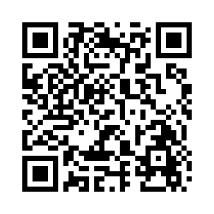
Your Money, Your Goals email sign-up
Use this link: https://go.usa.gov/xdTgT
Or this QR code:
Notes:
Key concept
If participants want to stay in touch, they can join the Your Money, Your Goals listserv.
Suggested script​
If you would like to sign-up to receive Your Money, Your Goals email, use the link or scan the QR code.

Slide 59
Dr. Fallon Wilson, Multicultural Media & Telecommunications Internet Council

Slide 60
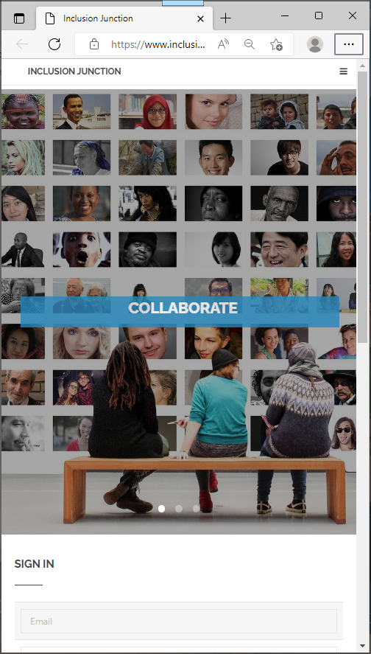
Inclusion Junction
InclusionJunction.org
Create an account
Receive email notification/verification
Await rapid validation (to screen out spamming, fictional characters …)
Create your profile (3-5 minutes)
Search for others
Send private messages to others in Inclusion community

Slide 61
Q & A
Session

Slide 62
Next Steps
Register for the next webinars! ☺
Create your account in www.InclusionJunction.org
Connect with others via Inclusion Junction to co-develop State(s)’ digital equity plans for systemic inclusion
Join fellow inclusion catalysts in scaling and sustaining collective efforts
Plan to attend national systemic inclusion summit for State leadership teams in Atlanta, March 15-16, 2023

Slide 63
Next Webinar #3
Assembling Strategic Inclusion Allies – Enhancing Resources and Measuring Impact
Wednesday, November 2, 2022
1PM to 2PM (ET)

