Slide 1
Connecting States’ Financial, Economic and Digital Inclusion Initiatives
(webinar series)
Webinar # 1
Challenges of Systemic Inclusion - Unpacking Siloed Conversations for Greater Collaboration
Thursday, October 6, 2022
1:00PM (ET) to 2:00PM (ET)

Slide 2
WEBINAR SERIES
Webinar #2: Assembling Strategic Inclusion Allies – Enhancing Resources and Measuring Impact
Monday, October 17, 2022 - 10AM to 11AM (ET)
Resources for digital, economic, educational and financial inclusion that can be integrated for systemic impact.
Webinar #3: Be Kind and Refurbish - Laptops Bundled with Financial & Economic Inclusion Resources
Wednesday, November 2, 2022 – 1PM to 2PM (ET)
Why and how to create sustainable statewide ecosystems for refurbishing and donating computers
Webinar #4: Finding Free & Low-Cost Broadband Bundled with Financial and Economic Inclusion Resources
Wednesday, November 16, 2022 – 4PM to 5PM (ET)
How to leverage drive-imaging to offer inclusion apps and pointers with discounted broadband & devices.
Webinar #5: Encouraging Youth Leadership Development - The Future of Digital and Financial Inclusion
Monday, November 28, 2022 – 1PM to 2PM (ET)
How youth can lead local digital equity needs-sensing and planning while building their own digital, media & financial literacy skills.
Webinar #6: Uncovering Rural Systemic Inclusion Strategies - Outside the Urban Lines
Thursday, December 15, 2022 – 1PM to 2PM (ET)
Challenges, opportunities and lessons learned thus far from systemic inclusion efforts in New Hampshire.

Slide 3
Webinar Agenda:
Welcome/Opening Remarks
Terry Lee, FDIC
Aim of the webinar series (spoiler alert: systemic inclusion)
Dr. Bob McLaughlin, NCDE
Panelists:
Francine Alkisswani, NTIA
Patrick Eichholtz, Bank On Florida
Marquita Robertson, Bank On North Carolina
Dr. Gerry Hanley, Skills Commons
Michelle Henry, JPMorgan Chase
Nischal Chandra, Universal AI, Inc.
Q & A
Next steps

Slide 4
Panelists Thoughts:
Promising and impactful inclusion resources
How their efforts stand ready to support those addressing other inclusion dimensions
How those addressing other inclusion dimensions can enhance their desired outcomes
Systemic Inclusion = Financial, Economic Educational & Digital Inclusion

Slide 5
The views expressed in this presentation are the presenters and do not necessarily represent the views of the Federal Deposit Insurance Corporation

Slide 6
Aims of the webinar series
Dr. Robert McLaughlin, NCDE
Title III (Digital Equity Act) of Infrastructure Bill allocates $1.25 billion to States to develop and implement State digital equity plans in support of economic inclusion impact
States submit plans/funding requests summer 2023 for four-years implementation funding
Act requires plans based on need sensing with underrepresented, key stakeholders
Opportunity & challenge to bring together underrepresented and leaders in otherwise disparate inclusion siloes to design for systemic impact on intergenerational poverty
Systemic Inclusion = “FEED” – financial, economic, educational & digital
FDIC webinar series intended to help local, state and national inclusion leaders connect across inclusion dimensions, with planning led by underserved and committed to impact on poverty
National summit, March 15-16, 2023, in Atlanta for state systemic inclusion teams to share most promising strategies for integration in each other’s State plans
www.InclusionJunction.org enable inclusion leaders to share about their efforts and find colleagues to collaborate with

Slide 7
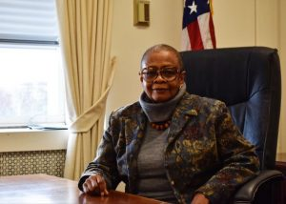
Francine Alkisswani, NTIA
Telecommunications Policy Analyst, Office of Minority Broadband Initiatives

Slide 8
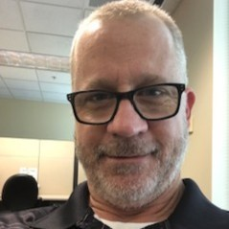
Patrick Eichholtz, Bank On Florida
Director

Slide 9

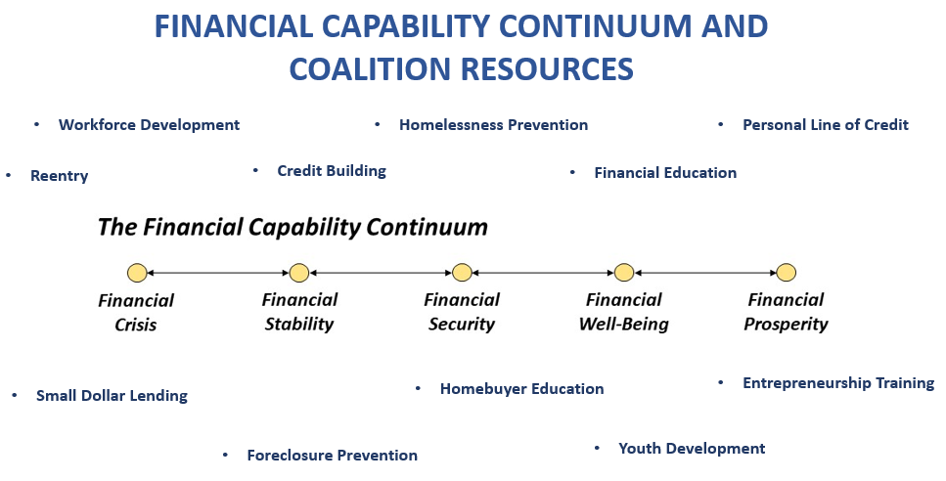


Power of a Bank On Coalition

Slide 10
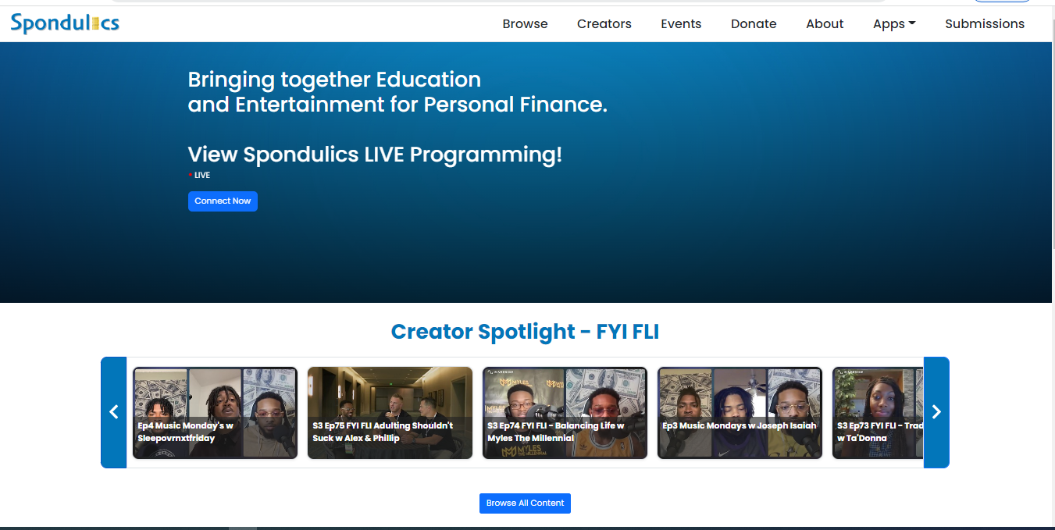
Edutainment Reaching The World - Spondulics

Slide 11
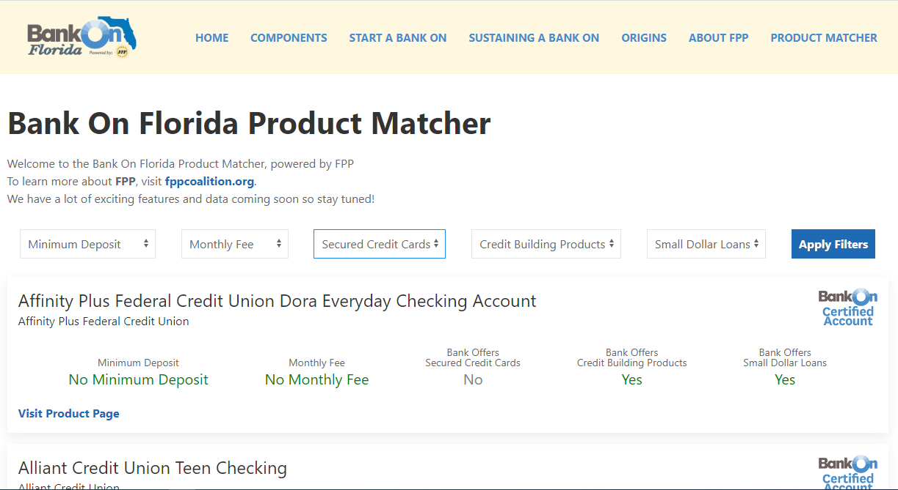
Automating the Integration Process w/the FPP Coalition/Bank On Florida Product Matcher

Slide 12
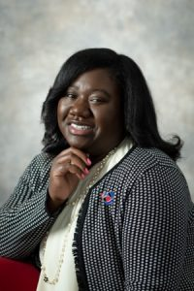
Marquita Robertson, Bank On North Carolina
Executive Director, The Collaborative

Slide 13

The Collaborative
Closing the wealth gap in North Carolina by ensuring that everyone has a pathway to prosperity
Bank On North Carolina
This is initiative expands access to safe and affordable bank accounts to all North Carolinians through nonpredatory bank accounts for everyone, vetted financial inclusion resources and a statewide coalition.
Capacity Building for Nonprofits
The Collaborative places paid, fulltime volunteers at nonprofits focused on financial inclusion for a year to build capacity, create programs and strategies combating poverty in the community.
Consumer Advocacy and Asset Building Coalition
The advocacy arm of The Collaborative, the NC Assets Alliance, is a statewide asset building coalition comprised of more than 200 member organizations representing all areas of economic improvement.

Slide 14
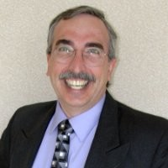
Gerry Hanley, SkillsCommons & MERLOT
Executive Director

Slide 15

FEEDing the BankOn Pipelines with
Open Educational Resources and Services
Scaling and sustaining systemic inclusion (FEED) programs efficiently will require open and freely available “supply lines” of instructional and program management materials for BankOn programs. (No need to “reinvent the wheel)
An open and online library of teaching and learning materials that any person participating in a BankOn, FDIC, NCDE, Dept of Labor, Dept of Education, or… program could find and use reliably and efficiently.
SkillsCommons (www.skillscommons.org) provides an open, online public library for workforce training materials, created for and funded by the U.S. Dept of Labor (part of the $1.9 B TAACCT program for all 50 states since 2014).
will expand its library to include more FEED (Financial, Economic, Educational, and Digital) materials can be available to all.

Slide 16
Supporting the Capacity Building of BankOn Programs (and others)
Challenge: Banks have enthusiastic subject matter experts on how to become “fully banked” but they often could benefit from support to become better teachers of their expertise
Strategy: SkillsCommons has self-paced tutorials and webinars for enabling “Industry Experts to become Excellent Instructors”
Challenge: There will be very diverse groups of individuals and organizations delivering systemic inclusion programs. How do we support consistent quality and reliability of programs while enabling local customization of programs?
Strategy: SkillsCommons can provide a library of curated, free, and online materials that will be licensed so people can reuse, revise, remix, retrain, and redistribute the open educational resources as they wish (with TA)

Slide 17
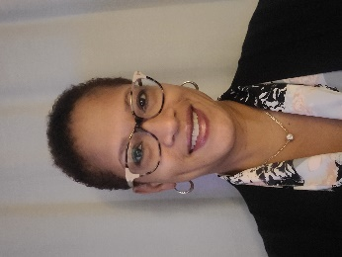
Michelle Henry, JPMorgan Chase
East Region Executive for Community Engagement

Slide 18



Our $30 Billion Racial Equity Commitment
Five-Year Commitment, by the end of 2025
Structural barriers in the U.S. have created profound racial inequalities, made worse by the pandemic. JPMorgan Chase is committed to helping close the racial wealth gap and driving economic inclusion by providing more opportunities for homeownership, access to affordable housing, entrepreneurship and bolstering financial health.
See the progress we’re making at:
jpmorganchase.com/racialequity

Slide 19
Our $30 Billion Racial Equity Commitment
Five-Year Commitment, by the end of 2025
Increase homeownership and expand affordable rental housing
Improve financial health and access to banking, and invest in minority-owned and -led financial intuitions
Grow small businesses and spend more with diverse suppliers
Accelerate investment in employees and build a more diverse and inclusive workforce
See the progress we’re making at:
jpmorganchase.com/racialequity

Slide 20
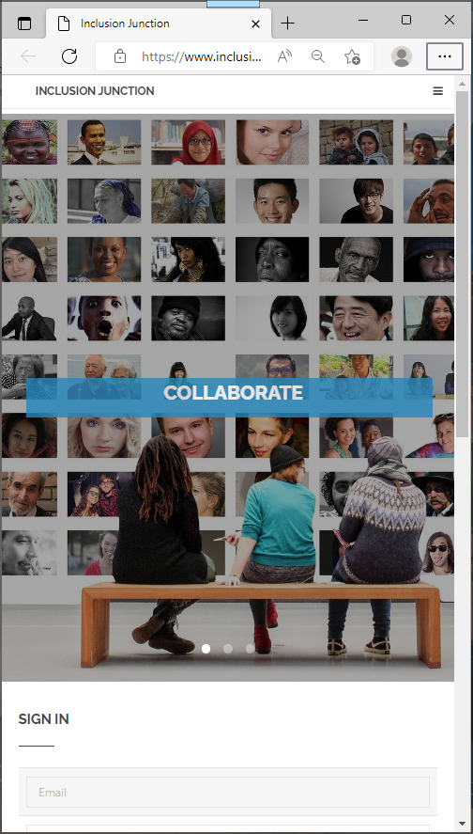
Nischal Chandra, Universal AI, Inc.
InclusionJunction.org
Create an account
Receive email notification/verification
Await rapid validation (to screen out spamming, fictional characters …)
Create your profile (3-5 minutes)
Search for others
Send private messages to others in Inclusion community

Slide 21
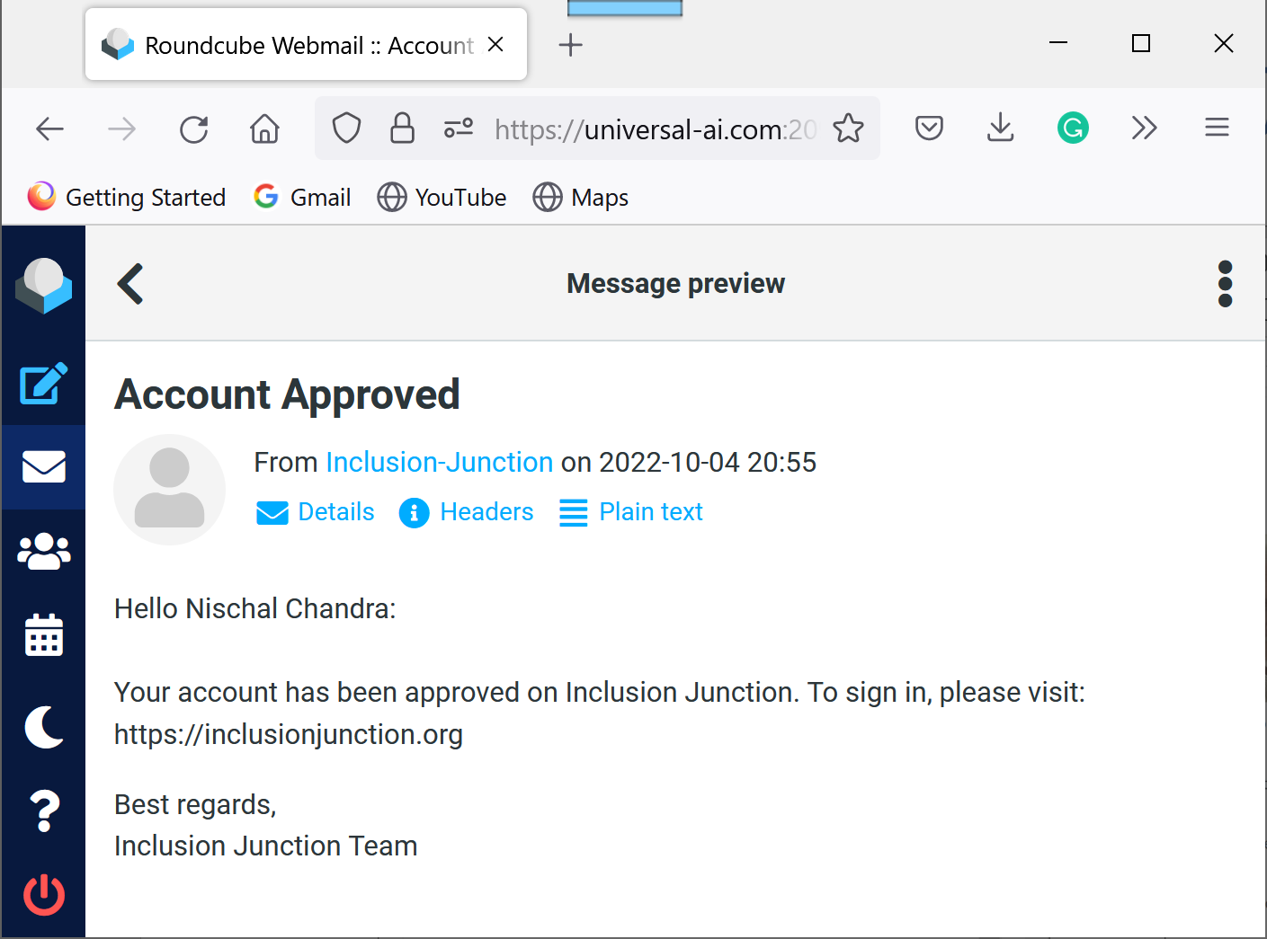
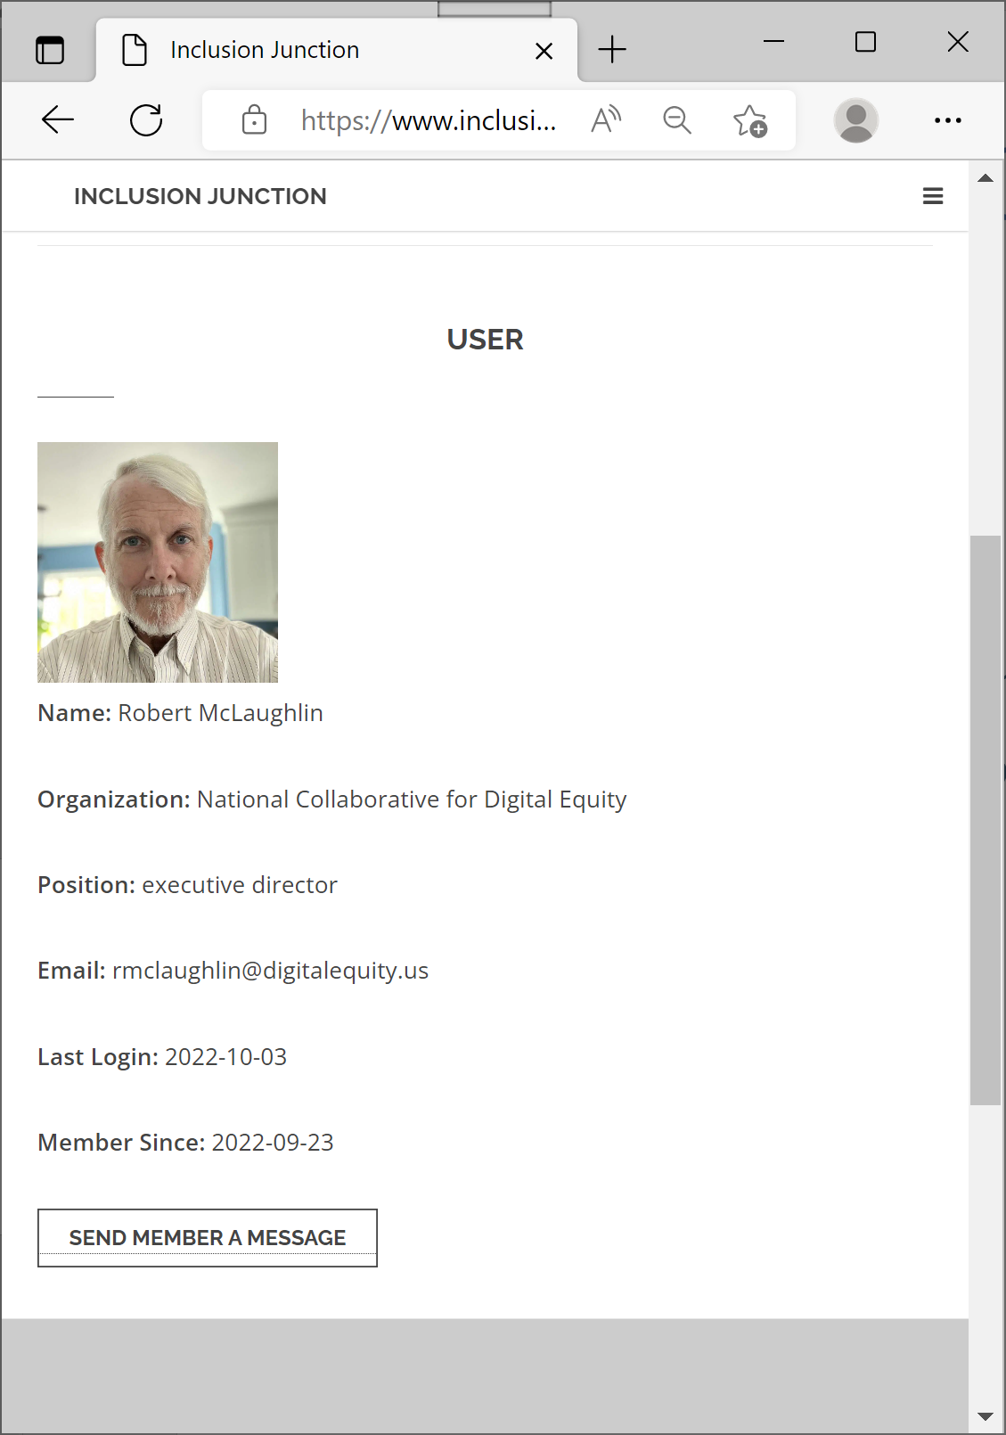
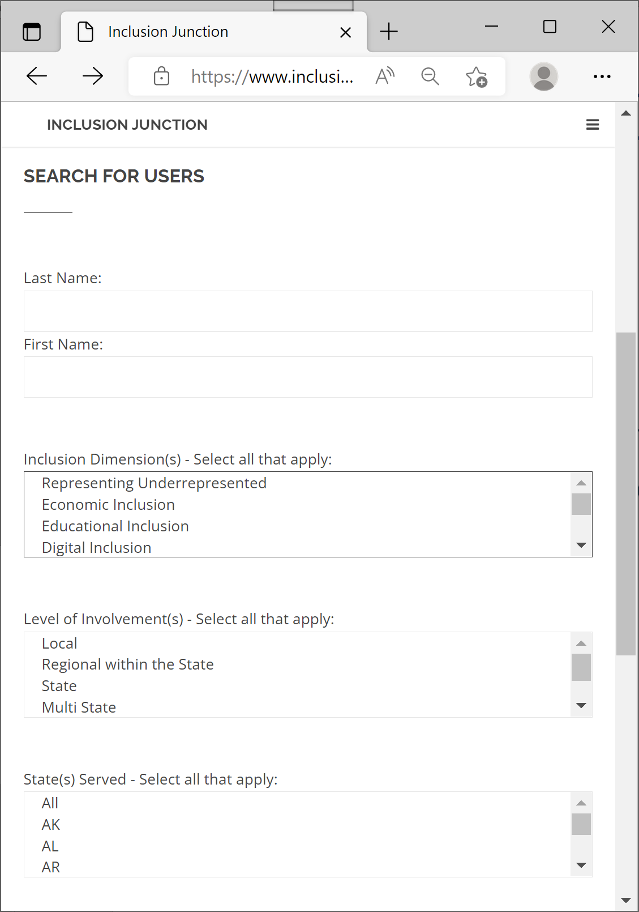
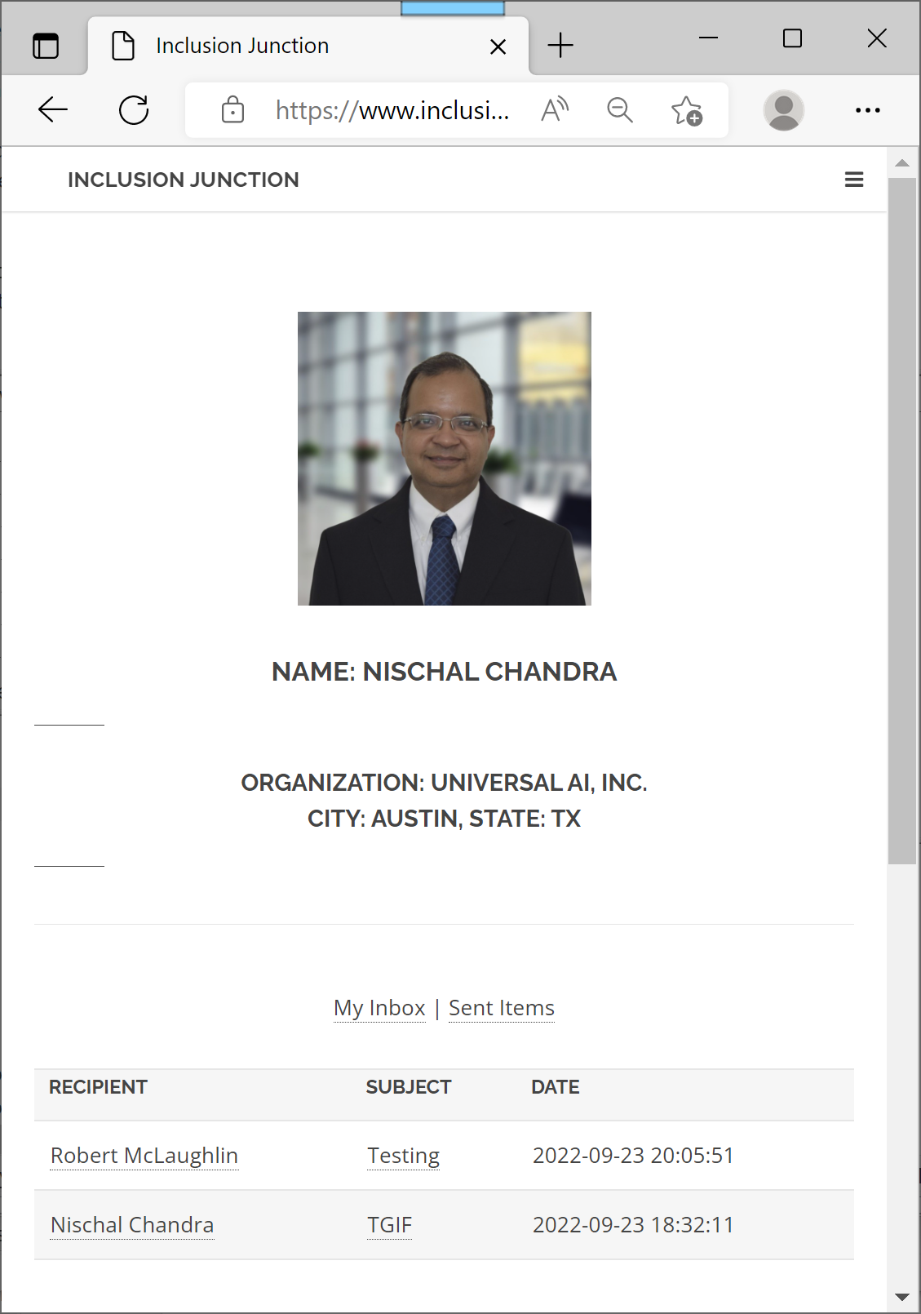
Nischal Chandra, Universal AI, Inc. (cont.)

Slide 22
Q & A
Session

Slide 23
Next Steps
Register for the next webinars! ☺
Create your account in www.InclusionJunction.org
Connect with others via Inclusion Junction to co-develop State(s)’ digital equity plans for systemic inclusion
Join fellow inclusion catalysts in scaling and sustaining collective efforts
Plan to attend national systemic inclusion summit in Atlanta, March 15-16, 2023

Slide 24
Next Webinar #2
Assembling Strategic Inclusion Allies – Enhancing Resources and Measuring Impact
Monday, October 17, 2022
10AM to 11AM (ET)

