Slide 1
Connecting States’ Financial, Economic and Digital Inclusion Initiatives (webinar series) Webinar # 3 Refurbished Laptops with Financial & Economic Inclusion Resources
Wednesday, November 2, 2022
1:00PM (ET) to 2:00PM (ET)

Slide 2
WEBINAR SERIES Webinar #4: Finding Free & Low-Cost Broadband Bundled with Financial and Economic Inclusion Resources Wednesday, November 16, 2022 – 4PM to 5PM (ET) How to leverage drive-imaging to offer inclusion apps and pointers with discounted broadband & devices. Webinar #5: Encouraging Youth Leadership Development - The Future of Digital and Financial Inclusion Monday, November 28, 2022 – 1PM to 2PM (ET) How youth can lead local digital equity needs-sensing and planning while building their own digital, media & financial literacy skills. Webinar #6: Uncovering Rural Systemic Inclusion Strategies - Outside the Urban Lines Thursday, December 15, 2022 – 1PM to 2PM (ET) Challenges, opportunities and lessons learned thus far from systemic inclusion efforts in New Hampshire.

Slide 3
Webinar Agenda:
Welcome/Opening Remarks
Terry Lee, FDIC
Aim of the webinar series (spoiler alert: systemic inclusion)
Dr. Bob McLaughlin, NCDE
Panelists:
Mike Logan, Bluum
Tom Finn, AVID Products
Sarah Segrest, Octosmos LLC
Dr. Gerry Hanley, SkillsCommons & MERLOT
Bill Mills, Florida Prosperity Partnership
Q & A
Next steps

Slide 4
Panelists Thoughts: Systemic Inclusion = Financial, Economic Educational & Digital Inclusion -------------------------- Computers & Headsets bundled with Inclusion Resources More than a “computer bundle”… … a platform for Access, Inclusion & Connectedness Scalable, Tangible & Impactful Program Sustainable & Responsible Model Enabled by purpose-driven, committed and capable thought-leaders/companies

Slide 5
The views expressed in this presentation are the presenters and do not necessarily represent the views of the Federal Deposit Insurance Corporation

Slide 6
Aims of the webinar series
Dr. Robert McLaughlin, NCDE
Opportunity to bring together leaders of underserved and in key dimensions of inclusion for systemic impact on intergenerational poverty
Systemic inclusion = FEED: melding financial, economic, educational & digital inclusion
Webinar series to help each State’s leaders in inclusion and in meeting priority concerns of the underserved plan & work together, so that $1 billion in NTIA grants for State digital equity plans for economic inclusion are highly impactful
National summit in Atlanta, March 15-16, 2023 for State systemic inclusion planning teams to share promising and proven inclusion strategies & resources
www.InclusionJunction.org enabling Inclusion and DEI leaders to locate one another much more easily

Slide 7
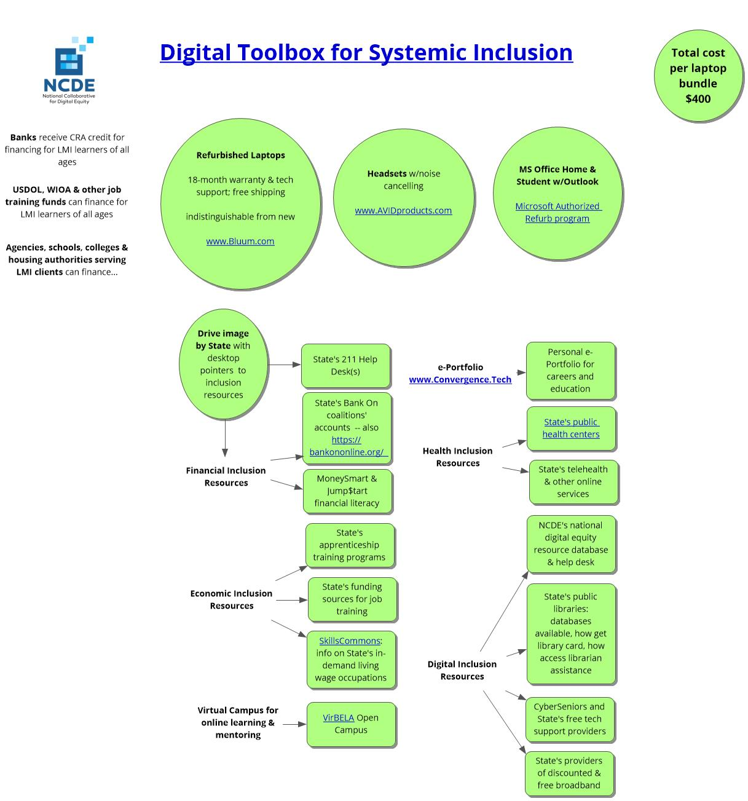

Slide 8
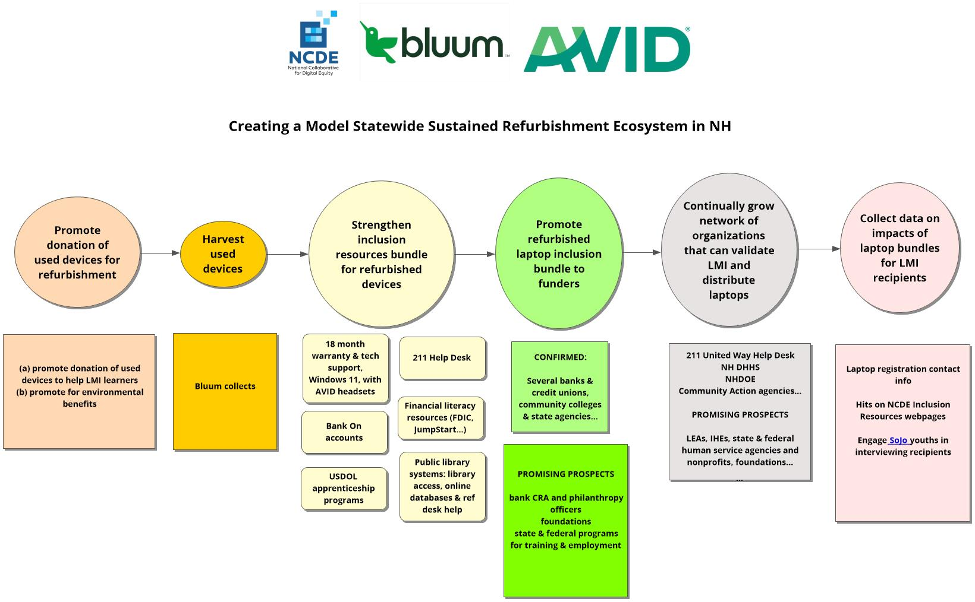

Slide 9
Mike Logan, Bluum * scalable approach to enabling funders to affordably finance well-equipped laptops bundled with inclusion resources

Slide 10
Bluum Technology Mike Logan Senior Vice President

Slide 11
Technology Solutions Company:
Meeting rooms and learning centers
ITAD and technology recycling programs
Computing solutions, networking, cybersecurity
Digital signage, wayfinding solutions, audio-video systems
Experiential technology for customer centric applications
Mike Logan
Mike.logan@bluumtech.com

Slide 12


Landfill
Electronics in landfills release heavy metals like mercury, arsenic and lead. And while only 2% of our landfills are made up of electronics, that 2% is responsible for 70% of our toxic waste. Despite this, less than 20% of electronics are recycled properly.
The device is refreshed.
Device Recertified:
Data destruction documented
Device is scrubbed clean
Cosmetic damage is minimized
Hard drive is replaced
Battery is replaced
Screen hinges are tightened
Device is tested and quality checked
Windows, Office, and other programs are loaded
Windows device, 8th gen processor, camera, 14” display
(3-4 years old)
Evaluate device condition
Parts harvested, metals removed, plastic recycled
Device is re-introduced into the market for additional service!!!

Slide 13
Tom Finn, AVID Products

Slide 14

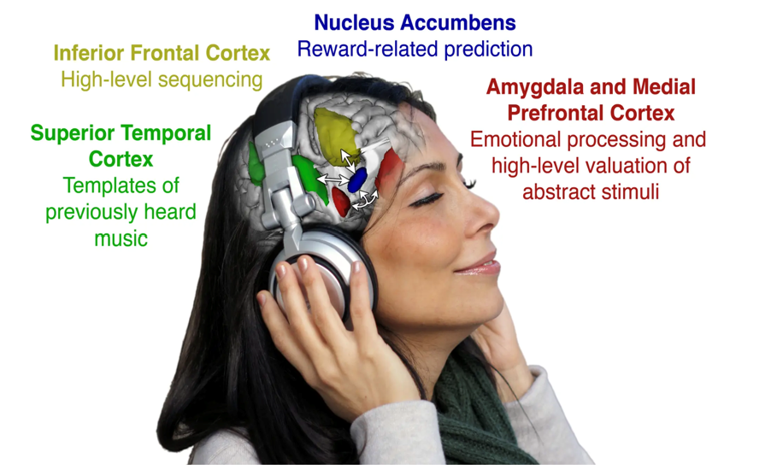

Amplifying Your Future
Computers & Headsets are the vehicles of access and connectedness
Headsets designed for everyone’s success:
Deliver (speakers) and capture (mics) sound
Eliminate ambient distractions
Enhance attention, focus, engagement, efficacy
Enable user to hear and to be heard clearly
Provide sense of self & agency
The Impact of Audio
4.5 Million US households with children lack consistent access to a connected device
17% of children ages 3-18 live in US households without computer access
" By advocating for and supporting digital access for the underserved and underrepresented, we encourage and grow the next generation of learners, leaders, and problem solvers. With our partners in Bluum and NCDE, we have a program that not only provides affordable devices to low- and moderate-income learners, but also the crucial inclusive resources that create and provide access to opportunities for them to make a difference.”
Tom Finn, President & CEO
AVID Mission | Essential Audio Devices: Whitepaper | Podcasts: Educational EPOCH Change and Active Listening

Slide 15

Sarah Segrest, Octosmos LLC

Slide 16
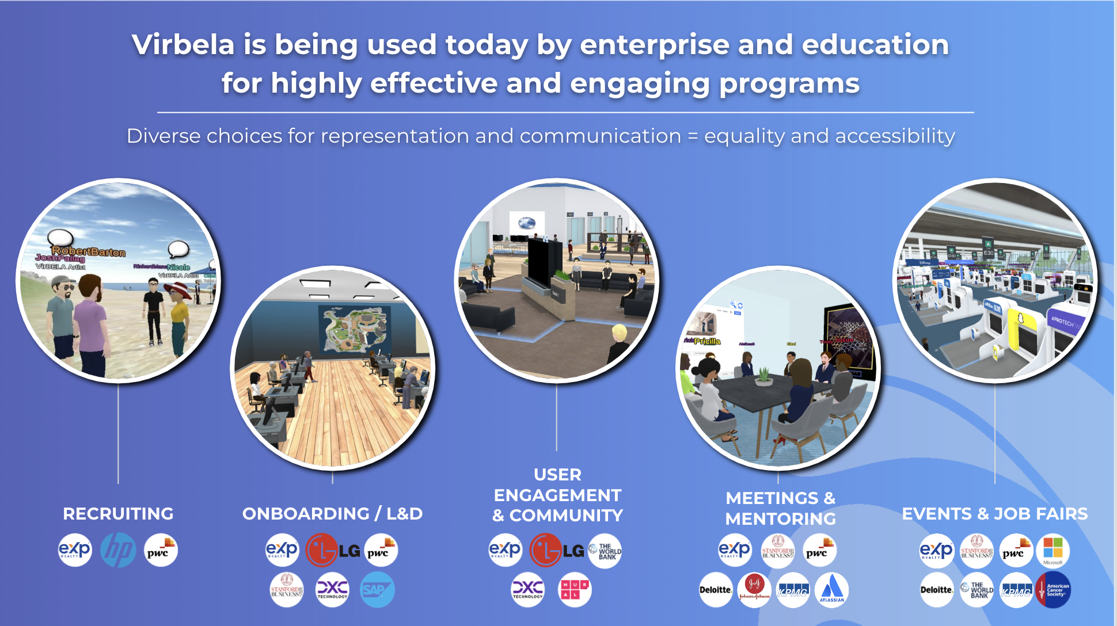
Notes:
bundling VirBELA with laptops * role of VirBELA environment to foster engagement based on quality of one’s ideas not one’s appearance

Slide 17
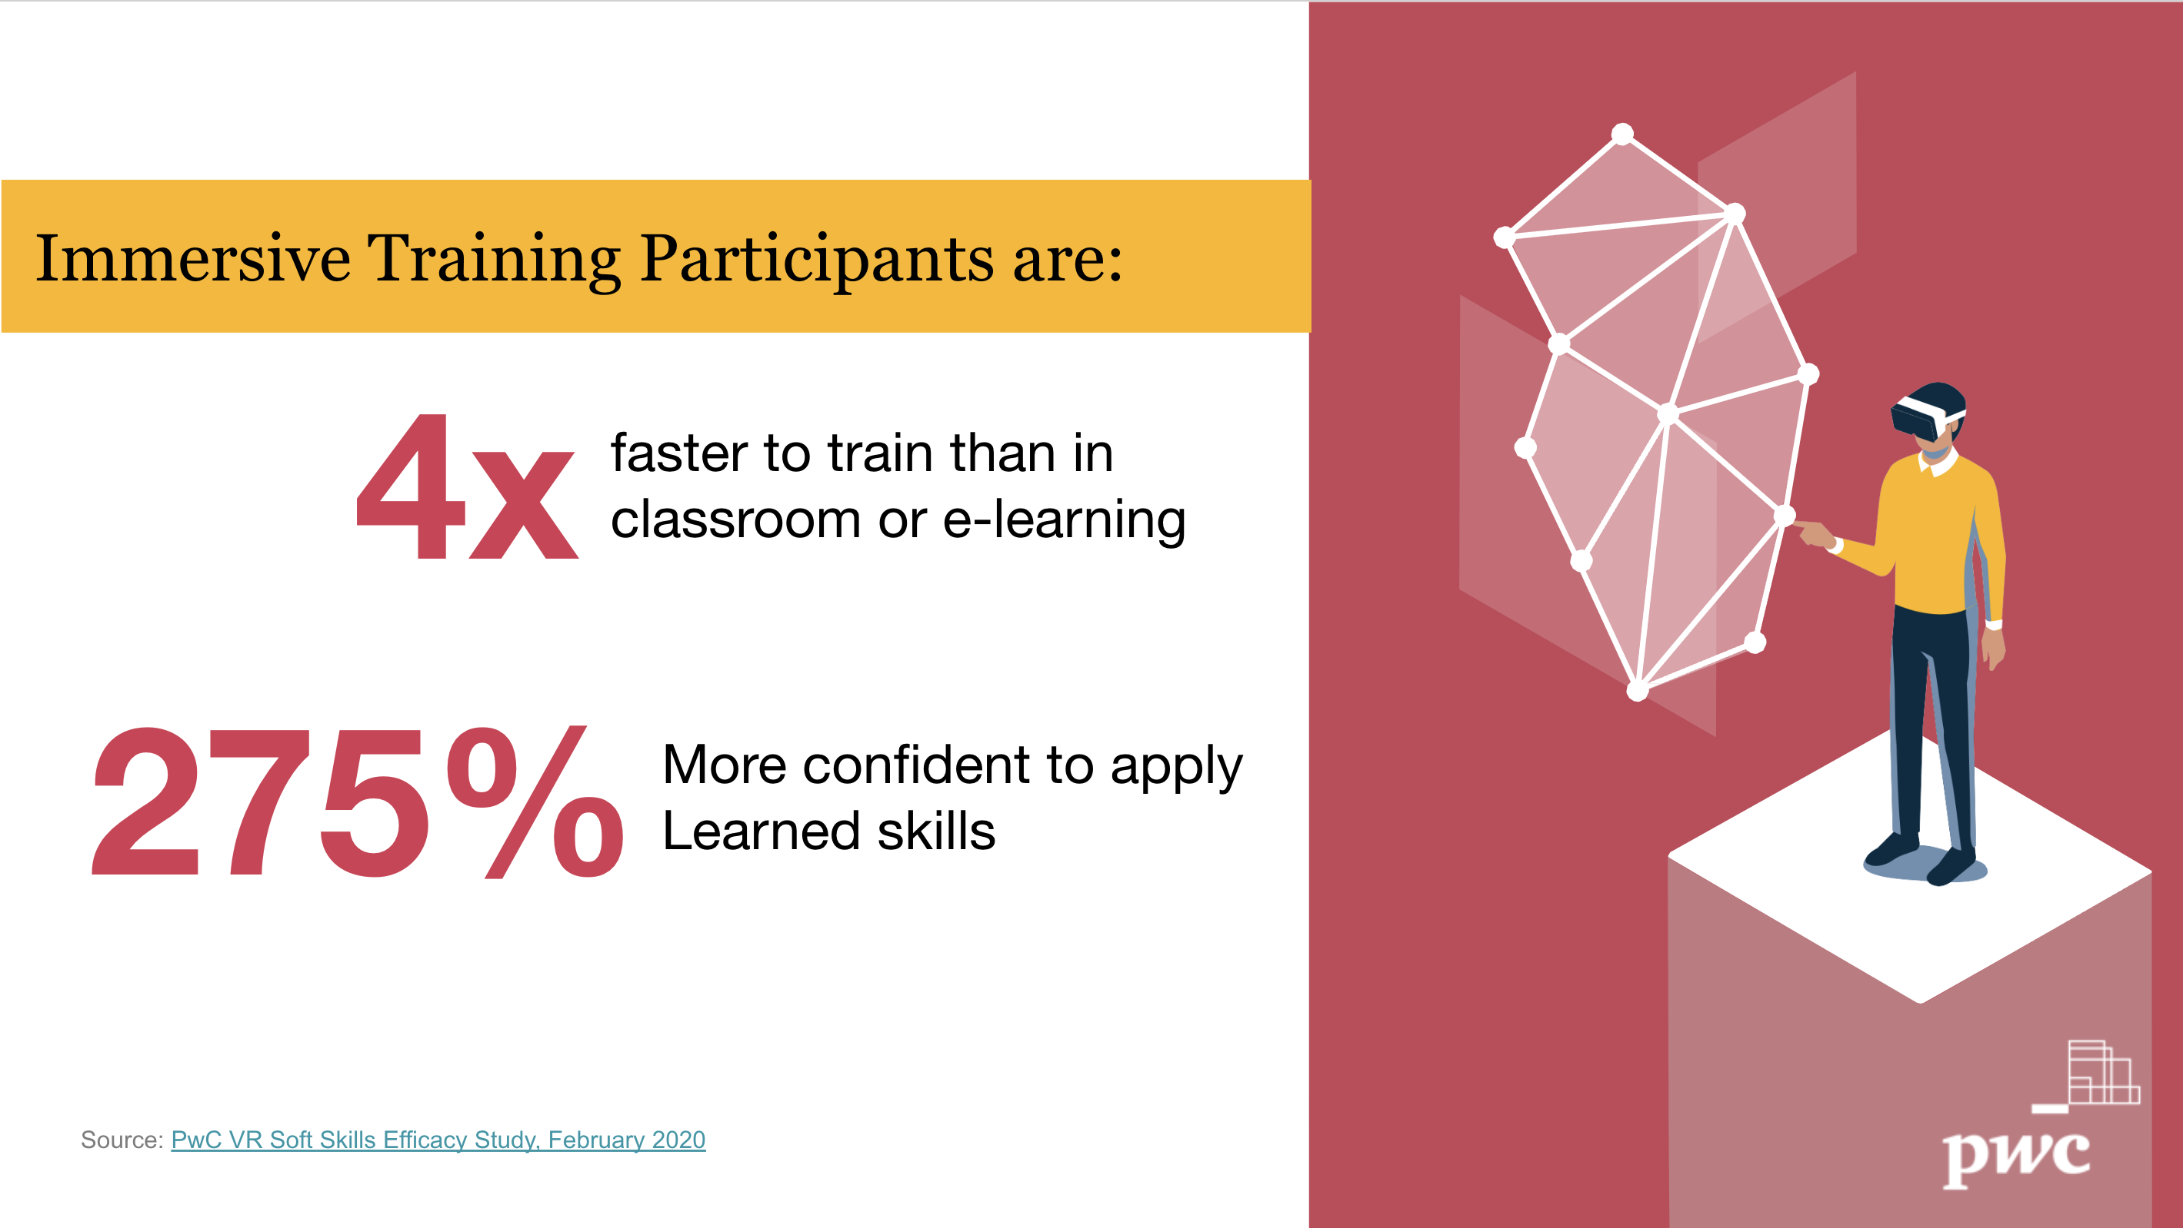
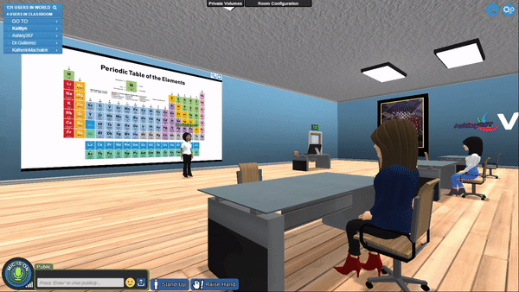
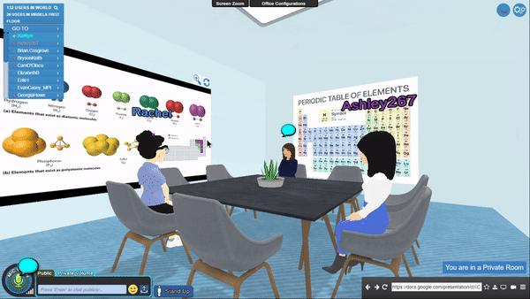
Notes:
* pilot financial literacy classrooms (a) teach fin lit volunteers how to coach/teach (b) provide fin lit instructional materials in classroom for fin lit for K12, financial aid borrowing, and learning to manage money when get living wage income for 1st time

Slide 18

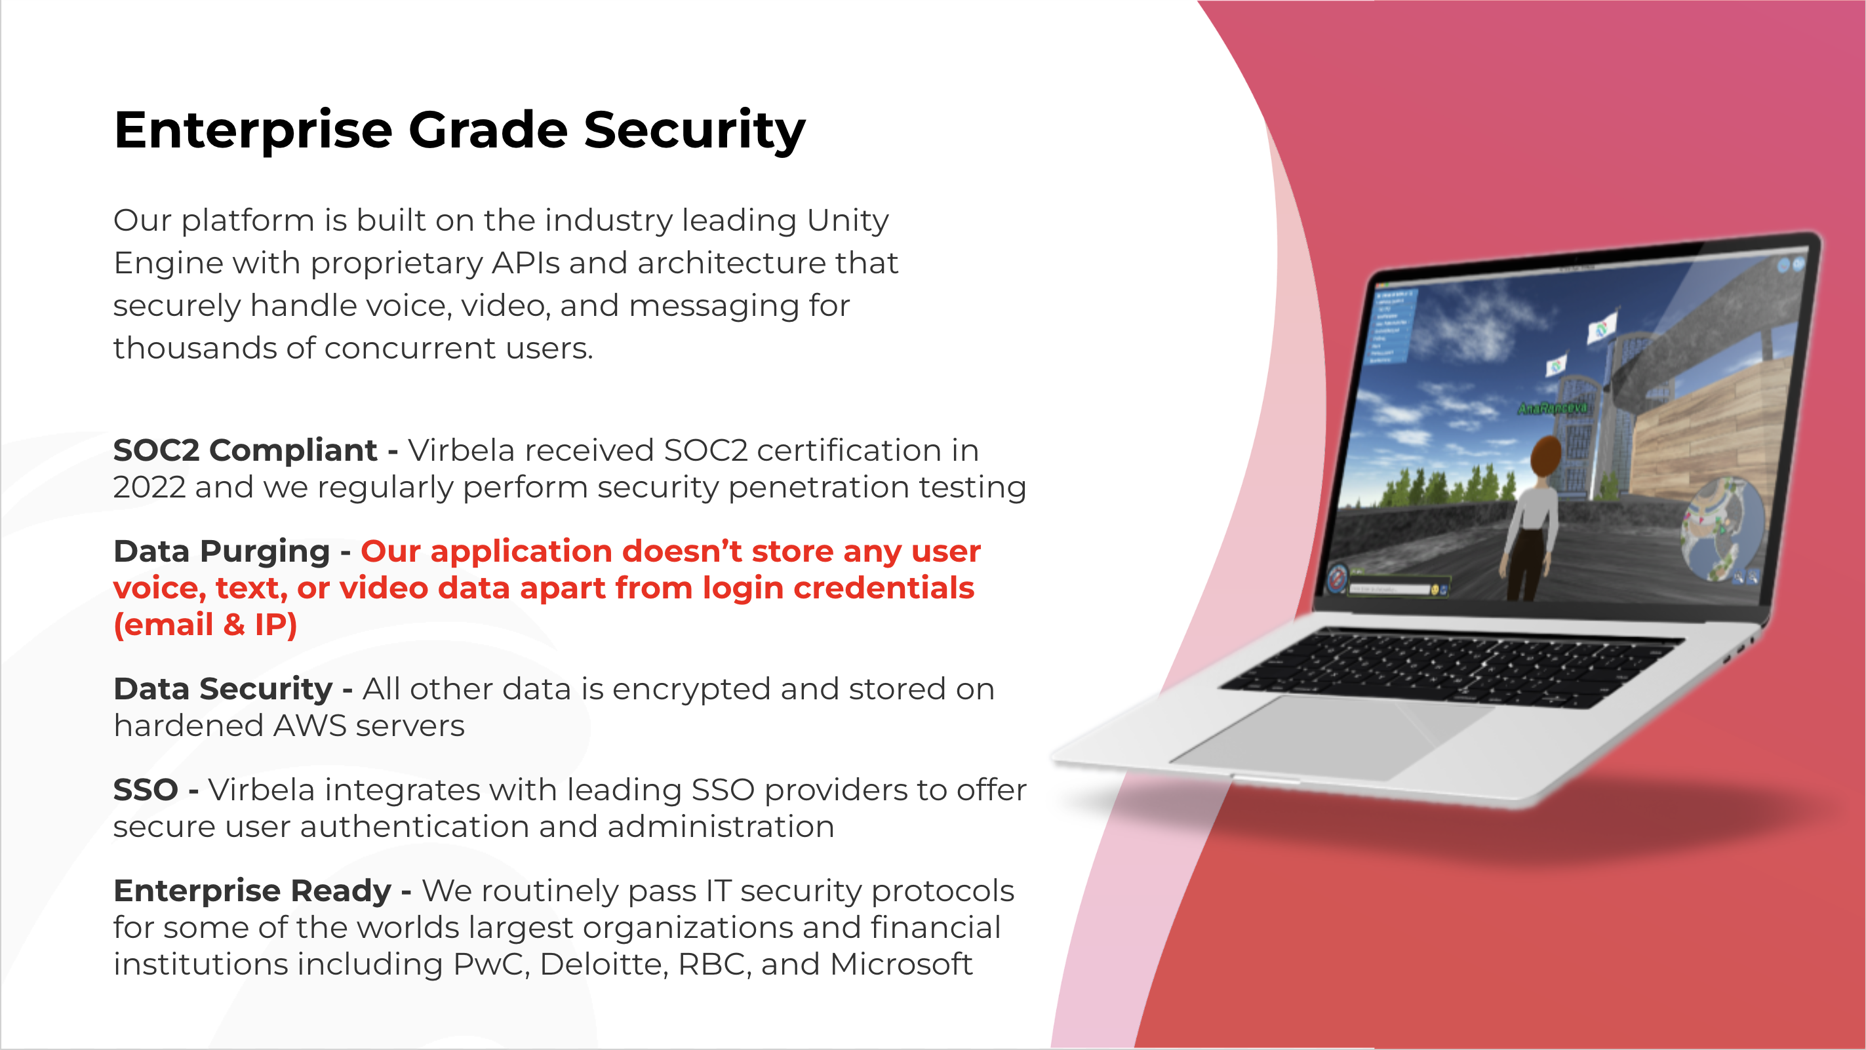

Slide 19
Finding Career Pathways to Sustainable Family Income
Gerry Hanley
SkillsCommons and MERLOT
California State University, Long Beach

Slide 20
Discovering Dreams Are Possible
Career One Stop is a U.S. Department of Labor website that provides free and open educational resources about a wide range of career pathways
What is the typical income of a career?
Is the career opportunity growing in my future?
What are the educational requirements?
Where can I get the career training to pursue this career?
And MORE!
https://www.careeronestop.org/

Slide 21
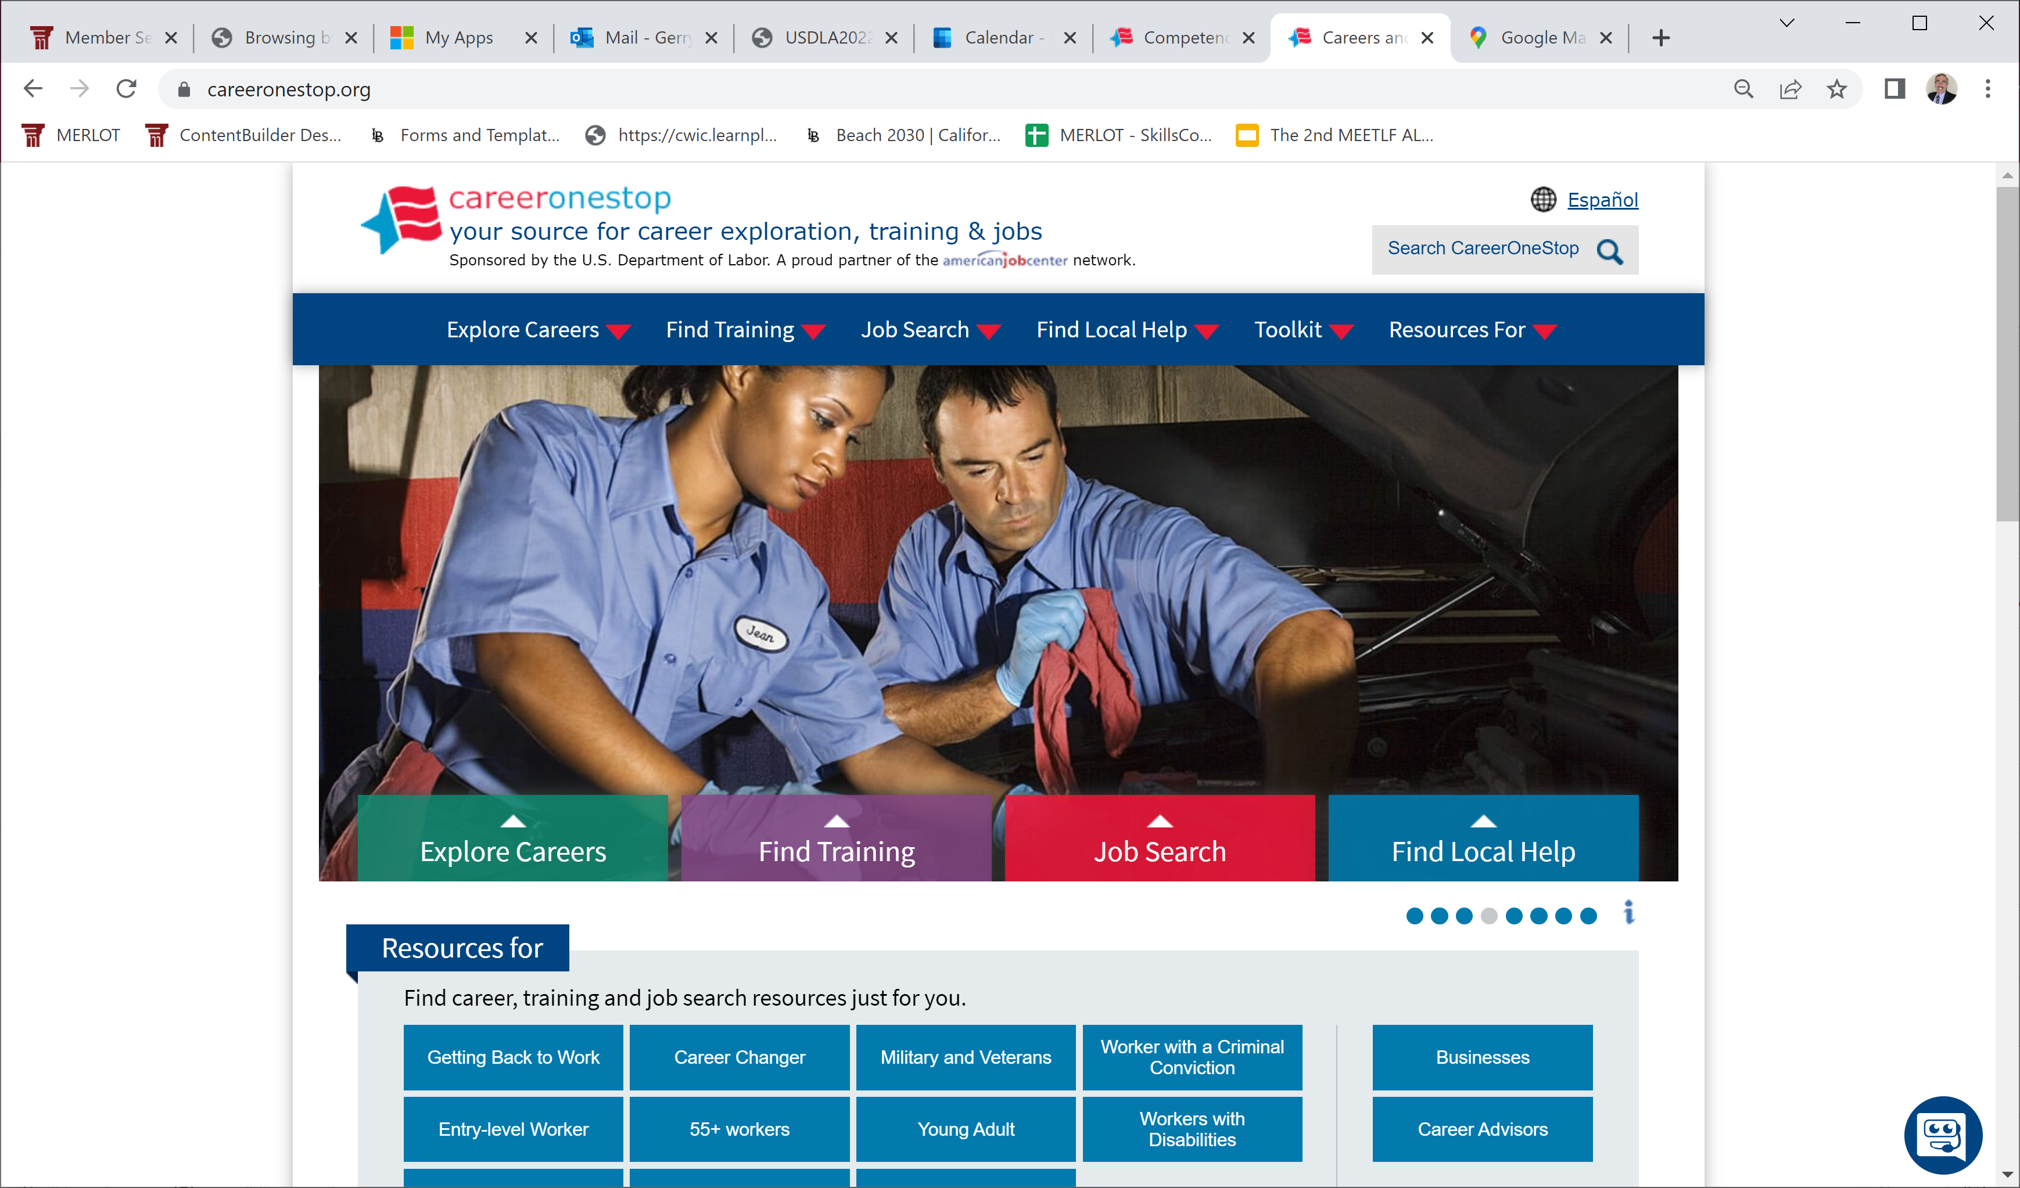
Exploring Career Pathways

Slide 22
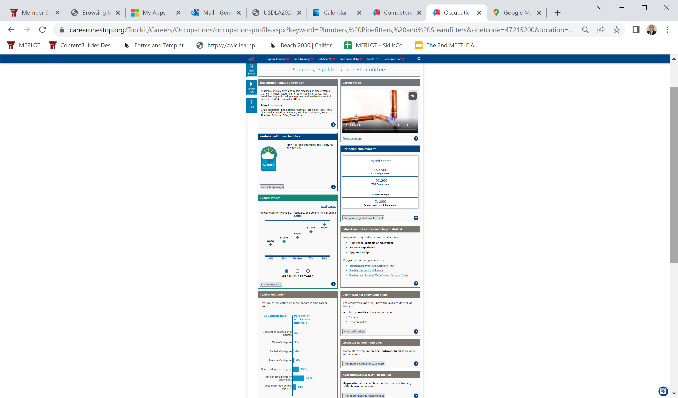
Plumbers, Pipefitters, & Steamfitters

Slide 23
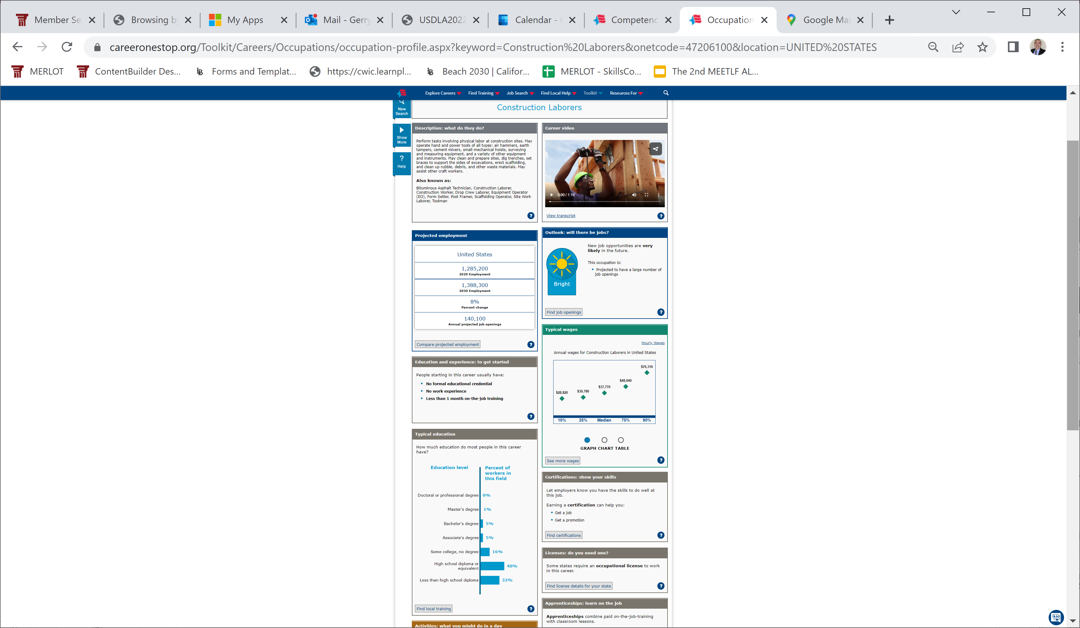
Construction Laborers

Slide 24
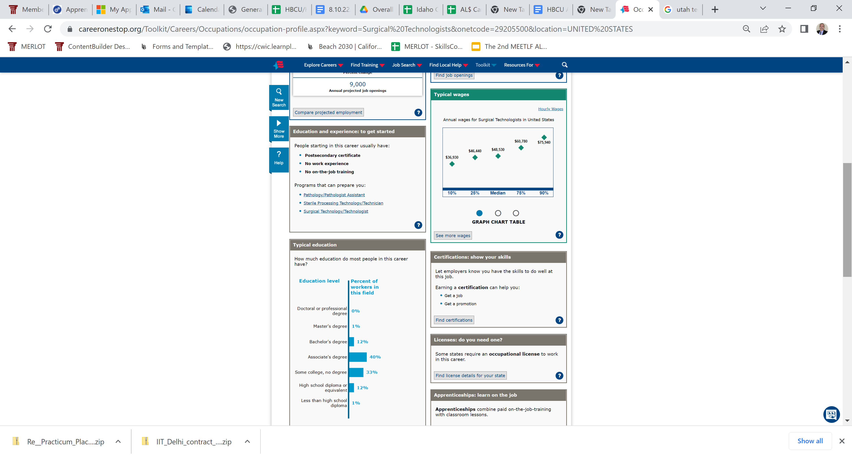
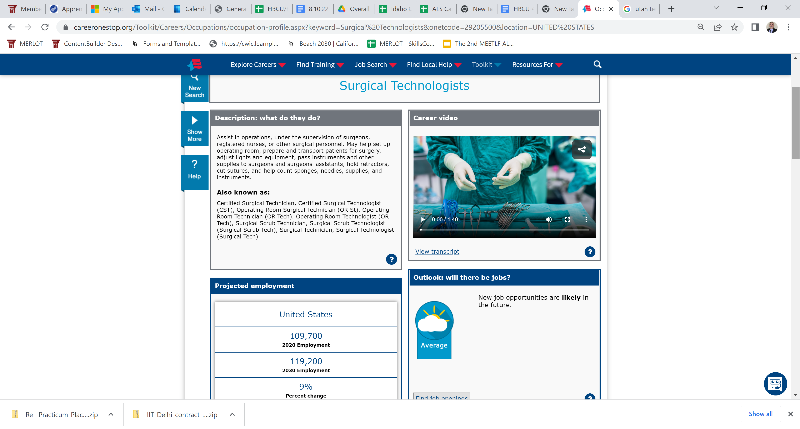
Surgical Technologists
Notes:
Medium income $48K

Slide 25
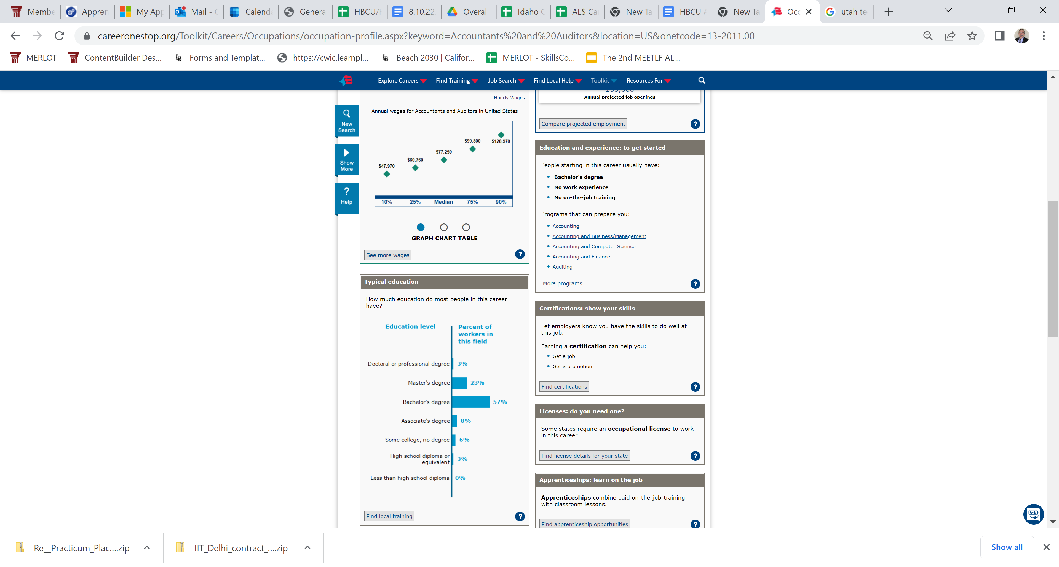
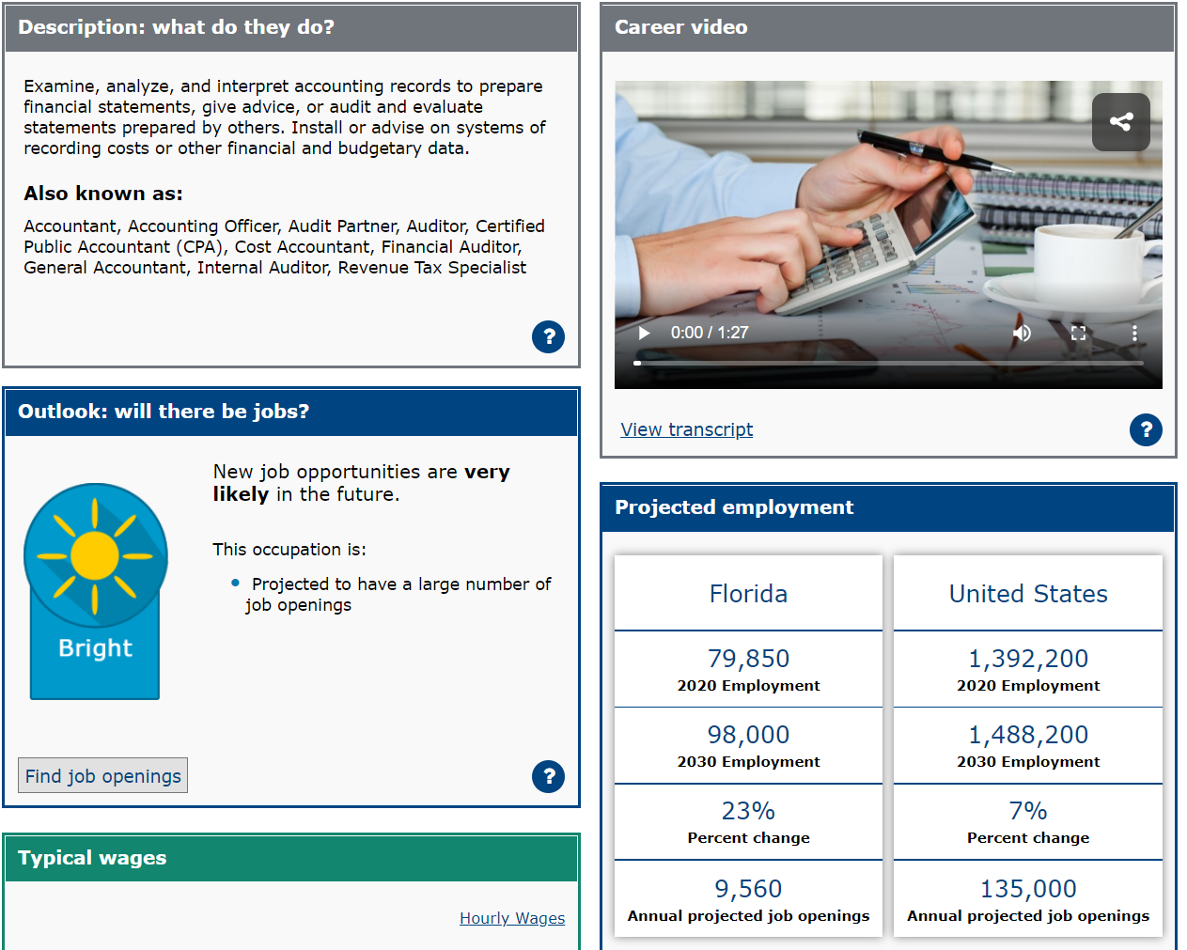
Accountants and Auditors

Slide 26
Finding & Using FREE Workforce Training Materials
SkillsCommons (www.skillscommons.org) provides FREE and open workforce training materials.
Over 60,000 free and open online materials in manufacturing, healthcare, information technology, energy & sustainability, facilities and business operations, agriculture, construction, oil & gas operations,… curated by industry & education experts
You can download and customize materials for your local training programs.
Leverage the $1.9 Billion investment by the U.S. Dept of Labor

Slide 27
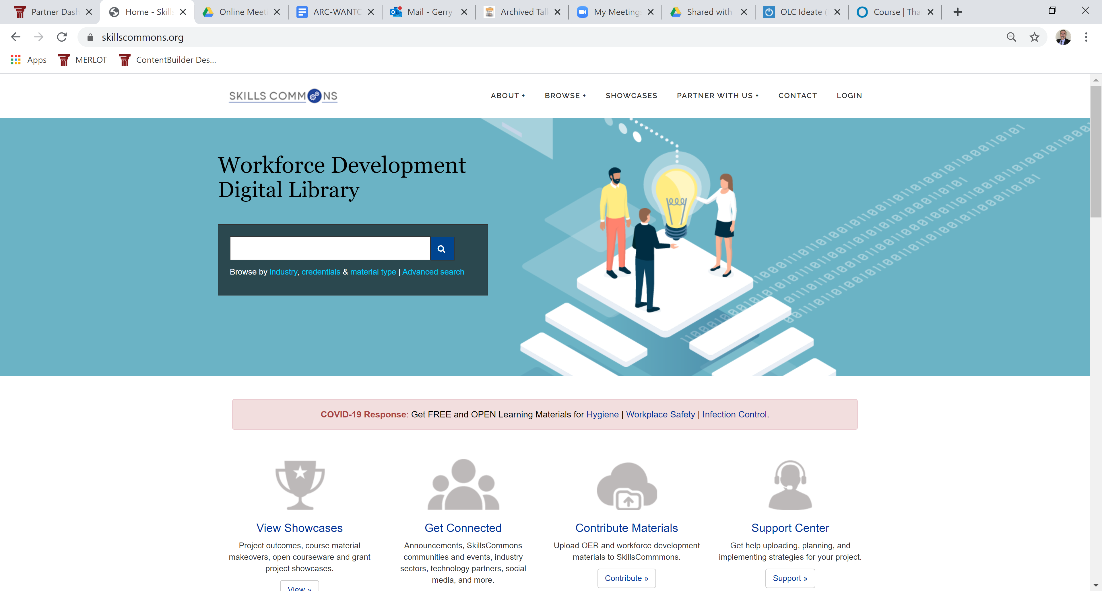
www.skillscommons.org

Slide 28
Apprenticeship Programs: Earn While You Learn
Apprenticeship programs: Where people learn to perform the skills required to complete the job.
Designing apprenticeship programs then becomes a critical element of competency-based education.
SkillsCommons provides both open educational resources and open educational practices for designing successful apprenticeship programs. You can also find models for the evaluation of apprentices’ demonstration of competencies.

Slide 29
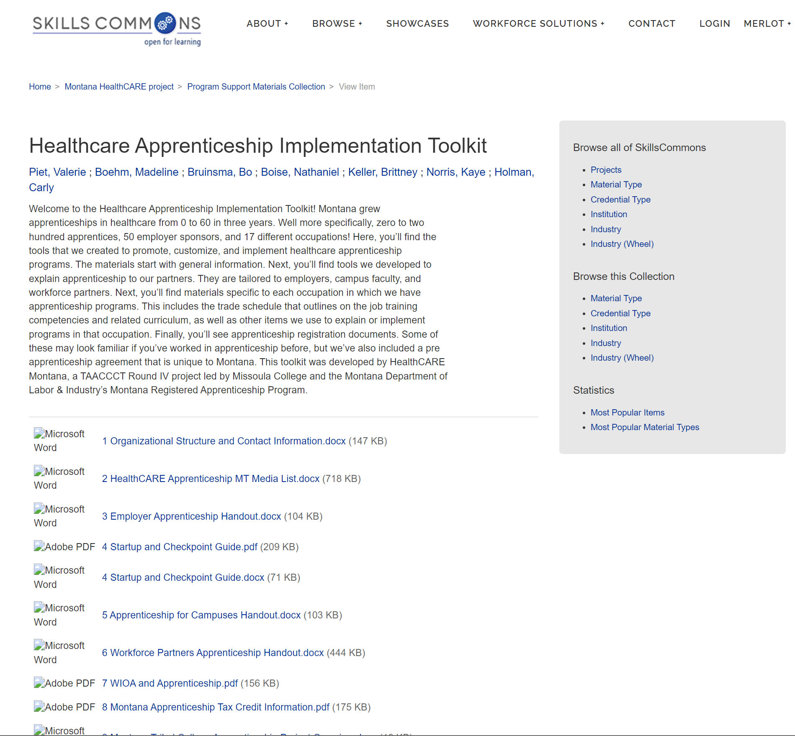
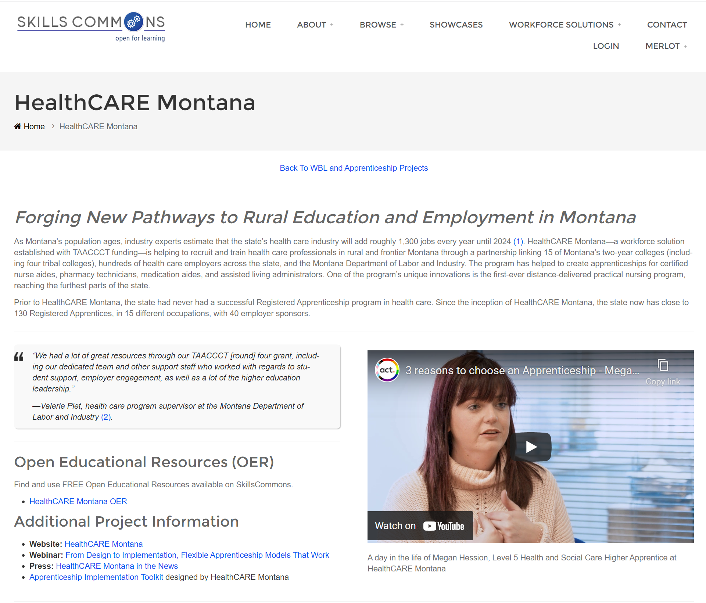
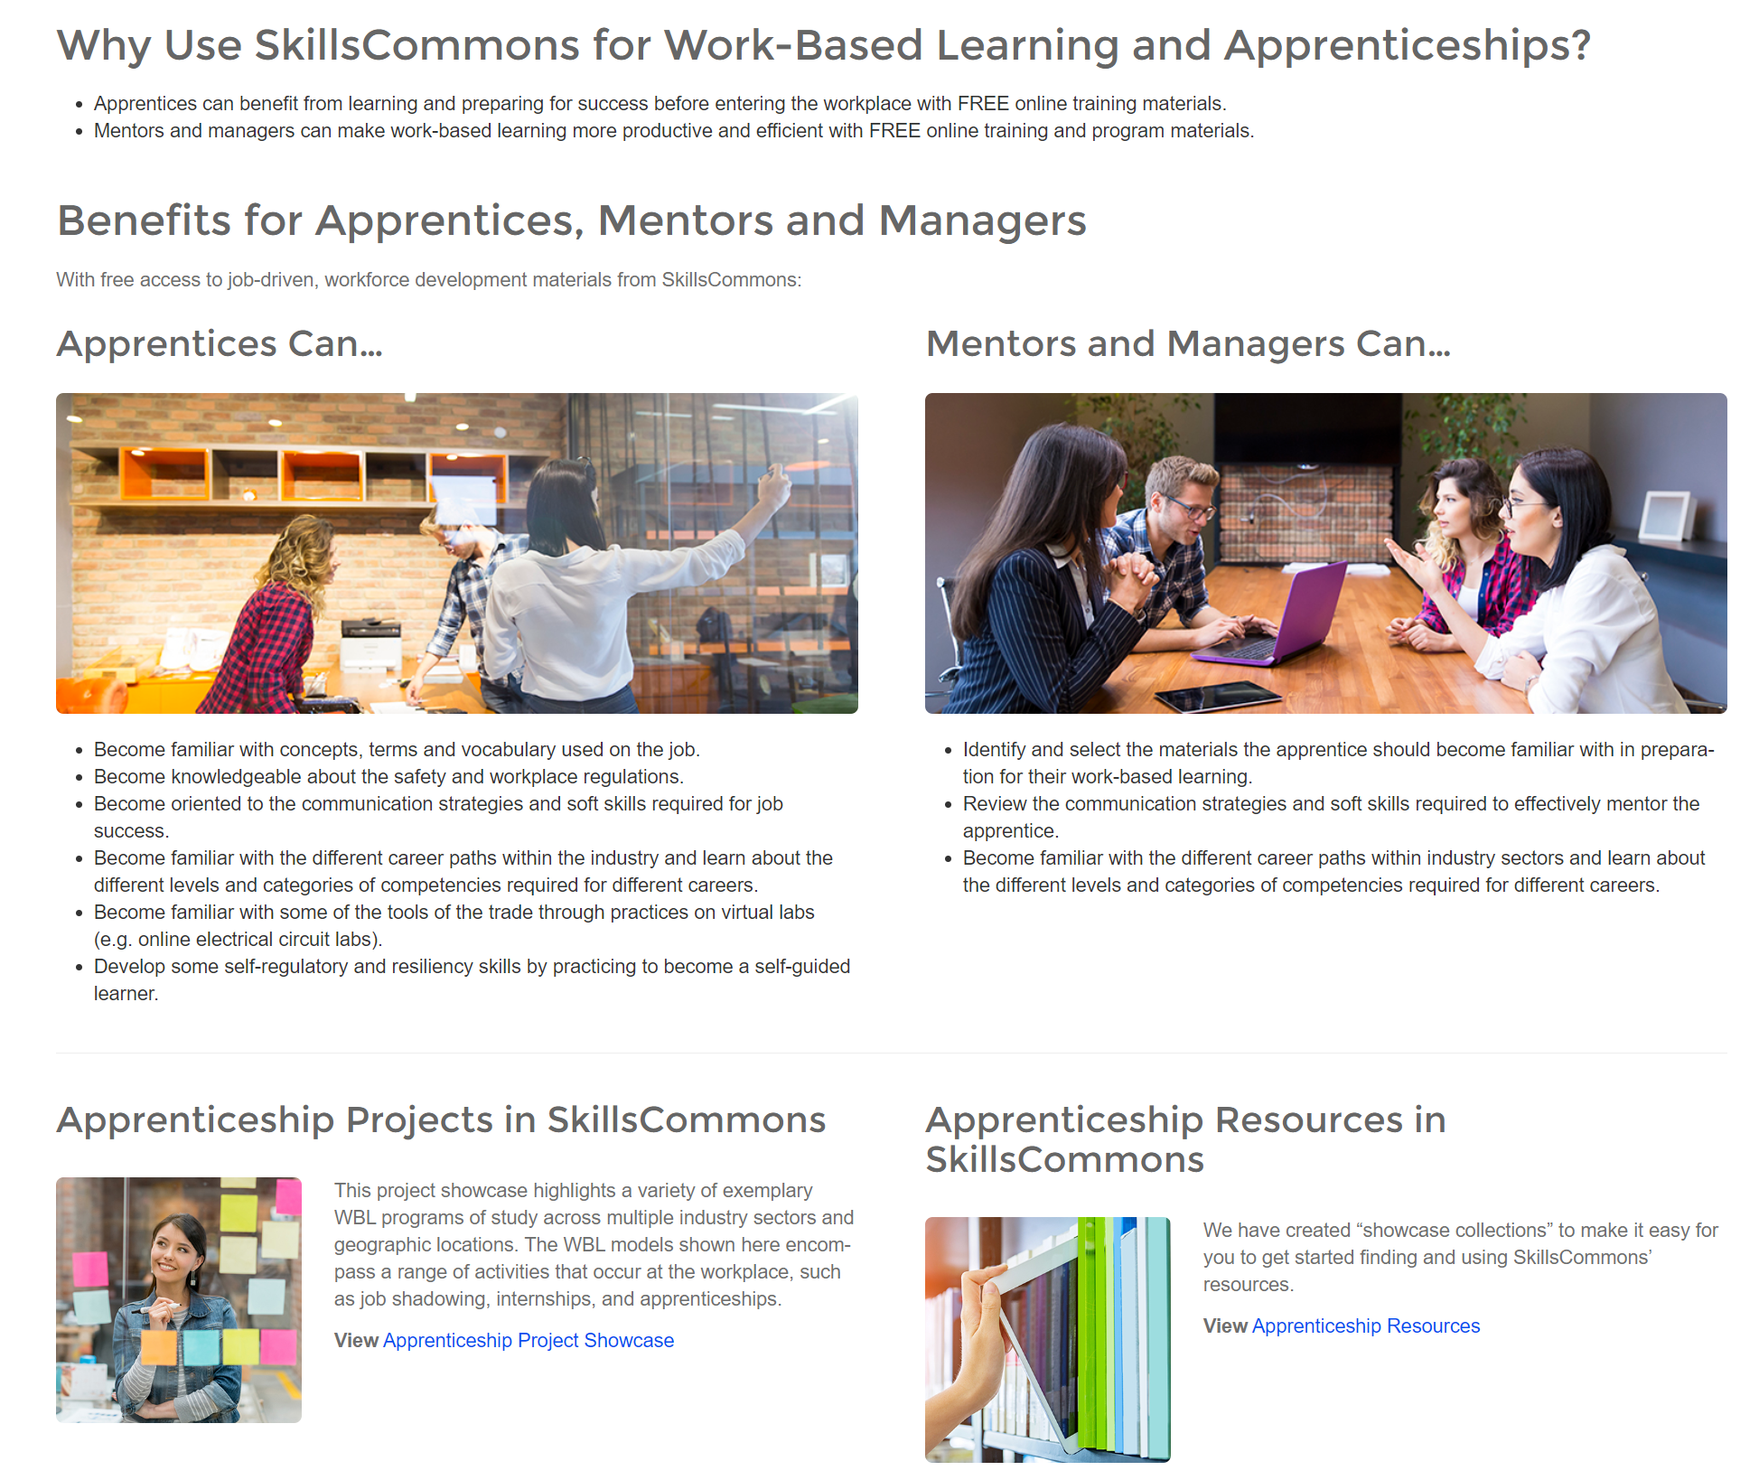
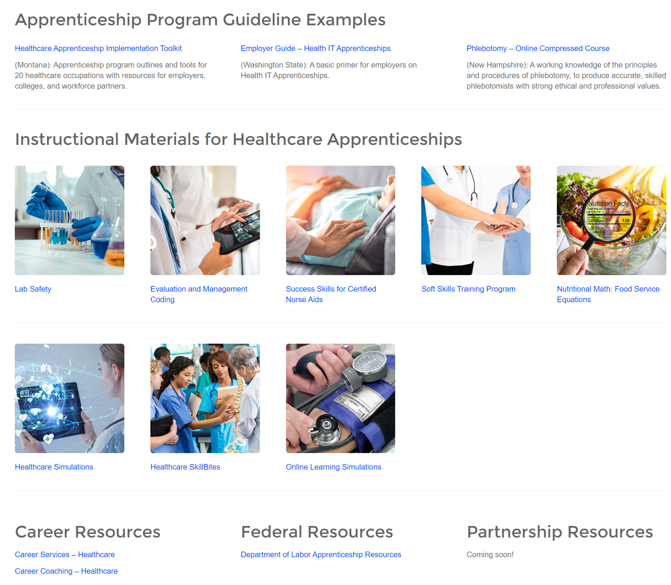
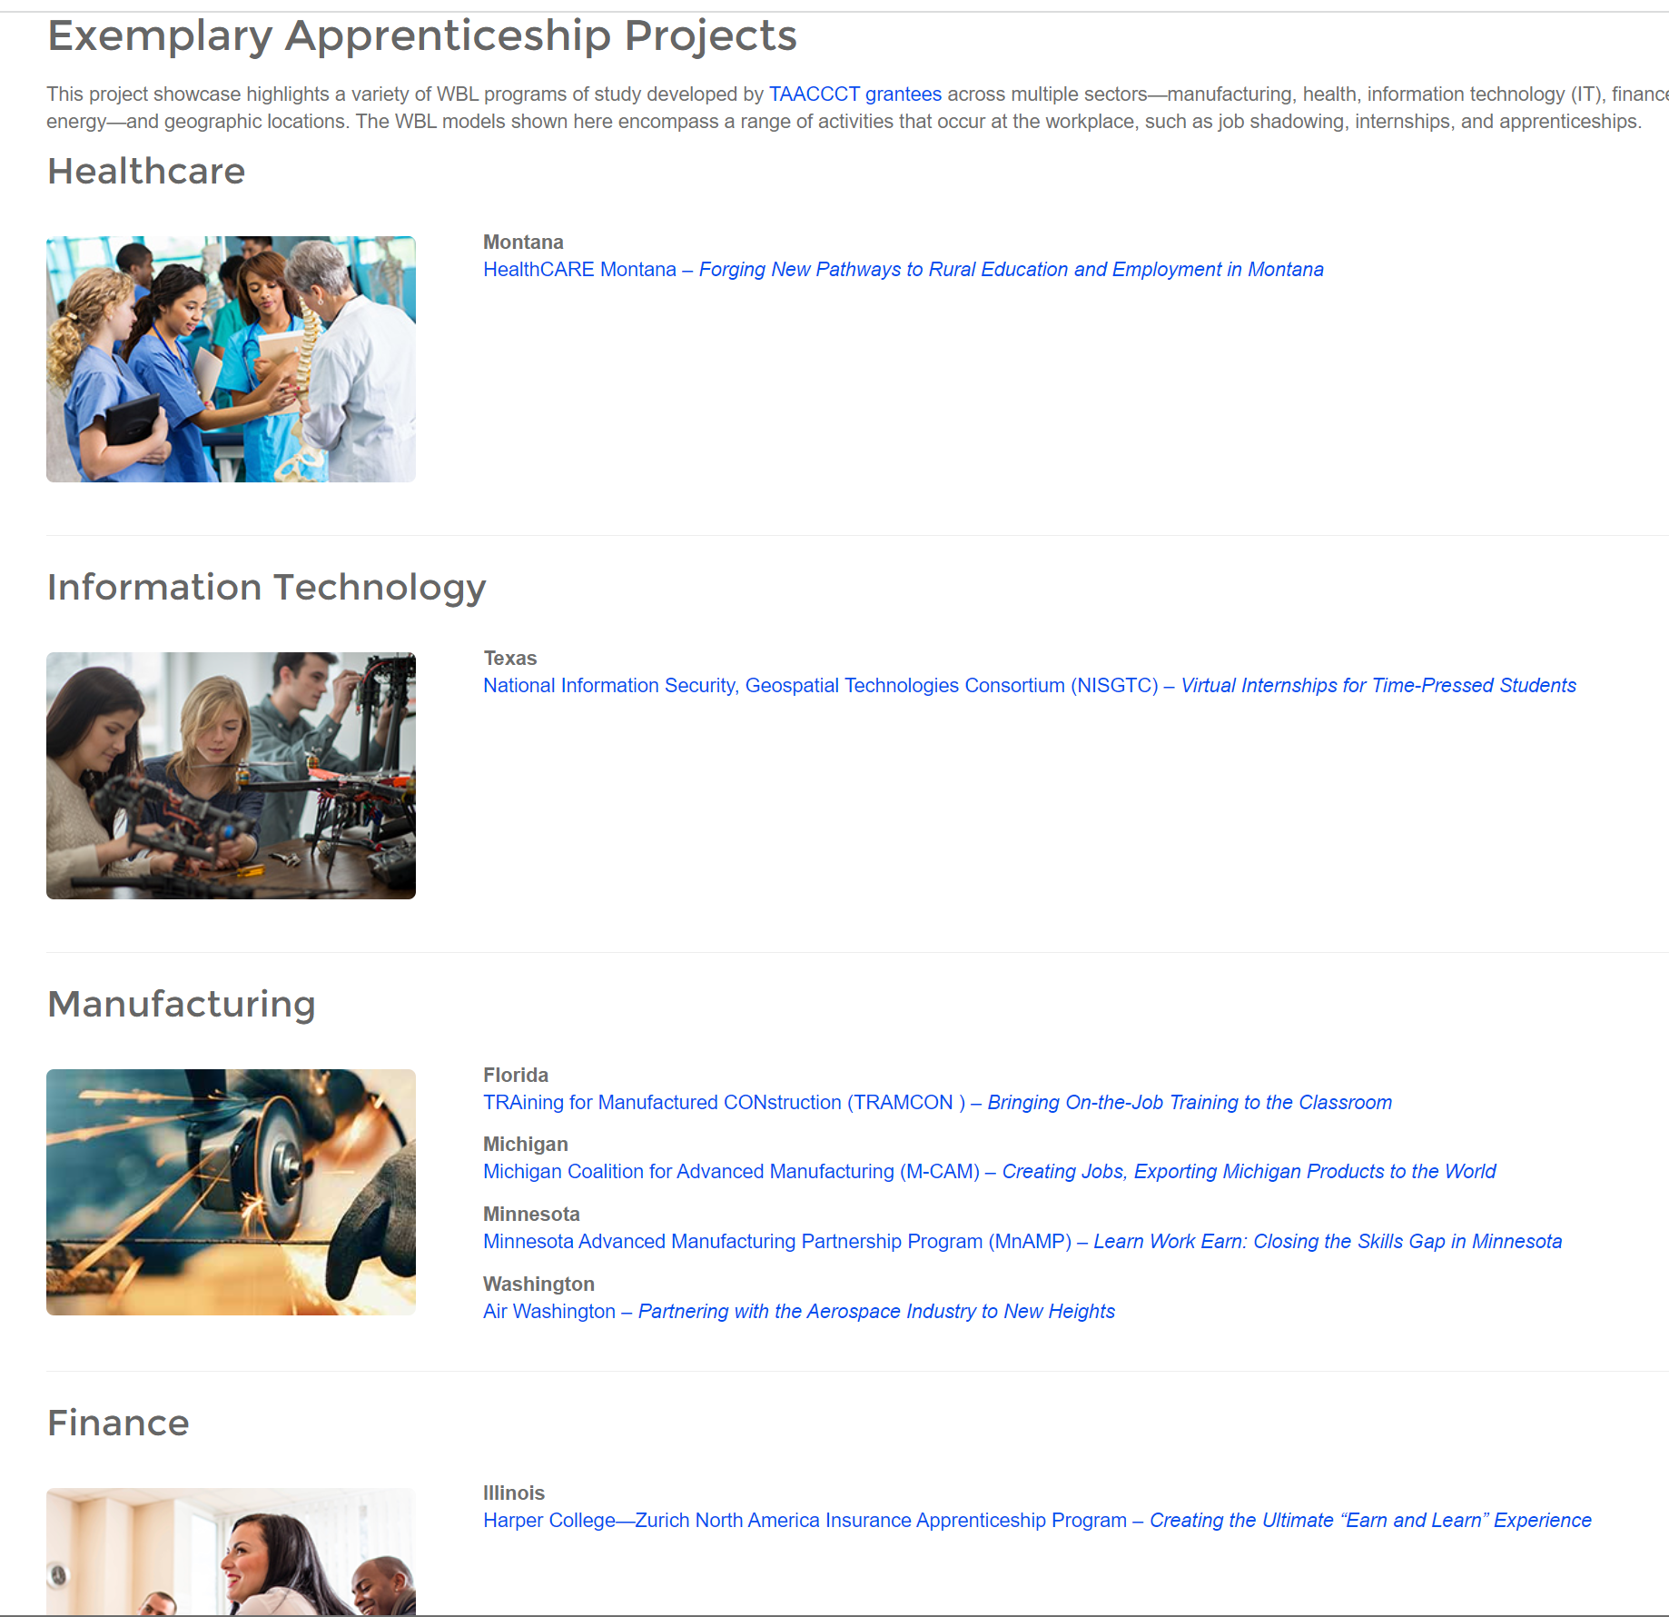
SkillsCommons provides free and open instructional materials and program management materials for apprenticeship programs for different industry sectors.
Choose and Use what works for you! All the information is OPEN
https://support.skillscommons.org/showcases/

Slide 30
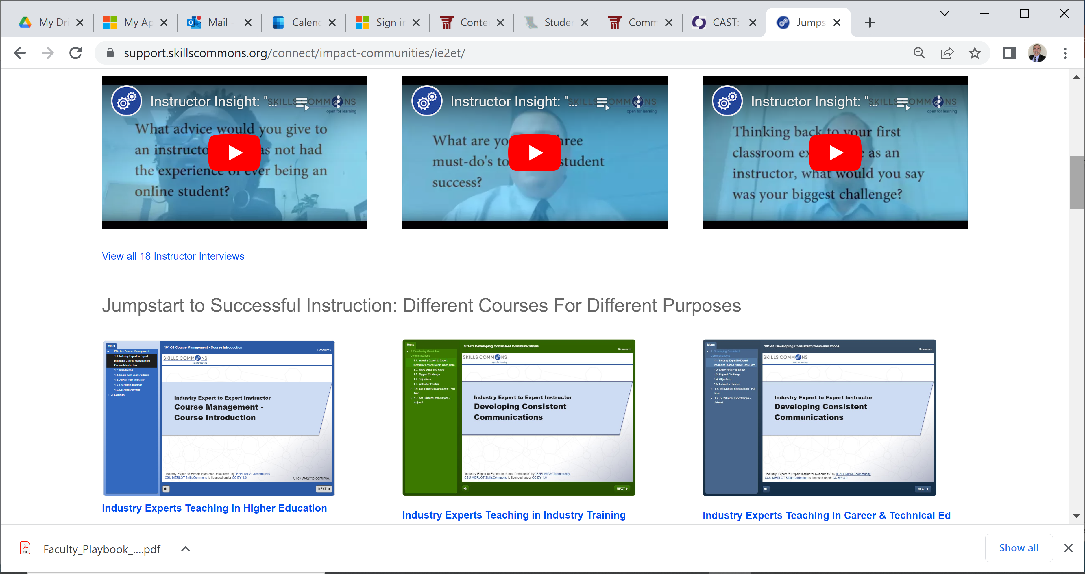
Bank Employees Need Support To Become Excellent Educators (and more)
Volunteer bank employees are essential for the outreach and development of people's financial literacy skills.
Subject matter expertise doesn’t make you an excellent teacher of your expertise
SkillsCommons has developed a series of short tutorials to help industry experts to become excellent instructors
Available as self-paced online tutorials
SkillsCommons can provide customized webinars to provide coaching and technical assistance

Slide 31

Bill Mills, FPP Coalition

Slide 32
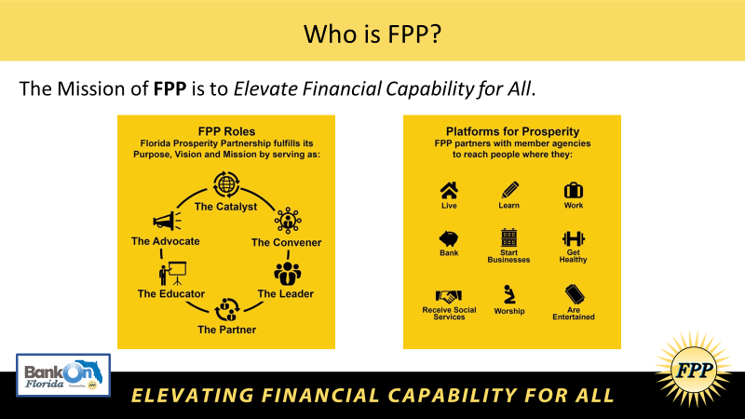
resources

Slide 33
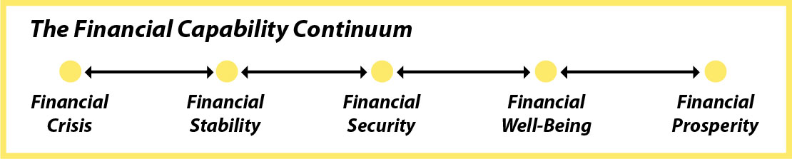
What is Financial Capability?

Slide 34


Slide 35
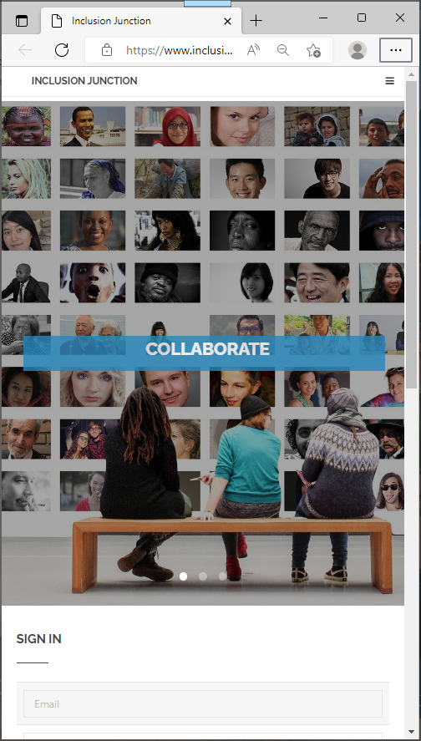
Inclusion Junction
InclusionJunction.org
Create an account
Receive email notification/verification
Await rapid validation (to screen out spamming, fictional characters …)
Create your profile (3-5 minutes)
Search for others
Send private messages to others in Inclusion community

Slide 36
Q & A Session

Slide 37
Next Steps
Register for the next webinars! ☺
Recordings and slide shows of this and the other webinars are being posted here.
Create your account in www.InclusionJunction.org
Connect with others via Inclusion Junction to co-develop State(s)’ digital equity plans for systemic inclusion
Join fellow inclusion catalysts in scaling and sustaining collective efforts
Plan to attend national systemic inclusion summit for State leadership teams in Atlanta, March 15-16, 2023

Slide 38
Next Webinar #4 Free & discounted broadband and devices with inclusion apps
Wednesday, November 16, 2022
4PM to 5PM (ET)

