Slide 1
Connecting States’ Financial, Economic and Digital Inclusion Initiatives
(webinar series)
Webinar # 4
Free & Affordable Broadband and Devices
Wednesday, November 16, 2022
4:00PM (ET) to 5:00PM (ET)

Slide 2
WEBINAR SERIES
Webinar #5: Encouraging Youth Leadership Development - The Future of Digital and Financial Inclusion
Monday, November 28, 2022 – 1PM to 2PM (ET)
How youth can lead local digital equity needs-sensing and planning while building their own digital, media & financial literacy skills.
Webinar #6: Uncovering Rural Systemic Inclusion Strategies - Outside the Urban Lines
Thursday, December 15, 2022 – 1PM to 2PM (ET)
Challenges, opportunities and lessons learned thus far from systemic inclusion efforts in New Hampshire.

Slide 3
Webinar Agenda:
Welcome/Opening Remarks
Terry Lee, FDIC
Aim of the webinar series (spoiler alert: systemic inclusion)
Dr. Bob McLaughlin, NCDE
Panelists:
Keyla Hernandez-Ulloa, Federal Communications Commission
John Windhausen, Schools Health & Libraries Broadband Coalition
Michael Flood, Kajeet
Pierrette Renee Dagg, MERIT Network
Carol Miller, NCDE
Gary Obermeyer, NCDE
Q & A
Next steps

Slide 4
The views expressed in this presentation are the presenters and do not necessarily represent the views of the Federal Deposit Insurance Corporation

Slide 5
Aims of the webinar series
Dr. Robert McLaughlin, NCDE
Webinar series to help each State’s leaders in inclusion and in meeting priority concerns of the underserved plan & work together, so that $1 billion in NTIA grants for State digital equity plans for economic inclusion are highly impactful
Bring together leaders of underserved and in key dimensions of inclusion for systemic impact on intergenerational poverty
Systemic inclusion = FEED: melding financial, economic, educational & digital inclusion
National summit in March 15-16, 2023 for State systemic inclusion planning teams to share promising and proven inclusion strategies & resources
www.InclusionJunction.org enabling Inclusion and DEI leaders to locate one another much more easily

Slide 6
Keyla Hernandez-Ulloa, FCC
Affordable Connectivity Program

Slide 7
Affordable Connectivity Program
What is the benefit?
Who is eligible?
How can households apply?

Slide 8
Agenda
The Affordable Connectivity Program (ACP) – Program Description and Design Overview
Who is eligible for the ACP?
Consumer Protections Within the Program
Be A Local Outreach Partner
Contacts and References

Slide 9

What is the Benefit?
The Affordable Connectivity Program is a Federal Communications Commission (FCC) Program that provides a discount on monthly broadband bills for qualifying low-income households. Eligible households can receive:
Up to $30/month discount for broadband service and associated equipment rentals;
Up to $75/month discount for households on Tribal lands, and;
A one-time discount for $100 for a laptop, desktop, or tablet purchased through a participating provider. Participating consumers pay a $10 to $50 co-pay.

Slide 10
What is a Household?
A household is a group of people who live together and share money (even if they are not related to each other.) If you live together and share money, you are one household. If you either don’t live together or you don’t share money, you are two or more households.
A household can qualify because of eligible dependent children that meet the eligibility criteria.
You may have to answer questions about your household when you apply for the Affordable Connectivity Program.
A household worksheet will be available to assist in determining household eligibility.

Slide 11
Examples of Households
One Household :
A married couple who live together must share one ACP benefit
A parent/guardian and child who live together must share one ACP benefit
An adult who lives with friends or family who provide financial support must share one ACP benefit
Multiple Household:
Four roommates who live together but do not share money are four separate households. All four can receive the ACP.
30 seniors who live in an assisted-living home but do not share money are 30 separate households. All 30 can receive the ACP.
A student who receives a Federal Pell Grant and lives alone is a different household than his or her parents. Both the student and their parents are separate households and can receive their own benefits.

Slide 12

A Household is Eligible if:
Household income is at or below 200% of the Federal Poverty Guidelines, or
If a member of the household meets at least one of the criteria below:
Participates in certain assistance programs, such as SNAP, Medicaid
Federal Housing Assistance programs: Housing Choice Voucher (HCV) Program (Section 8 Vouchers) ,Project-Based Rental Assistance (PBRA)/202/811, Public Housing
SSI, WIC, or Lifeline;
Participates in the National School Lunch Program or the School Breakfast Program (Including the Community Eligibility Provision);
Received a Pell Grant in the current award year;
Receives Veterans Pension or Survivors Benefit; or
Meets the eligibility criteria for a participating provider's existing low-income program.

Slide 13
Households on qualifying Tribal lands are eligible they participate in one of the following programs:
Bureau of Indian Affairs General Assistance
Tribal Temporary Assistance for Needy Families
Food Distribution Program on Indian Reservations
Tribal Head Start (income based)
Affordable Housing Programs for American Indians, Alaska Natives or Native Hawaiians

Slide 14
What is Lifeline?
Lifeline is a federal program that lowers the monthly cost of phone and internet. Eligible customers will get up to $9.25 (up to $34.25 on Tribal lands) toward their bill.
Household income is less than 135% of the Federal poverty guidelines or a member of the household participates in one of these programs:
Supplemental Nutrition Assistance Program (SNAP), formerly known as Food Stamps
Medicaid
Supplemental Security Income (SSI)
Federal Housing Assistance
Veterans Pension and Survivors Benefit
Tribal programs (and you live on qualifying Tribal lands)

Slide 15

Two Steps to Enroll
Go to https://www.affordableconnectivity.gov/ to apply, or print out a mail-in application; and
Contact your preferred participating provider to select a plan and have the discount applied to your bill.
Some providers may have an alternative application that they will ask you to complete.
Eligible households must both apply for the program and contact a participating provider to select a service plan.

Slide 16
How Does the ACP Protect Consumers?
FCC rules protect Affordable Connectivity Program recipients by:
Empowering consumers to choose the service plan that best meets their needs (including a plan they may already be on);
Ensuring consumers have access to supported broadband services regardless of their credit status;
Prohibiting providers from excluding consumers with past due balances or prior debt from enrolling in the program;
Preventing consumers from being forced into more expensive or lower quality plans in order to receive the ACP;
Ensuring that consumers are not liable for early termination fees;
Reducing the potential for bill shock or other financial harms;
Allowing ACP recipients to switch providers or broadband service offerings; and
Providing a dedicated FCC process for ACP complaints.

Slide 17
Become an Outreach Partner
The FCC is mobilizing people and organizations to help share important consumer information about the new Affordable Connectivity Program.
Request A Speaker: Send a speaker request to ACPspeakers@fcc.gov.
Become A Partner: Send an email to outreach@fcc.gov.

Slide 18
ACP Outreach Toolkit
Social
Logos
Social Media Images
Draft Posts
Newsletter Insert
Draft Press Release
Printables
Fact Sheet
Flyer
9” x 5” Info Card
¼ Page Handout
Poster/Infographic
Videos and PSAs
ASL Video
Overview Video
Audio PSAs

Slide 19

Resources
FCC’s ACP Consumer Hub: www.fcc.gov/ACP
Help Line: Call the ACP Support Center at (877) 384-2575 or send an email to ACPSupport@usac.org
Consumer FAQ: https://www.fcc.gov/affordable-connectivity-program-consumer-faq
USAC ACP Claims and Enrollment Tracker: https://www.usac.org/about/affordable-connectivity-program/acp-enrollment-and-claims-tracker/
Toolkit: https://www.fcc.gov/acp-consumer-outreach-toolkit
Accessibility: FCC504@fcc.gov
To apply: https://www.affordableconnectivity.gov/
Contact: ACPinfo@fcc.gov

Slide 20
John Windhausen, SHLB Coalition

Slide 21




Public interest advocacy organization based in DC.
Over 300 members (schools, libraries, higher ed, telehealth networks, state broadband officials, public interest groups, research & education networks, commercial companies, etc.)
Mission: supporting open, affordable, high-quality broadband for anchor institutions and their communities.

Slide 22

New Federal Broadband Funding Programs
FCC:
Emergency Broadband Benefit (EBB) ($3.2 billion) (low-income consumers)
Emergency Connectivity Fund (ECF) ($7.2 billion) (schools/libraries)
Treasury:
State and Local Government Fiscal Recovery Funds ($350 billion) (ARPA funding)
Treasury Capital Projects Fund (CPF) ($10 billion)
NTIA:
Broadband Infrastructure Public-Private-Partnerships ($288 million)
Tribal Connectivity Fund ($980 million + $2 billion)
Connecting Minority Communities Pilot Program ($286 million)
Affordable Connectivity Program (ACP) ($14 billion)
Middle Mile Funding ($1 billion)
BEAD ($42 billion)
Digital Equity Act ($2.75 billion)

Slide 23
E-rate and Emergency Connectivity Fund (ECF)
ECF Funding will expire summer of 2023
- Most funding used for devices
- Connects about 7 million households to broadband
.
Can the FCC expand E-rate to fill ECF Shoes?
- WiFi on school buses – on circulation
- Cybersecurity?
- Grant SHLB Petition on cost allocation?
- Pilot program for sustainable off-campus networks?

Slide 24
Anchor-Enabled Wireless Networks (“To and Through”)
SHLB initiative to promote wireless extensions from anchor institutions to the surrounding community.
_____________________________________________________________________
Research report and cost model written by Dr. Raul Katz issued in August.
Finds that schools partnering with WISPs can connect households much cheaper than distributing hot spots.

Slide 25
Contact Information
John Windhausen
Executive Director
SHLB Coalition
jwindhausen@shlb.org
www.shlb.org
(202) 256-9616

Slide 26
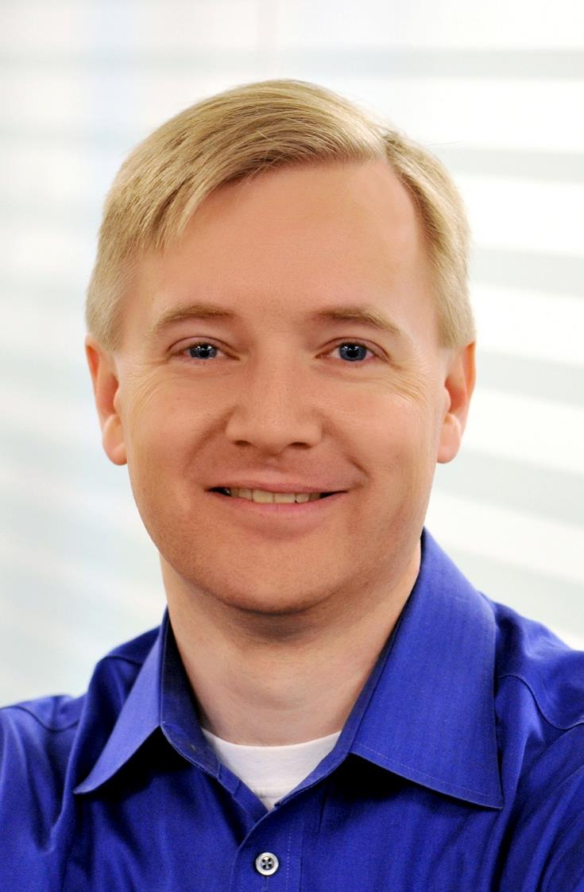

Mr. Michael Flood
Senior Vice President & General Manager of Education
Mr. Flood is responsible for social impact, business growth, and company strategy in the public sector market. Mr. Flood is actively involved with federal, state and local policy with partners including CoSN, SETDA, SHLB, and ISTE.

Slide 27
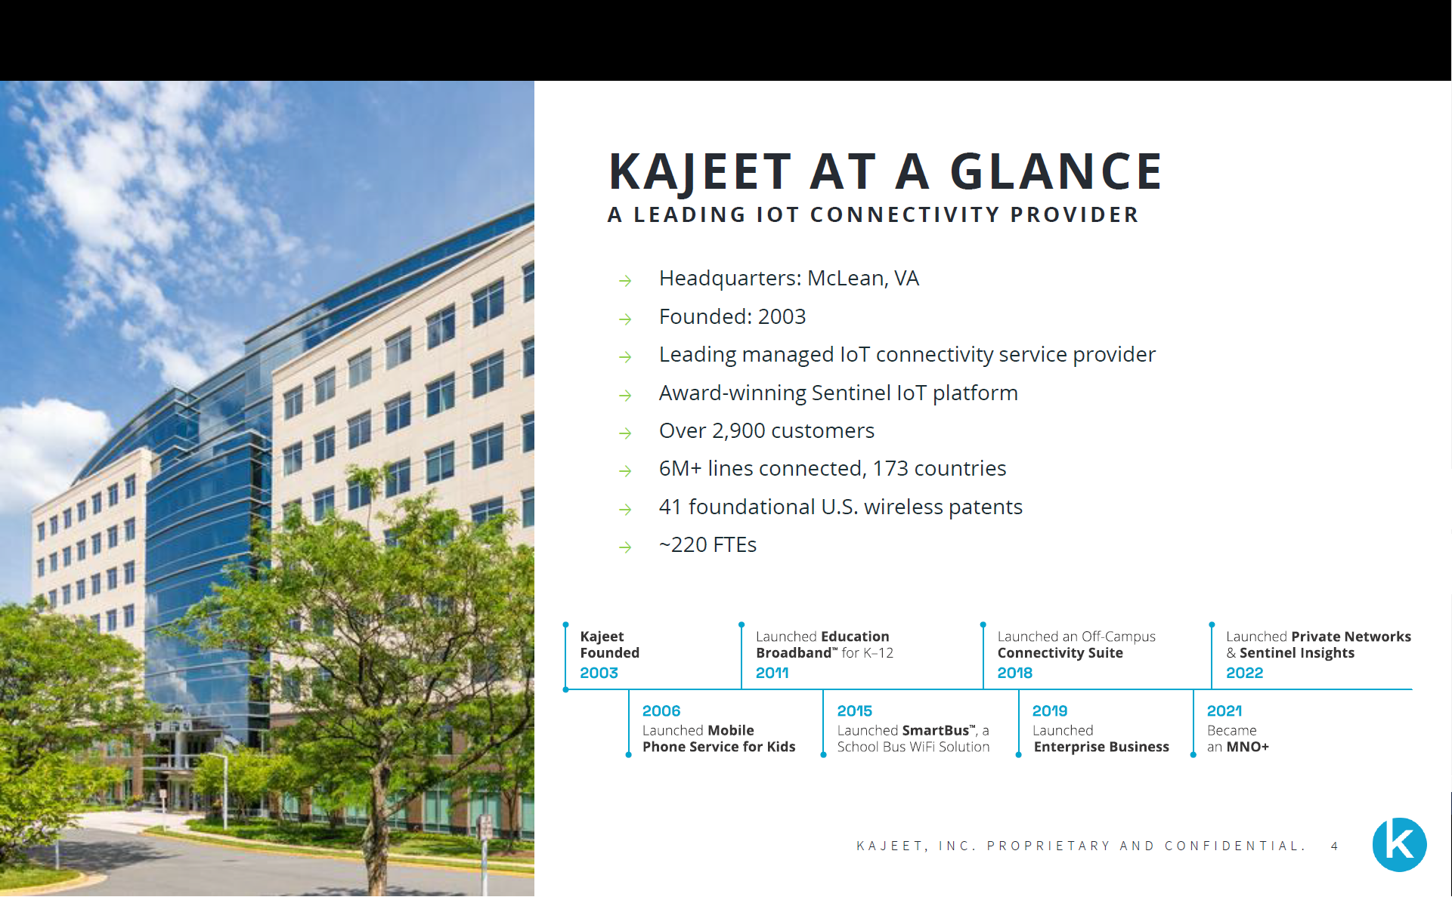

Slide 28
THE HOMEWORK GAP
PRE-PANDEMIC
The phrase “the Homework Gap” was coined in 2012 by Jessica Rosenworcel, now acting FCC chairwoman.
SINCE ONSET OF THE PANDEMIC
NSBA defines the homework gap, or the digital divide, as the “long-documented and persistent inequity of students that lack adequate broadband access.”
LOOKING AHEAD
of the temporary solutions enacted during the pandemic to connect students are expected to expire in 1-3 years
Source: Common Sense Media

Slide 29


KAJEET PARTNERSHIPS
Kajeet provides broadband solutions to and thru our partner entities to enable increased broadband access.
These partners include:
Anchor Institutions (Schools, Libraries, etc.)
Local Government Agencies (Housing, Parks & Rec, etc.)
Non-Profit Community Organizations
Wireless Internet Service Providers (WISPs)
With these partners, Kajeet enables:
4G/5G Connected Devices (laptops, chrome books, tablets)
Individual Mobile SmartSpots
Site-Based / Fixed Wi-Fi Hotspots in Public Spaces
Passenger Wi-Fi on Buses, Shuttles, Ferries, and Light-Rail

Slide 30
KAJEET’S PHILOSOPHY AND APPROACH
Broadband with a public purpose.
Driving toward positive outcomes.
Protecting and safeguarding.
Our partners are focused on education, public service programs, telehealth, citizen access, job and workforce development, and infrastructure.
Linking analytics on access and use to outcome analysis in public policy programs, educational systems, and program compliance.
From early childhood education to community college and adult learners; library patrons; and general citizens with varying skills and knowledge of cybersecurity.
Accountable to the funding source.
Hybrid Networks.
Many of our partners are supported via taxpayer-funded programs from the federal, state, or local governments. Others are accountable to private philanthropic partner oversight. By leveraging our scale, and integrated analytics, we reduce costs across thousands of implementations and link spending to results.
Our platform combines mixed use of multiple commercial carrier networks and Kajeet Private 4G/5G Wireless networks custom-built for municipalities, counties, school districts, library systems, and WISPs.

Slide 31
KAJEET RESOURCES
Navigate to https://www.kajeet.net/resources/
You’ll find:
Kajeet Blog
Case Studies
Podcasts
Webinars
Infographics
White Papers
Guides / Toolkits
Customer Resources
Contributed Articles
You can also find Kajeet on YouTube!
(https://www.youtube.com/channel/UC2ilU-0BD0veDUNqDhtfO-w)

Slide 32
Pierrette Renee Dagg, MERIT Network

Slide 33
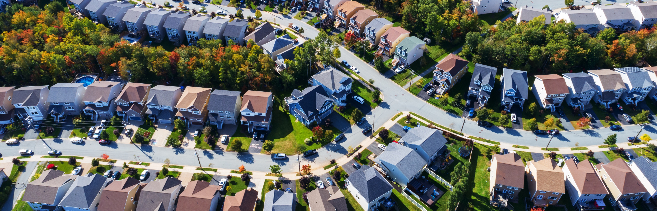

Municipally-led broadband: Decisions and Strategies
Pierrette Renée Dagg, Director of Technology Impact Research, Merit Network
PhD Candidate, University of Toledo

Slide 34

Municipal Broadband Decisions
Coalition, task force, and stakeholder identification
Network and service goals
Ownership model
Digital inclusion factors
Resources

Slide 35

Identifying your stakeholders and champions
Community activists
Municipal leaders
Existing efforts
Community anchors
Economic development groups
Residents

Slide 36

Goal Setting
Drives broadband strategy
Why is connectivity important to your stakeholders?
What services and levels of service will you provide?
What is the service footprint?
What are the needs and price sensitivities of your residents?

Slide 37

Example at MichiganMoonshot.org/Survey
Address
Number of people at the address
Number of residents under age 18
Number of K12 and college students
How do you get internet access (ie: fiber, cable, DSL, cellular, none)
Satisfaction with service (if you have it)
Promised speeds
Service interruptions
Affordability questions
Number of devices (tablet, computer, etc)
If you are not connected:
Reason (not available, price, lack of skills/digital literacy, no device, not wanted, etc.)
Price willingness
How would you use the internet if you had it?
Data Collection Points
Notes:
Complementarty access and sentiment

Slide 38
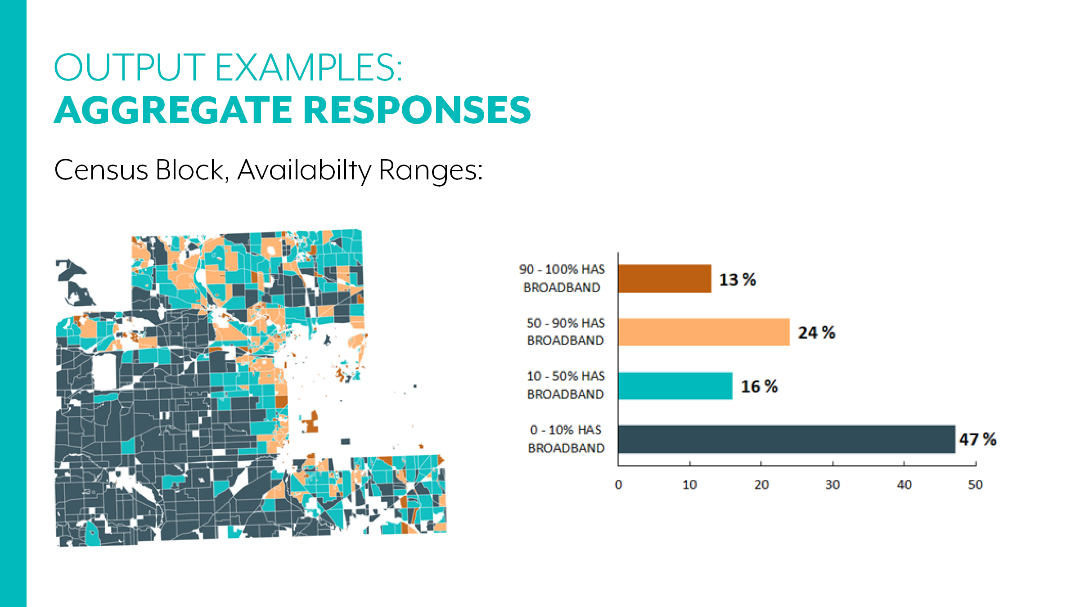

Slide 39
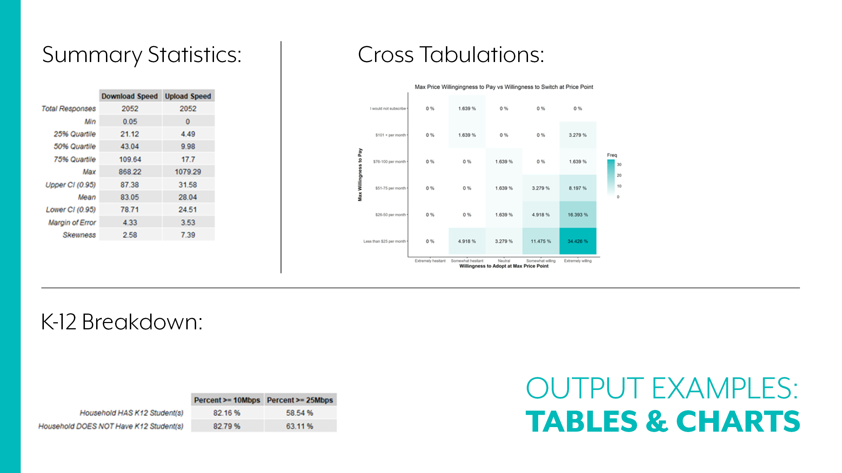

Slide 40
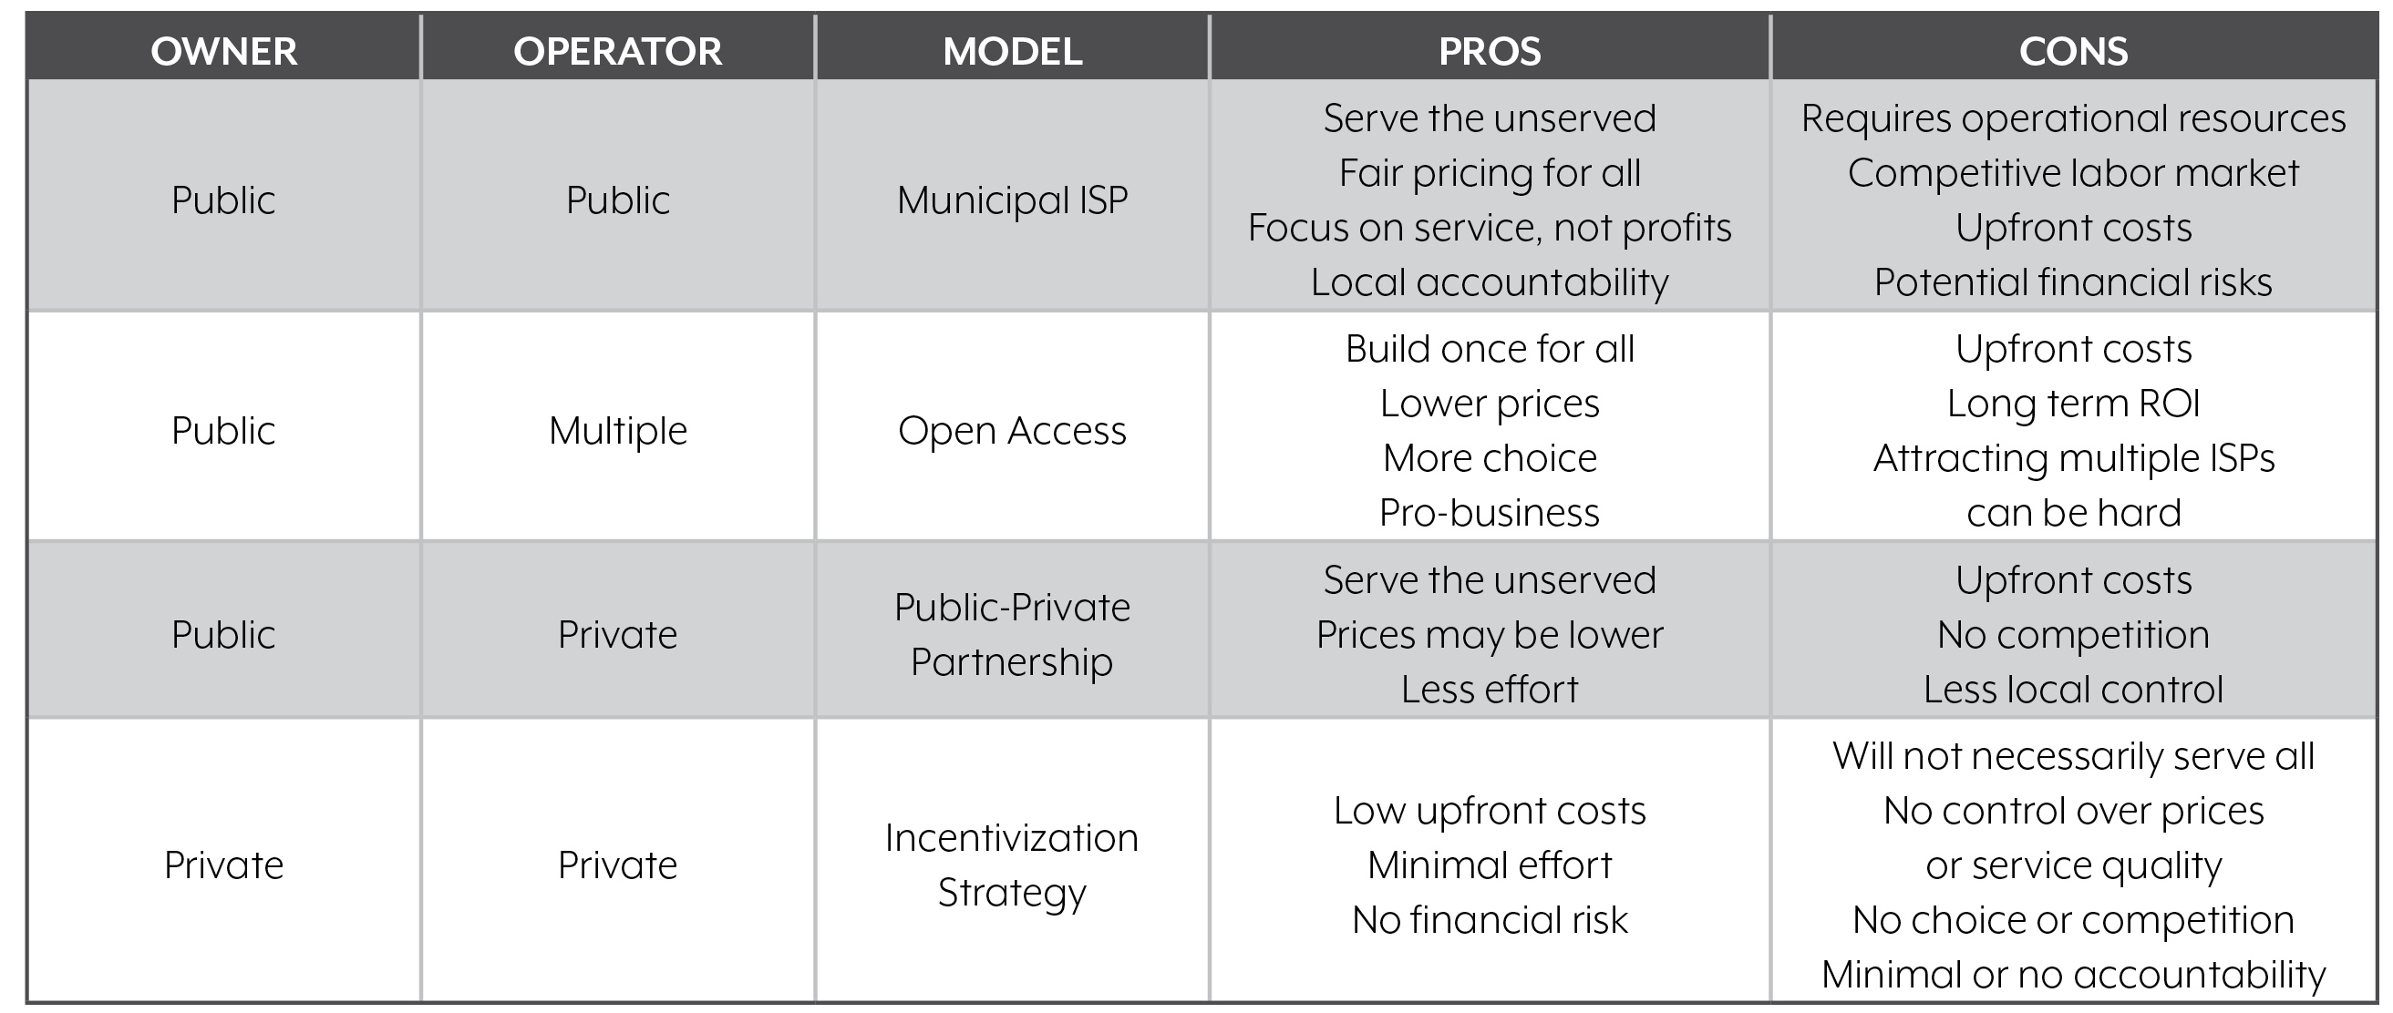
Ownership Models

Slide 41

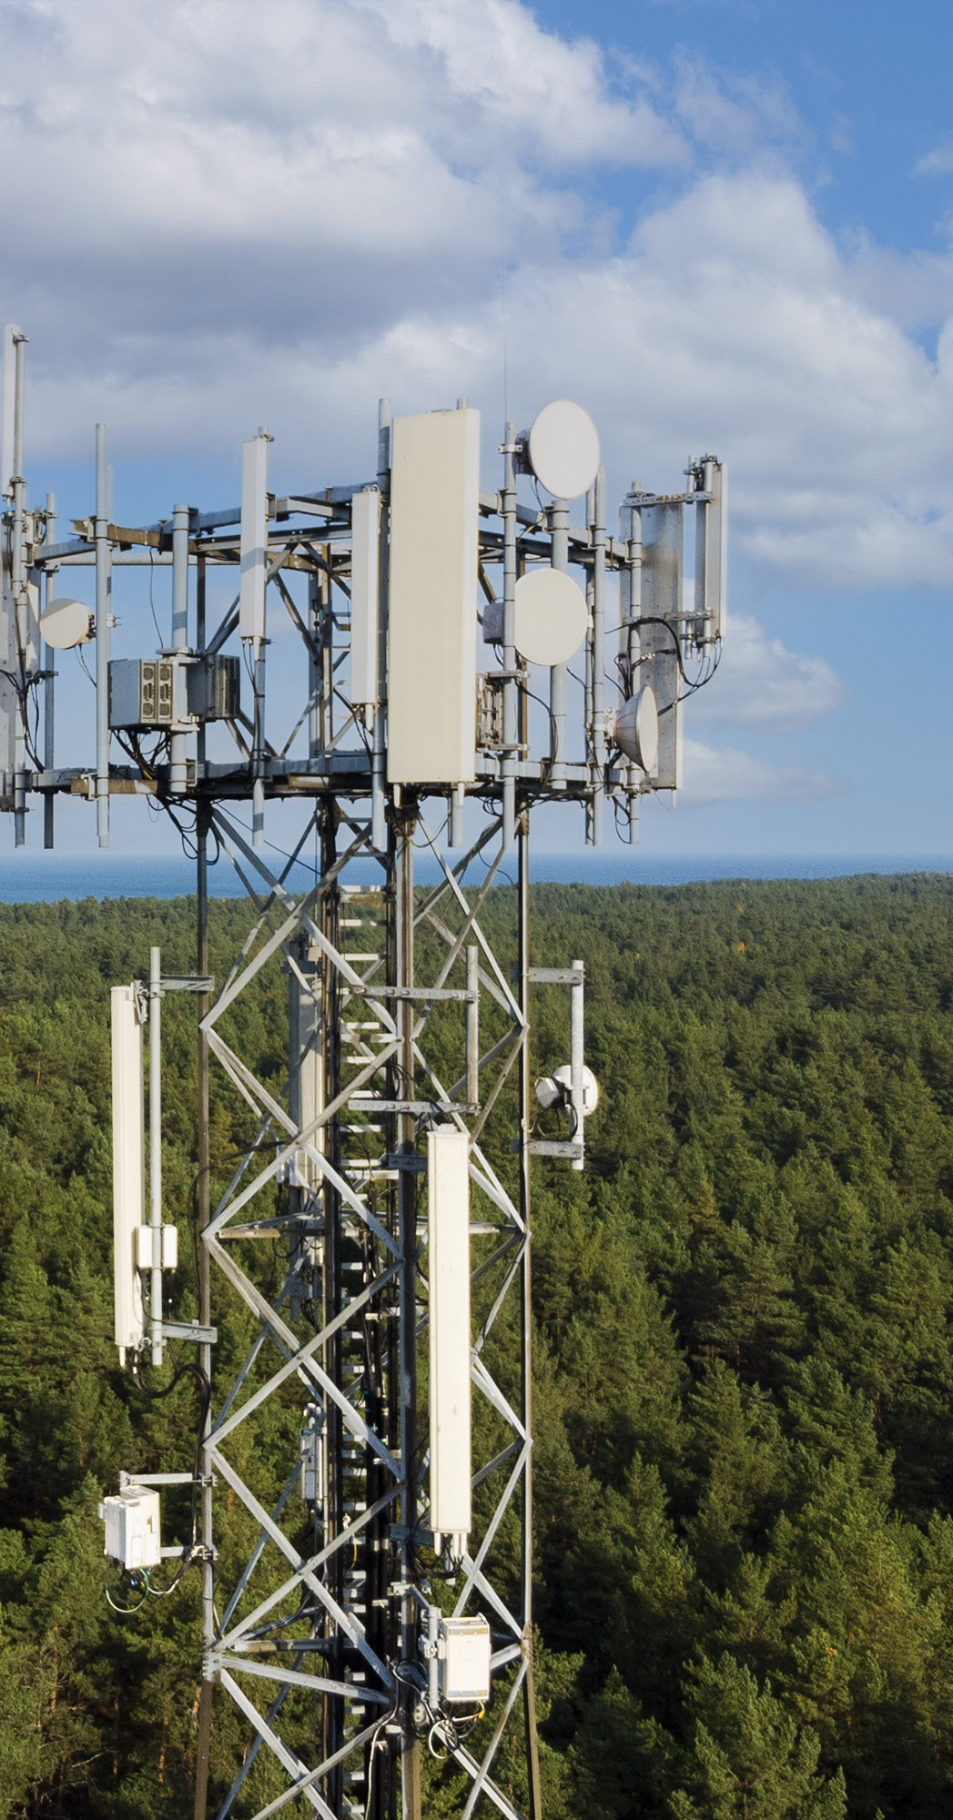

Digital
Opportunities
Index for Communities
Network infrastructure, affordability, and adoption
Digital literacy, skills, and uses
Community economic base and opportunities
Community assets and community lived experience
Policy and governance

Slide 42


Slide 43

Carol Miller cmiller@digitalequity.us
Broadband Mapping
Broadband Investment and Planning Network
Municipalities, Counties, States
Challenges and Opportunities
Rural Electric Cooperatives
Data Analytics
Sharing Resources and strategies
Working alone or combining efforts
Break down silos and leverage assets
Member Driven and ROI

Slide 44
Gary Obermeyer, director, learning community development, NCDE

Slide 45
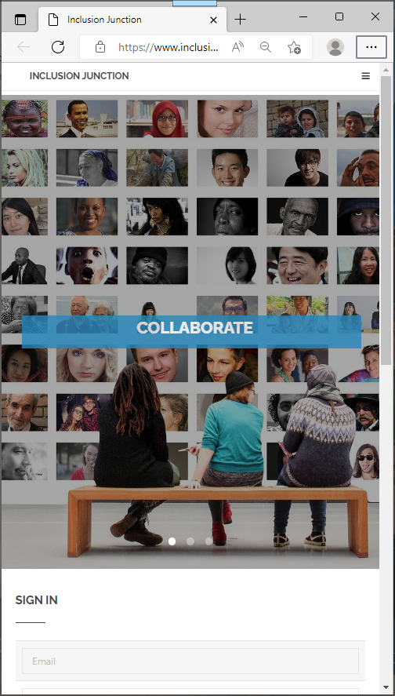
Inclusion Junction
InclusionJunction.org
Create an account
Receive email notification/verification
Await rapid validation (to screen out spamming, fictional characters …)
Create your profile (3-5 minutes)
Search for others
Send private messages to others in Inclusion community

Slide 46

NCDE Inclusion Junction
Goal: to facilitate connections and collaboration among local, state, and national leaders aiming/working to close the digital divide for underserved & low-income populations and to break the cycle of intergenerational poverty.
Gary Obermeyer, Coordinator,
NCDE Learning Community Development

Slide 47
NCDE Inclusion Junction
Inclusion Dimensions:
Digital
Economic
Educational
Financial
Food/Nutrition
Health
Housing
Gary Obermeyer, Coordinator
NCDE Learning Community Development

Slide 48
NCDE Inclusion Junction
Levels of Involvement:
Local
Regional within the State
State
Multi-State
National
Gary Obermeyer, Coordinator
NCDE Learning Community Development

Slide 49
NCDE Inclusion Junction
Sign Up:
Create an Account (free)
Complete Your Profile
(allow 24 hours for staff review)
Sign In:
Search for Prospects
Reach Out (built-in email)
Suggest Enhancements/Improvements
Gary Obermeyer, Coordinator
NCDE Learning Community Development

Slide 50


NCDE Inclusion Junction
www.InclusionJunction.org
(via smart phone, tablet, or computer)
Gary Obermeyer, Coordinator
NCDE Learning Community Development

Slide 51
Q & A
Session

Slide 52
Next Steps
Register for the next webinars! ☺
Recordings and slide shows of this and the other webinars are being posted here.
Create your account in www.InclusionJunction.org
Connect with others via Inclusion Junction to co-develop State(s)’ digital equity plans for systemic inclusion
Join fellow inclusion catalysts in scaling and sustaining collective efforts
Plan to attend national systemic inclusion summit for State leadership teams in Atlanta, March 15-16, 2023

Slide 53
Next Webinar #5
Youth leadership development for digital & financial inclusion
Monday, November 28, 2022
1PM to 2PM (ET)

